Slide 1
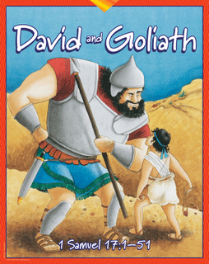

Slide 2
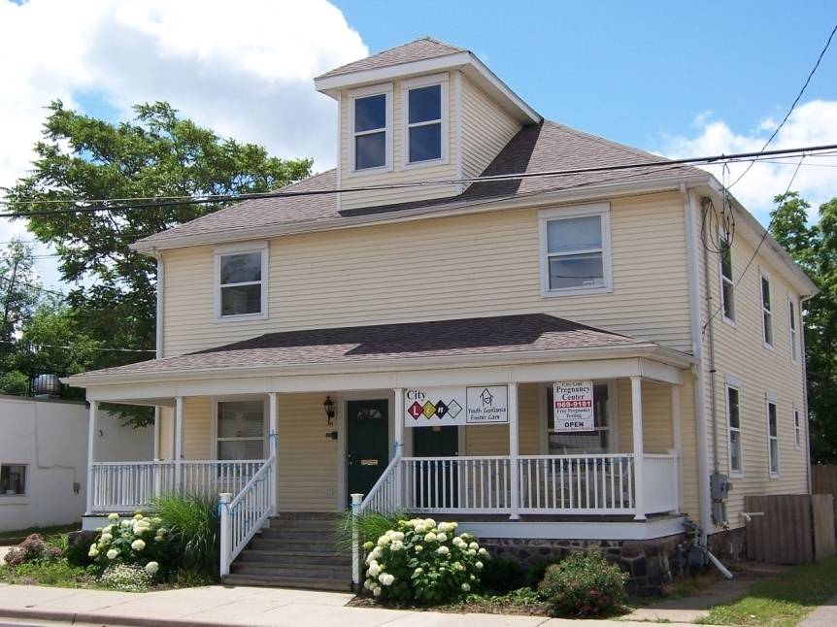
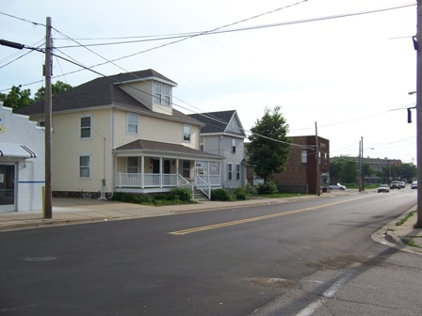


Slide 3
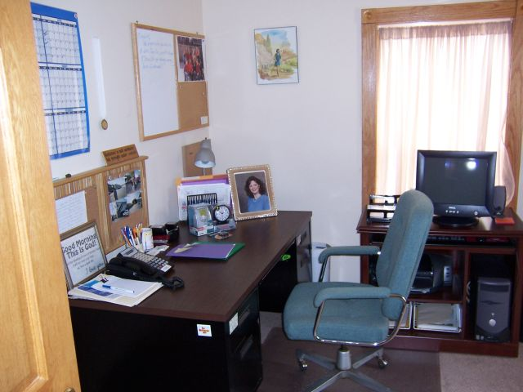
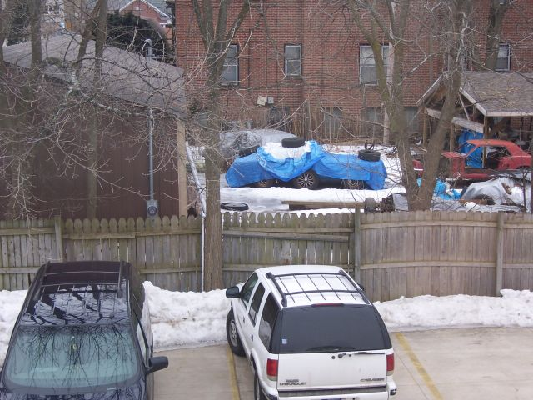
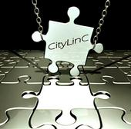

Slide 4
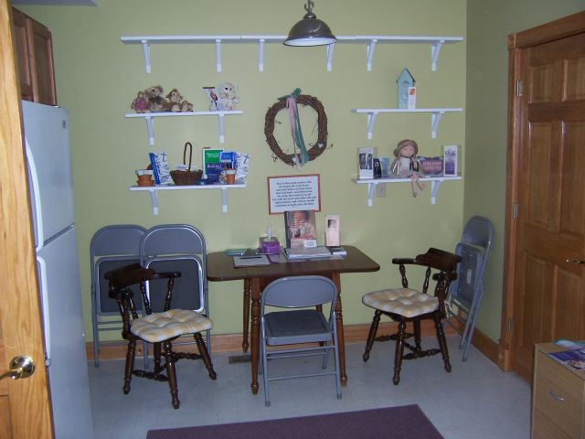

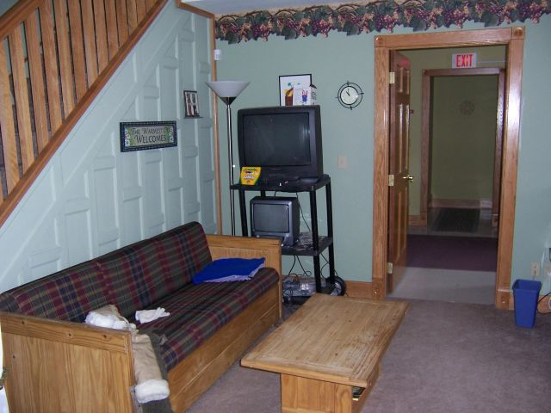

Slide 5
Our Mission
We Connect
1. Children and Youth to Loving Families
2. Families to Secure Futures
3. Individuals to Community, and
4. Community to Personal Faith
Five Ministries
Foster Care & Adoption
Pregnancy Help Center
Personal Counseling
Community Connection
Ministry Network

Slide 6


CityLinC Back-2-School Bash - Bailey Park

Slide 8
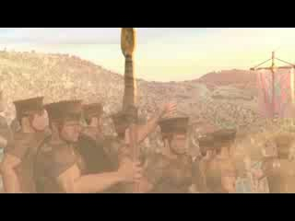

Slide 9

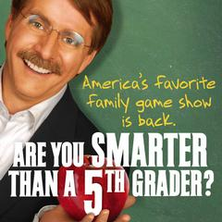
David was a small
shepherd-__________.
2. Goliath was a big, tall ______.
Saul was Israel’s _________.
What attracted David’s attention? ___________.
5. What was David’s first
reaction? ___________.

Slide 10
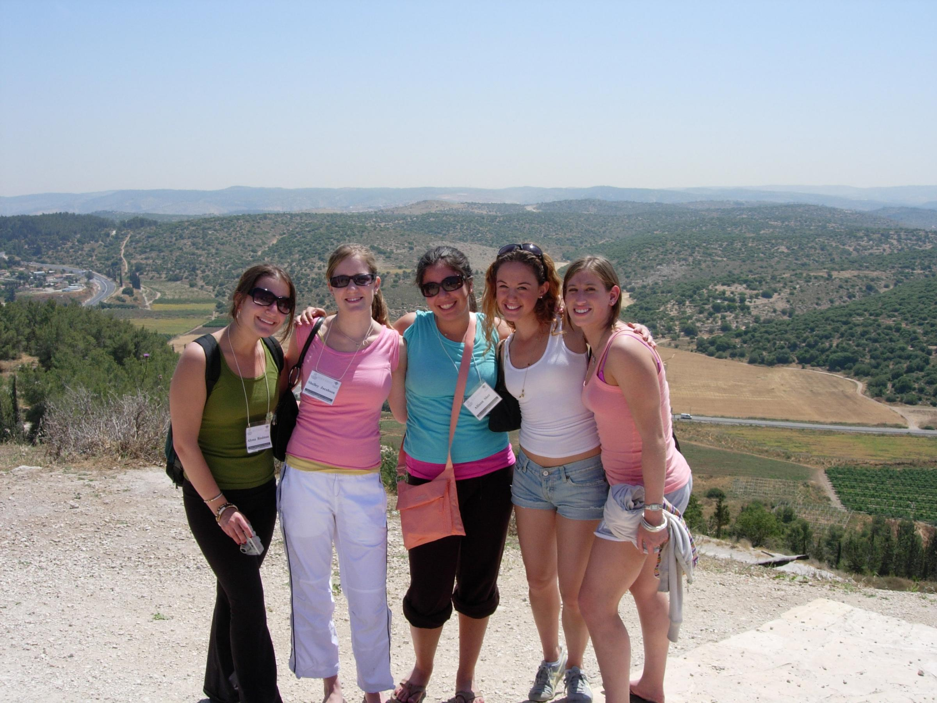

Slide 11
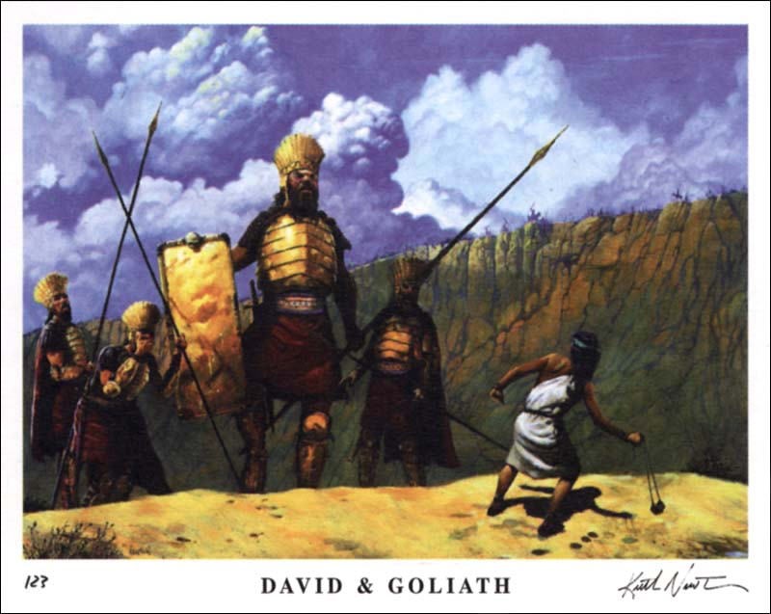

Slide 12
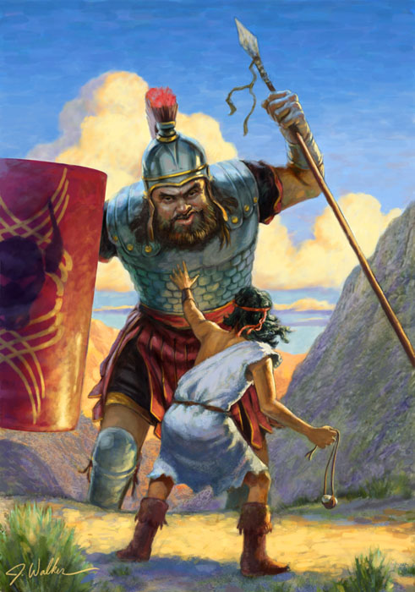
I Samuel 17
David was a son of a man named Jesse. 13 David’s three older brothers were in Saul’s army.
17 One day Jesse said to David, Take this bread and cheese to your brothers and see how they are doing.
20 So David left the sheep and set out early in the morning.

Slide 13
22 And David left his wagon with the keeper, and ran to the army, and greeted his brothers.
As he talked with them,
Goliath appeared and
spoke those same words again.
And David heard them.

Slide 14
24 And all the men of Israel fled and were very afraid.
25 And the men of Israel said, Have you seen this man that defies Israel ?
Behold, it has been said, that the man who kills him, the king will give him his daughter, Princess Michal, and give him great riches, and his family will live tax-free!

Slide 15
26 And David asked the men to repeat what they said:
What shall happen to the man that kills this Philistine?
Who is this uncircumcised Philistine, that he should defy the armies of the living God?
27 And the men repeated their answer, saying, That’s what will happen to the man that kills Goliath!

Slide 16
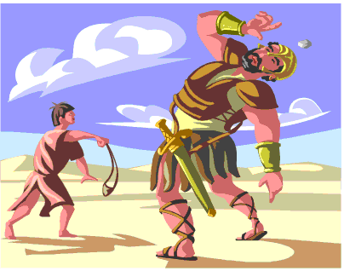

Slide 17
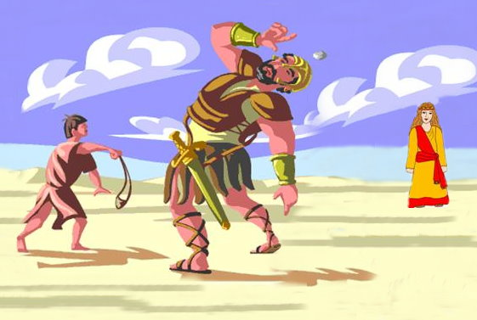

Slide 18


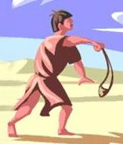
Life is a series of choices !

Slide 19

The Goal Never Moves !

Slide 20

The Goal Never Moves !

Slide 21
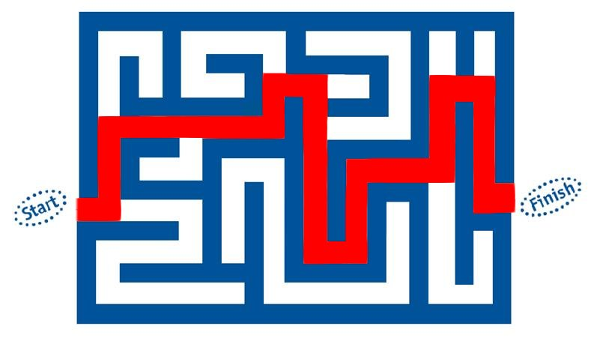
The Goal Never Moves !

Slide 22

A Good Goal Is:
Clear
Specific
Attainable

Slide 23
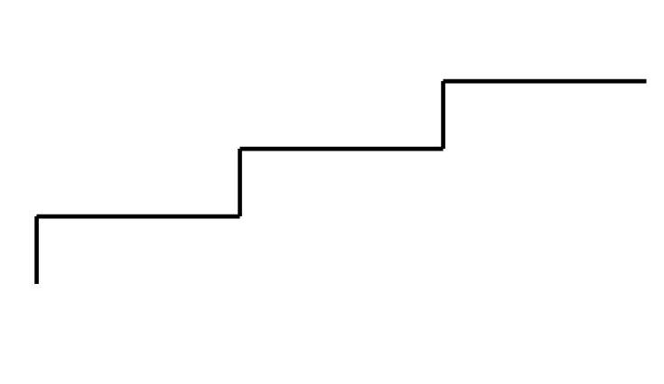
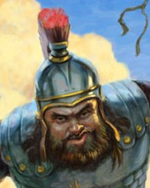
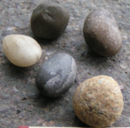
Achieving Your Goals
Final Goal
Important Goal
Immediate Goal
Immediate Goal – choose five stones
Important Goal – kill the giant
Final Goal – claim the Princess !

Slide 24
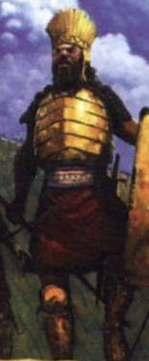
“Is that all I have to do ?”

Slide 25

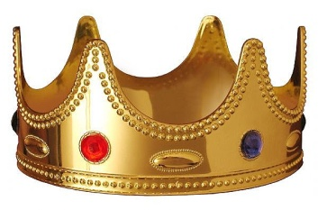
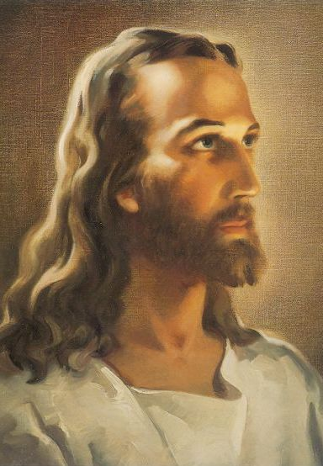
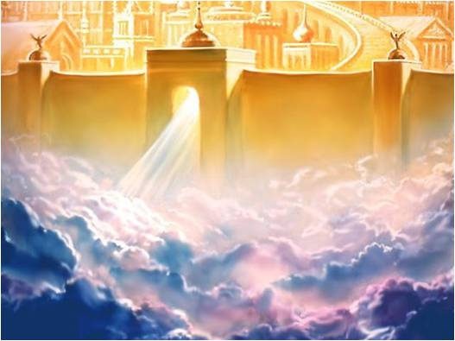
“Is that all I have to do ?”
JOY
Think aboutJesus

Slide 26
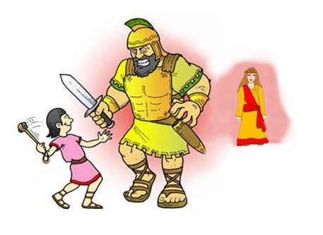

Slide 27
What
Is Your Goal
?

Slide 28
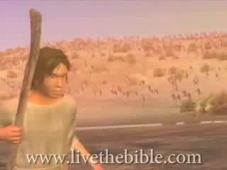

Slide 29
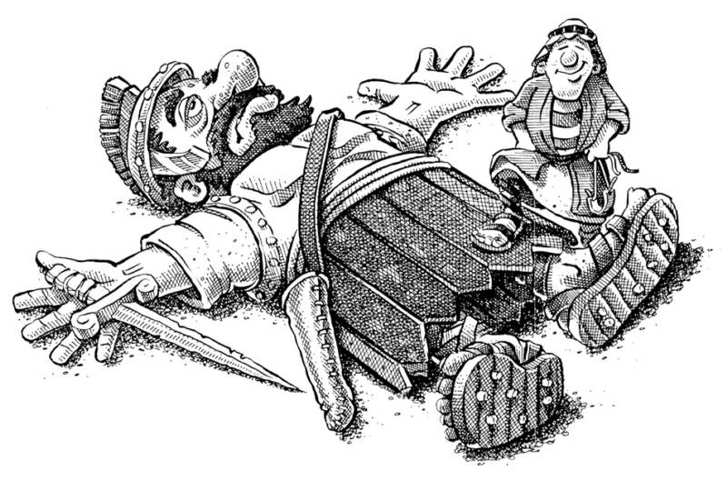
Keep Your
Eye on the
Princess !

