Slide 1


Slide 2

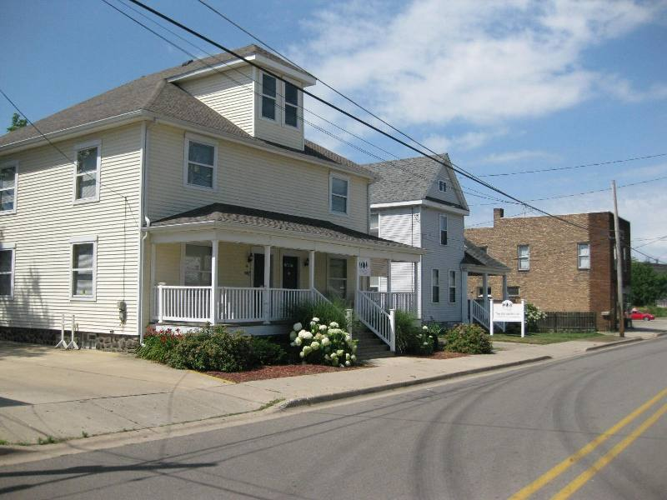
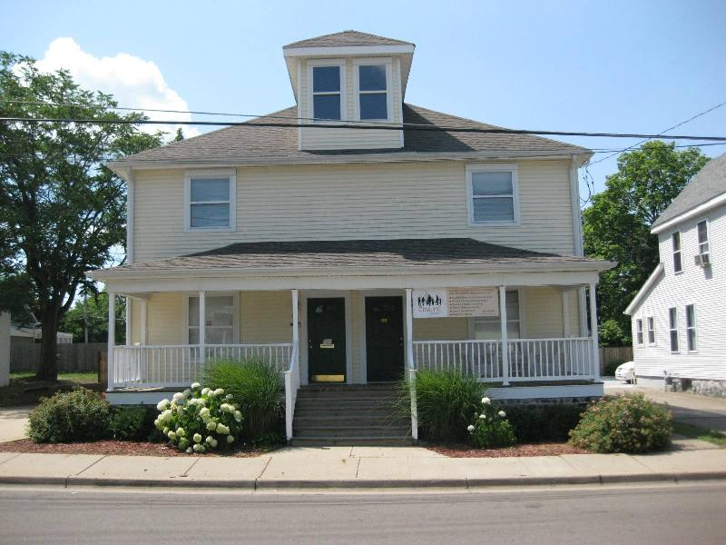
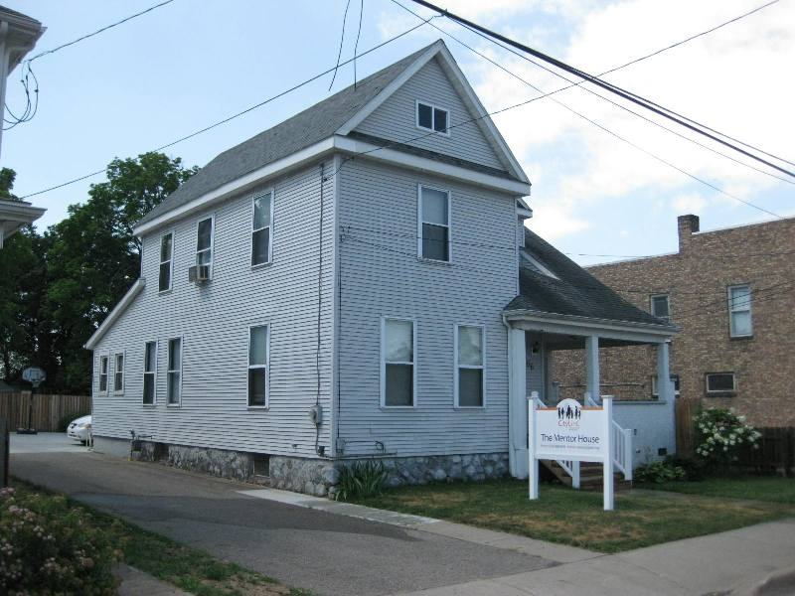

Slide 3
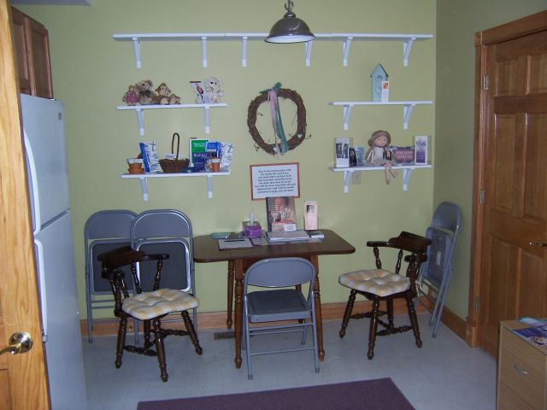
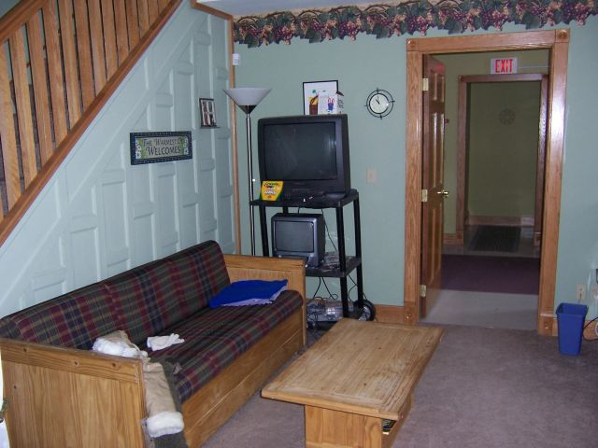
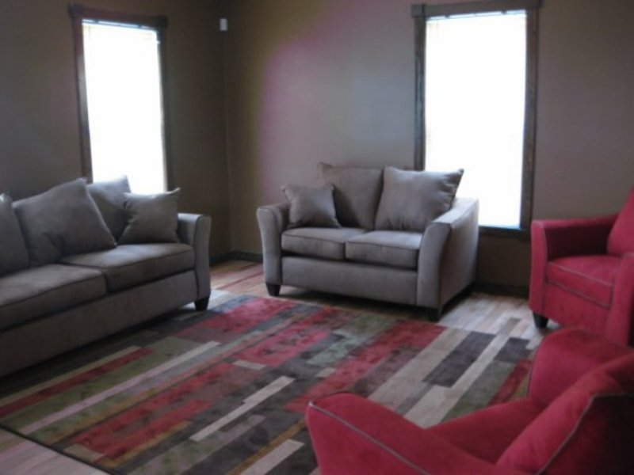
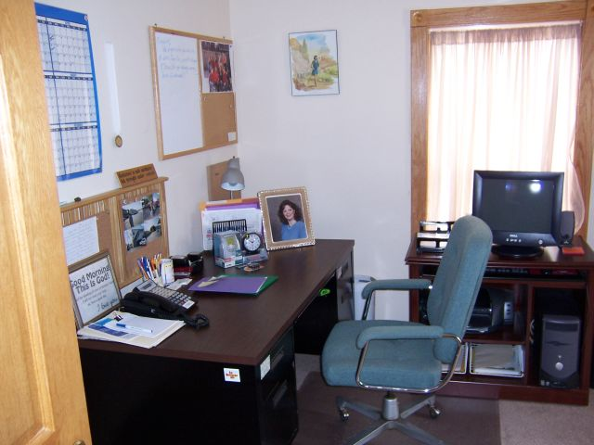

Slide 4

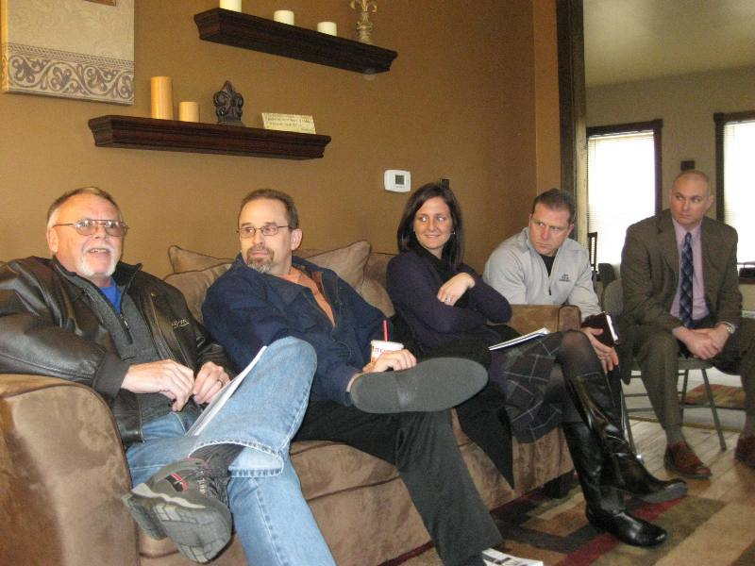
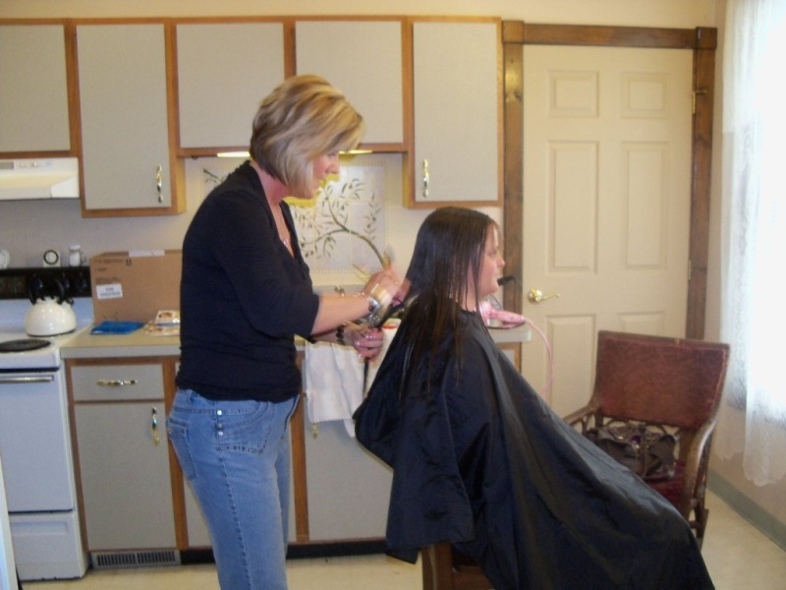
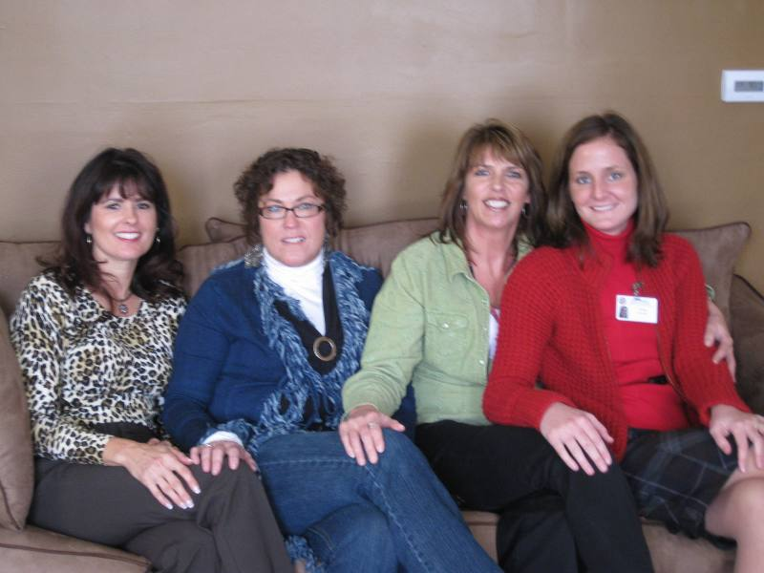

Slide 5
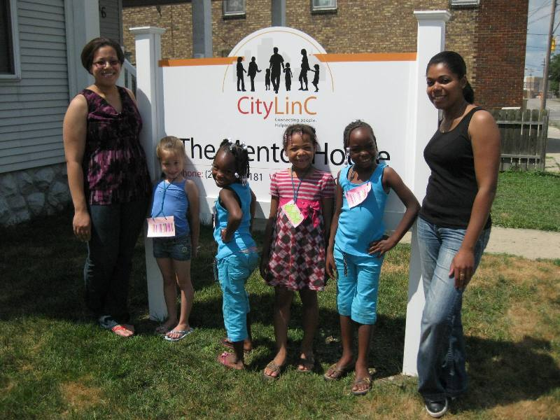
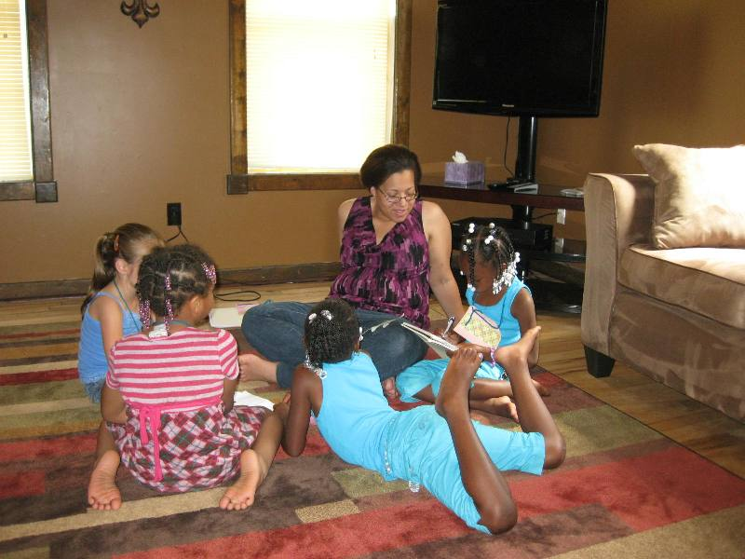
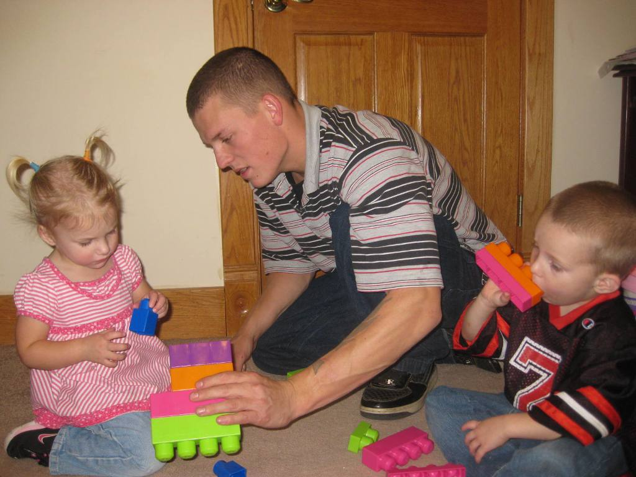

Slide 6


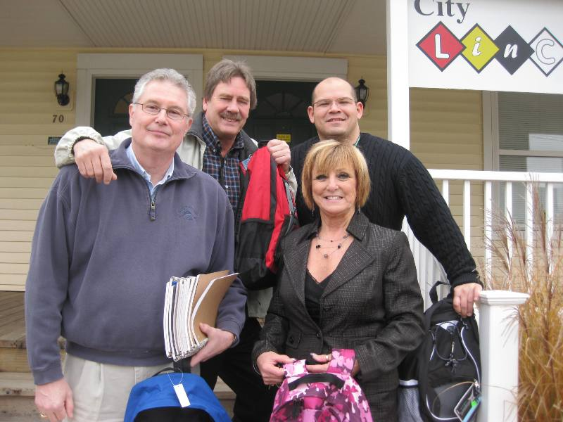
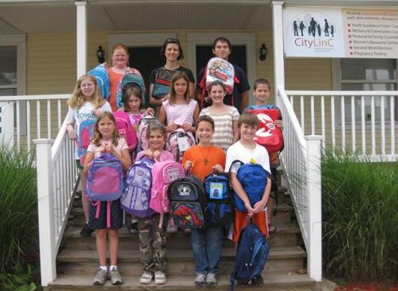

Slide 7

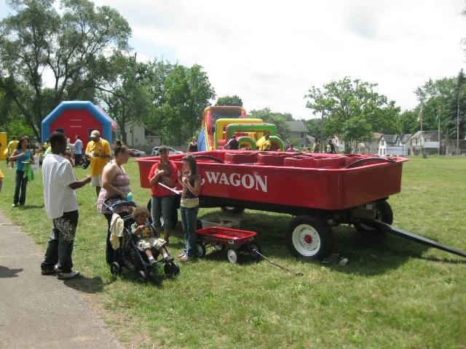
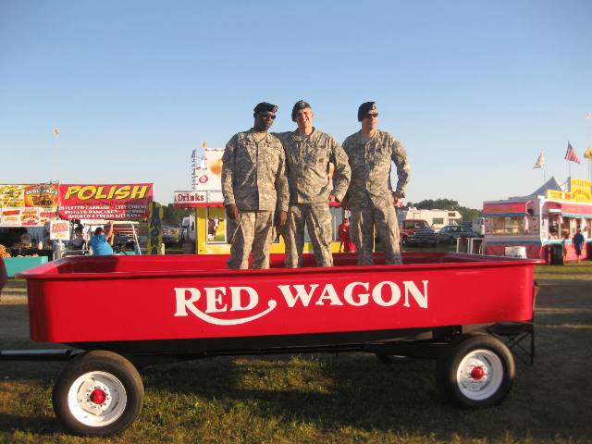
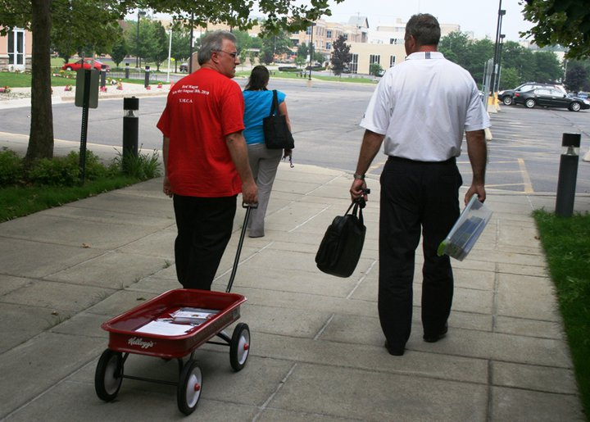
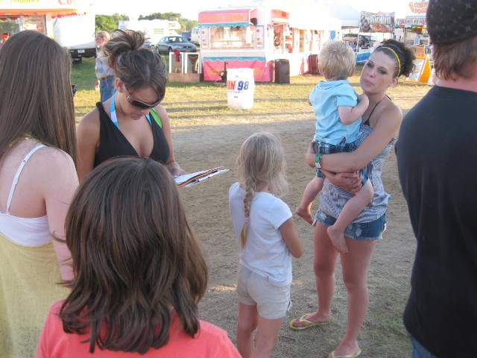
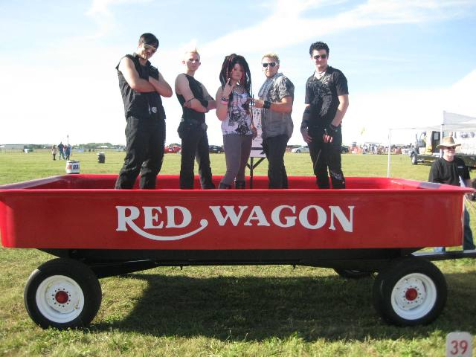

Slide 8
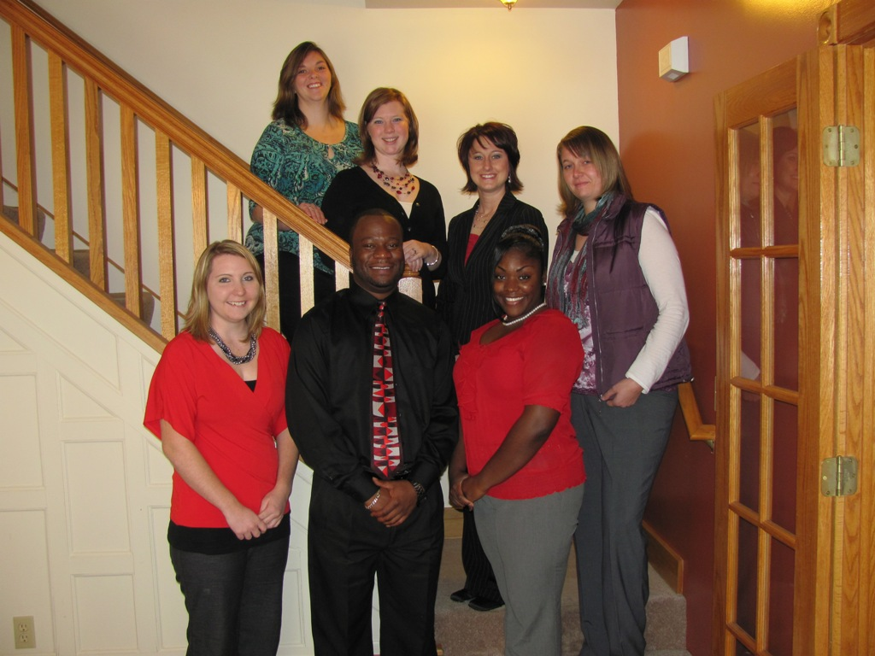

Slide 9

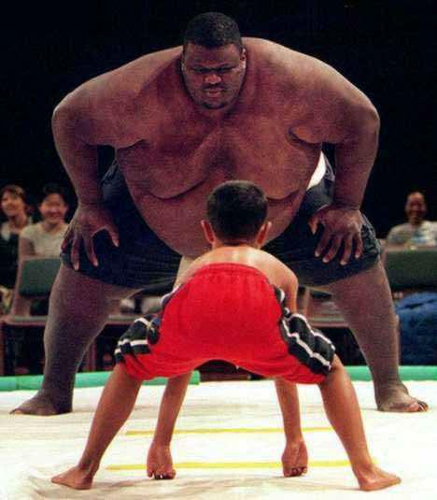

Slide 10
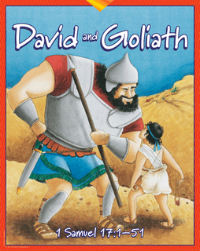

Slide 11
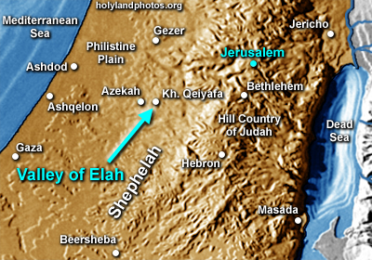
“Now the Philistines had gathered their armies
between Socoh and Azekah. And Saul was
camped in the Valley of Elah.”

Slide 12
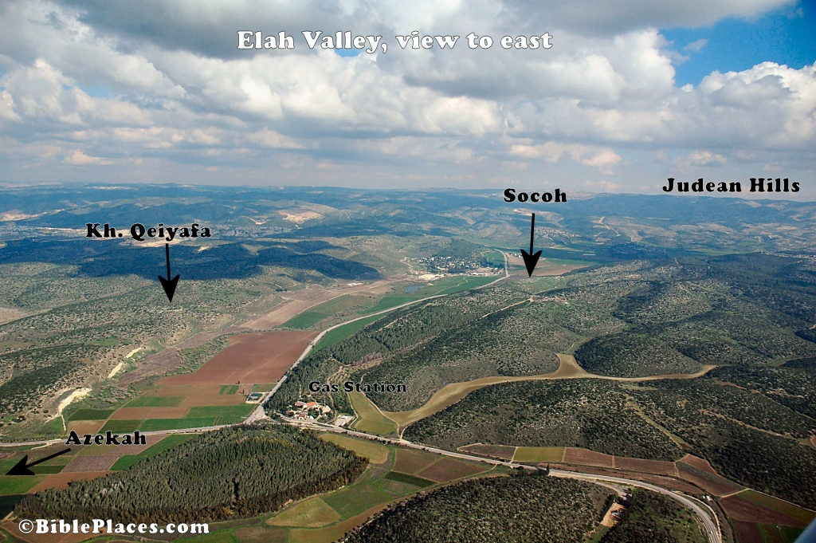
“The Philistines stood on a mountain on one
side, and Israel was on the other side, with a
valley between them.”

Slide 13
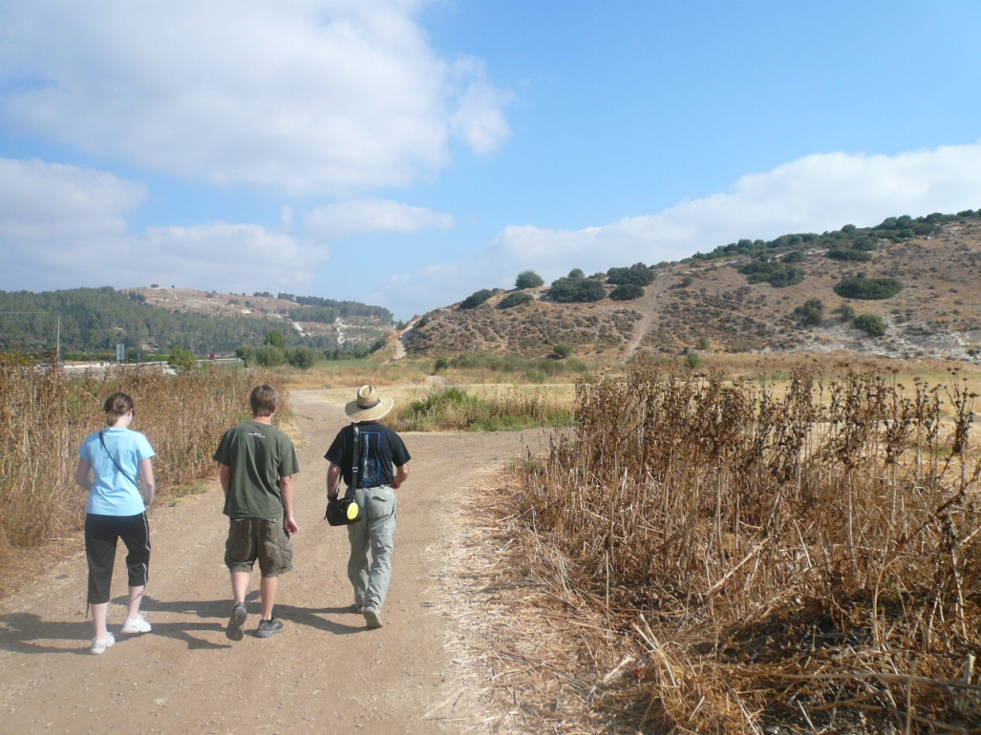
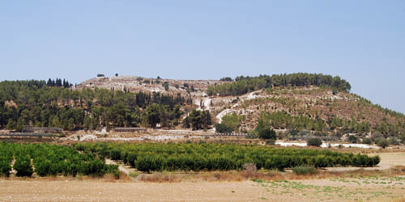

Slide 14
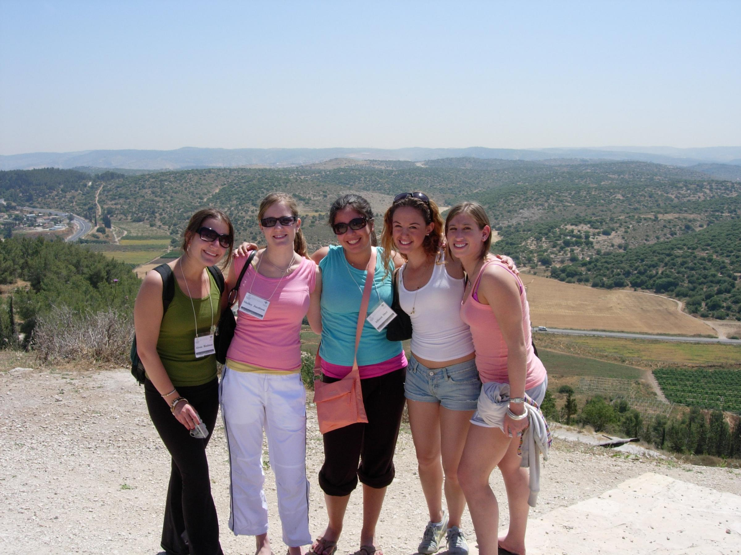

Slide 15
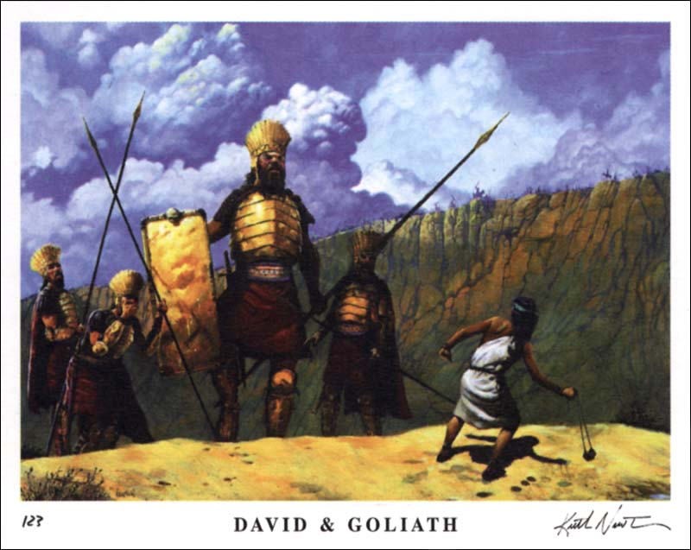

Slide 16


David was a small
shepherd-__________.
2. Goliath was a big, tall ______.
Saul was Israel’s _________.
What attracted David’s attention? ___________.
5. What was David’s first
reaction? ___________.

Slide 17
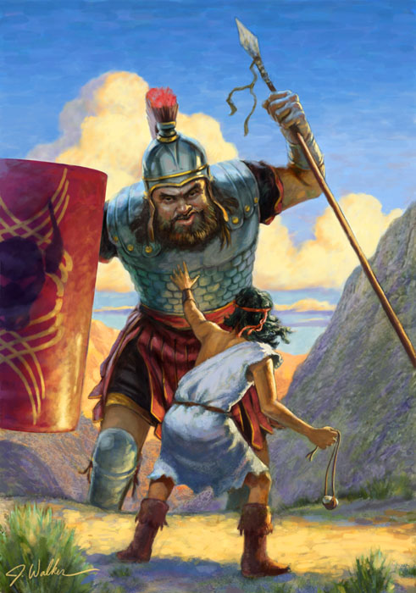
I Samuel 17
David was a son of a man named Jesse. 13 David’s three older brothers were in Saul’s army.
17 One day Jesse said to David, Take this bread and cheese to your brothers and see how they are doing.
20 So David left the sheep and set out early in the morning.

Slide 18
22 And David left his wagon with the keeper, and ran to the army, and greeted his brothers.
As he talked with them,
Goliath appeared and
spoke those same words again.
And David heard them.

Slide 19
24 And all the men of Israel fled and were very afraid.
25 And the men of Israel said, Have you seen this man that defies Israel ?
Behold, it has been said, that the man who kills him, the king will give him his daughter, Princess Michal, and give him great riches, and his family will live tax-free!

Slide 20
26 And David asked the men to repeat what they said:
What shall happen to the man that kills this Philistine?
Who is this uncircumcised Philistine, that he should defy the armies of the living God?
27 And the men repeated their answer, saying, That’s what will happen to the man that kills Goliath!

Slide 21
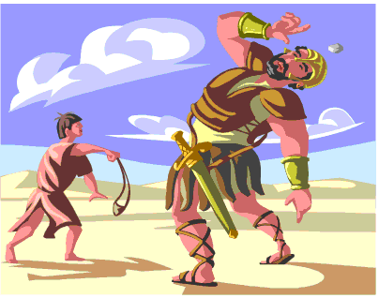

Slide 22
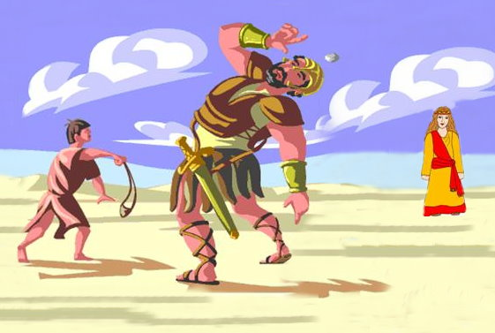

Slide 23


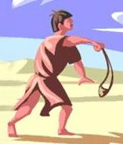
Life is a series of challenges !

Slide 24

The Goal Never Moves !

Slide 25

The Goal Never Moves !

Slide 26
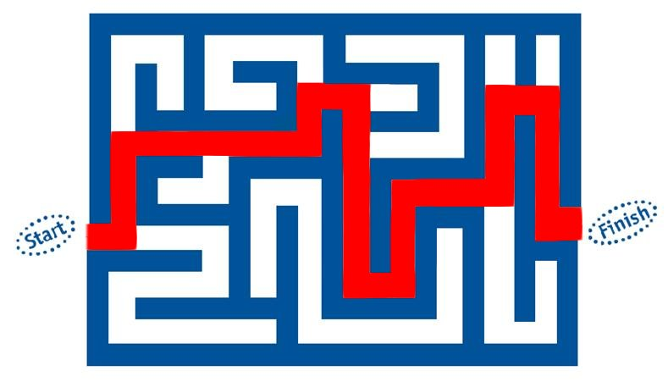
The Goal Never Moves !

Slide 27
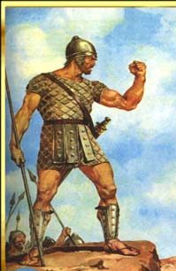
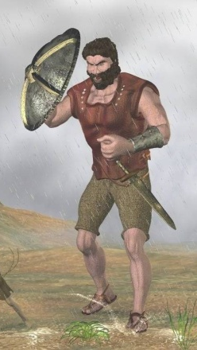
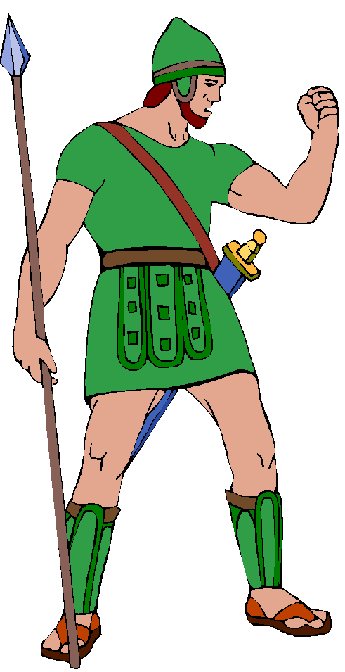
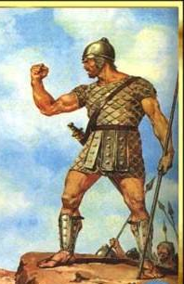
Four Giants David Could
Not Kill
II Samuel 21:15-22
Guilt
Greed
Bitterness
Lust

Slide 28
The Goal Never Moves !

Slide 29
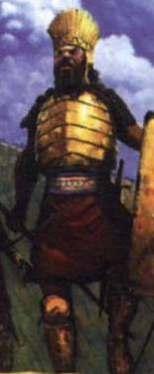
“Is that all I have to do ?”

Slide 30

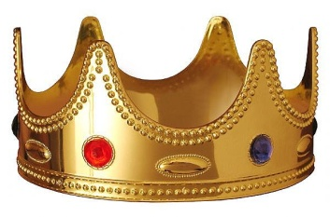
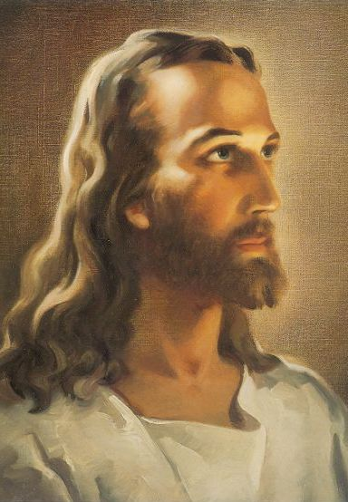
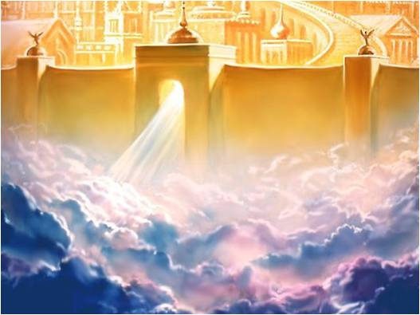
“Is that all I have to do ?”
JOY
Think aboutJesus

Slide 31
Focus
Philippians 3:7-14, 20-21
7 Things that were gain to me, I consider them lost for Christ. 8 I count all things loss for the excellent knowledge of Christ Jesus my Lord, for whom I have suffered the loss of all things, and count them as rubbish, that I may gain Christ. 10 That I may know Him and the power of His resurrection, and the fellowship of His sufferings, being conformed to His death.

Slide 32
12 Not that I have already attained,
or am already perfect. But I press on,
that I may lay hold of Christ Jesus.
13 Brethren, I do not consider myself to have arrived. But one thing I do, forgetting those things which are behind and reaching forward to those things which are ahead, 14 I press toward the goal for the prize of the upward call of
God in Christ Jesus.

Slide 33

A Good Goal Is:
Clear
Specific
Attainable

Slide 34
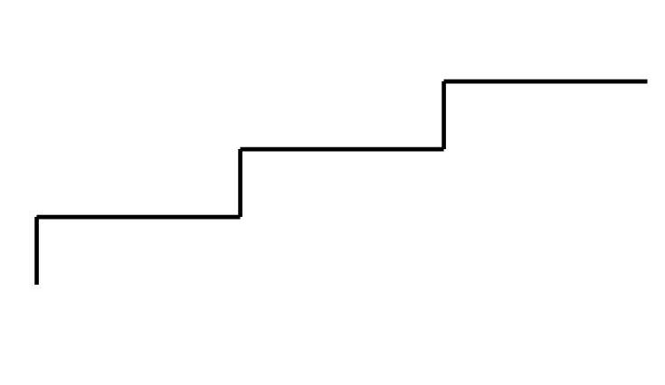
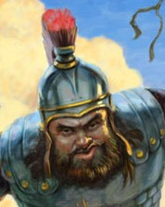
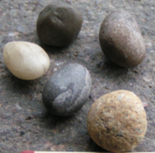
Achieving Your Goals
Final Goal
Important Goal
Immediate Goal
Immediate Goal – choose five stones
Important Goal – kill the giant
Final Goal – claim the Princess !

Slide 35
What
Is Your Goal
?

