Slide 1
Word of Life Church
Sunday, December 9, 2012

Slide 2
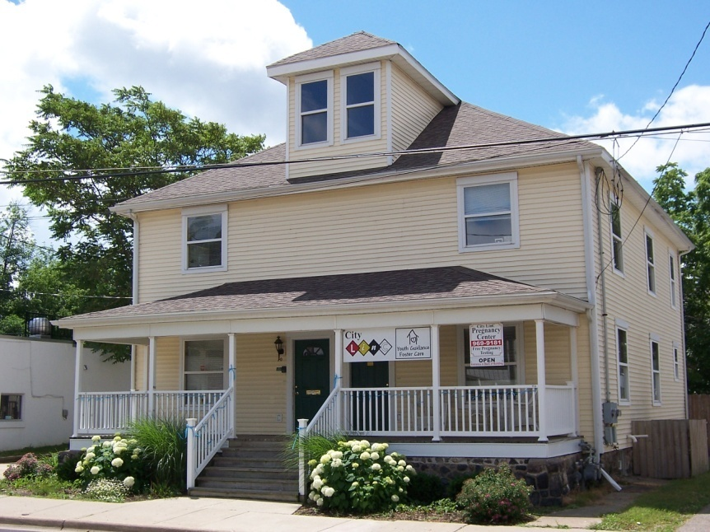
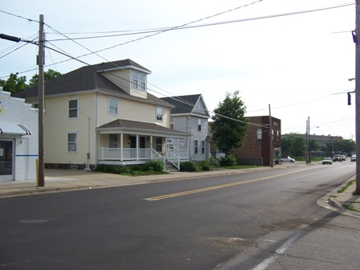

Slide 3
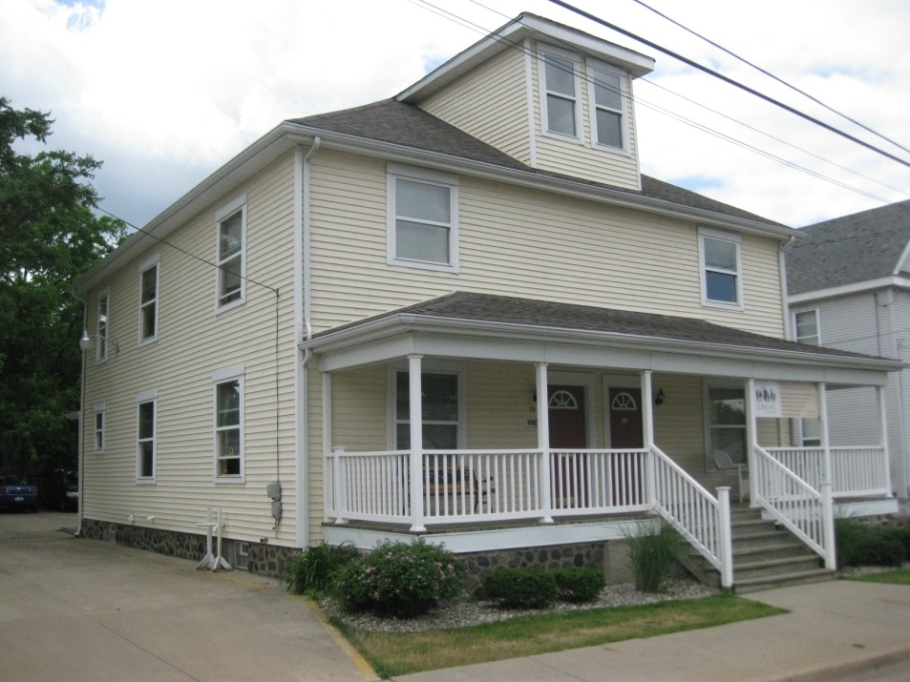
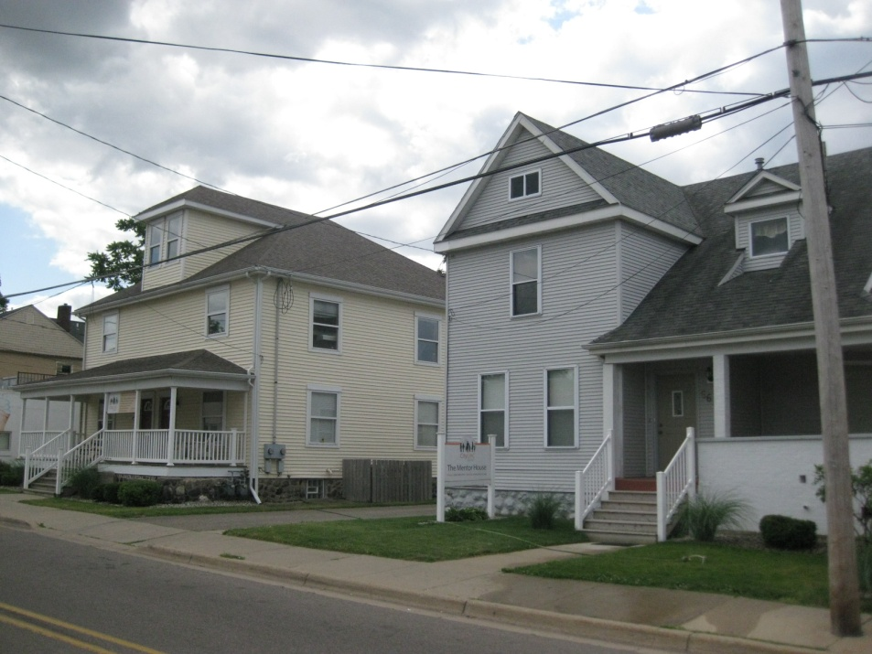
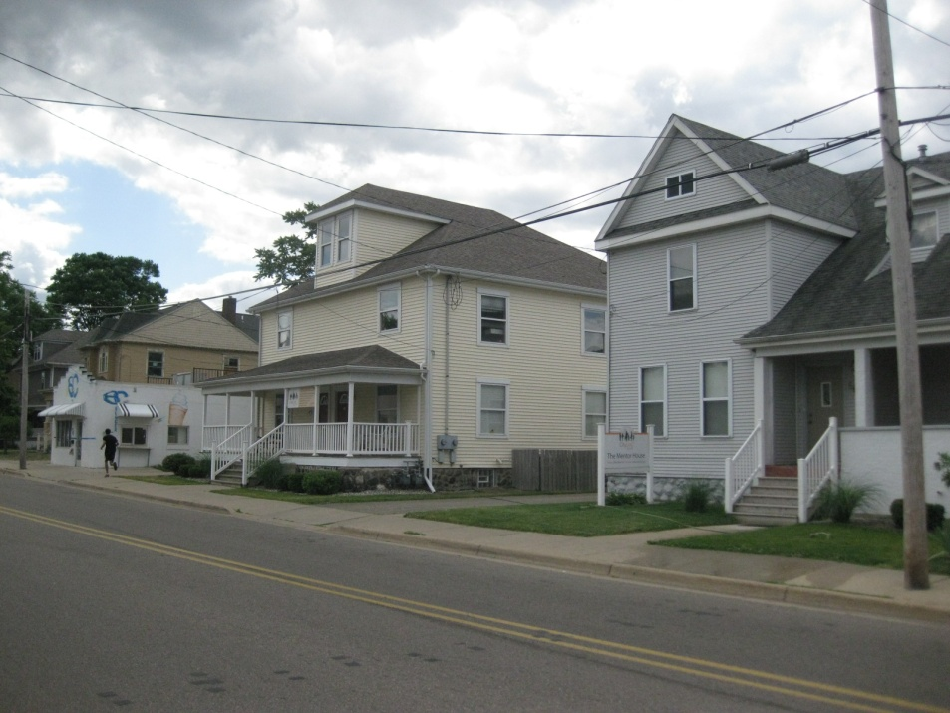
2008
2010
www. CityLinC.org
2012

Slide 4
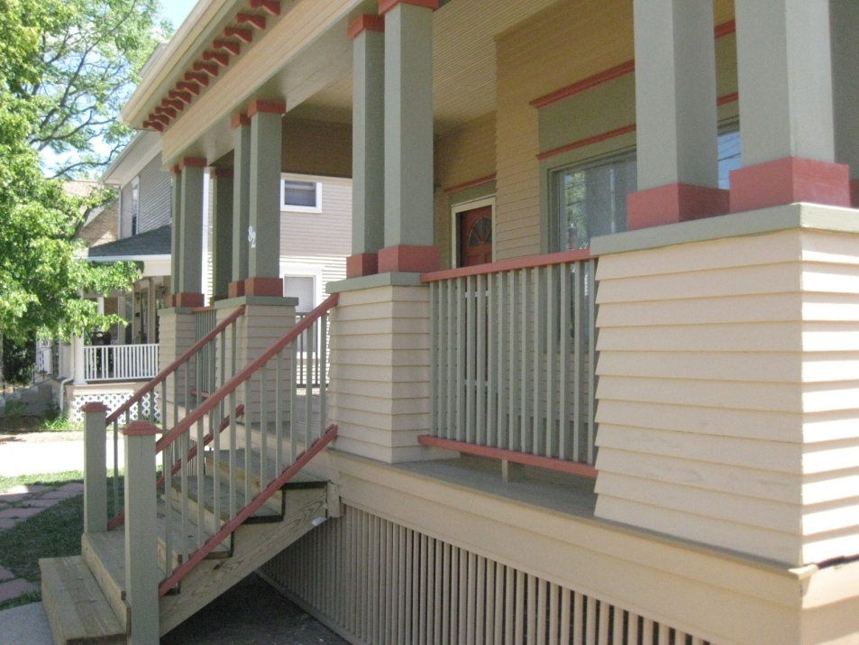
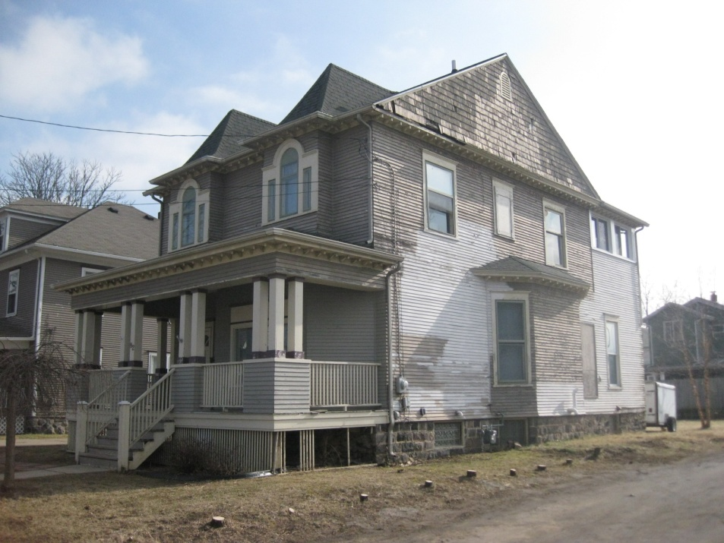
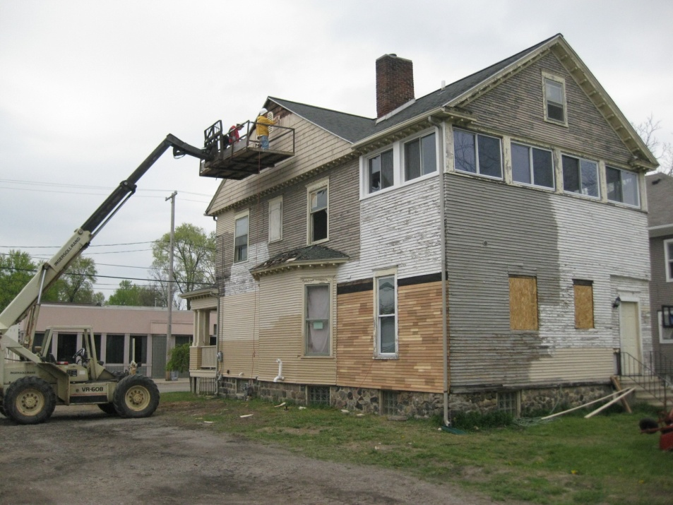
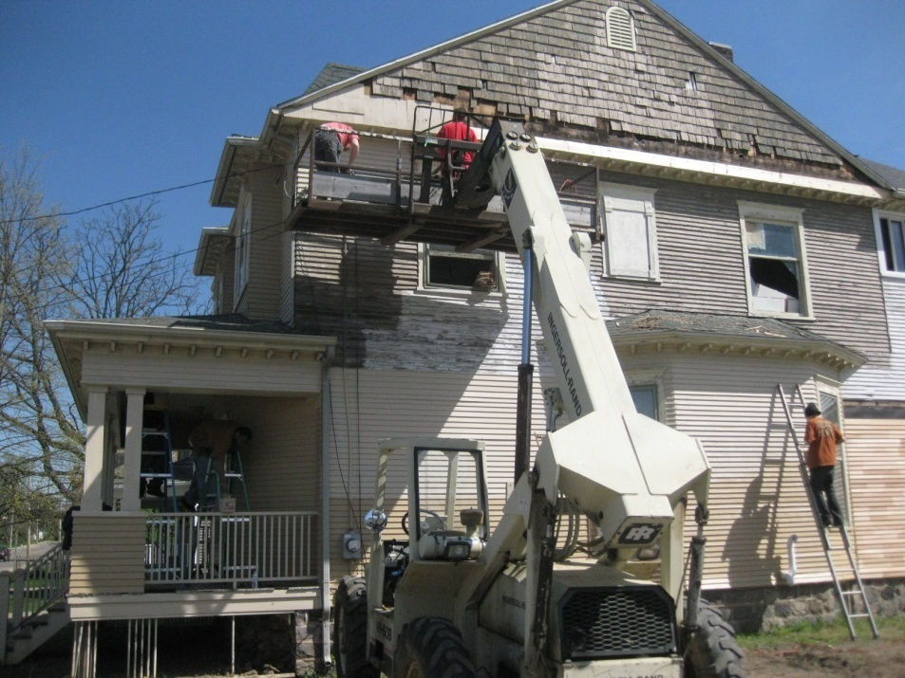
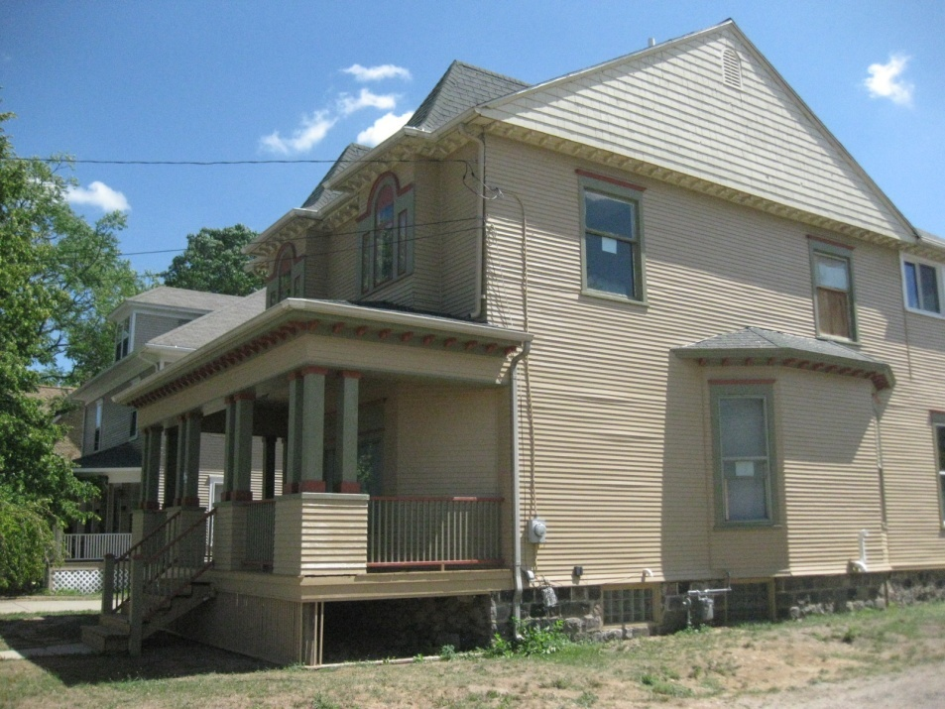
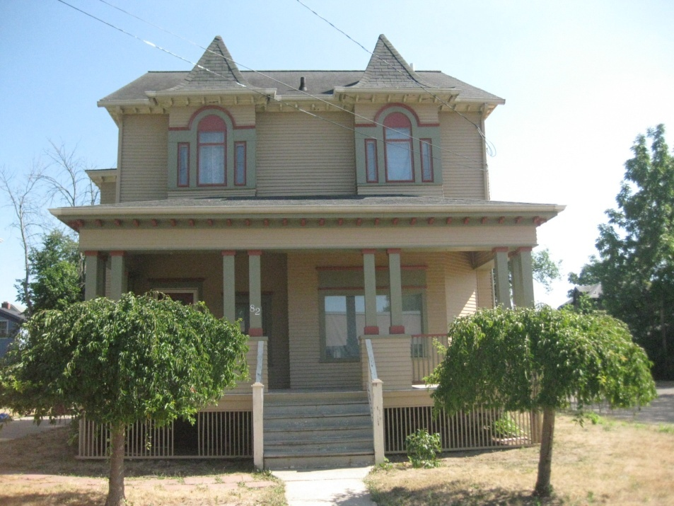
2012

Slide 5
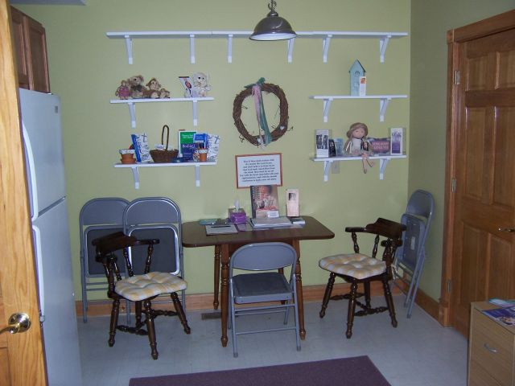

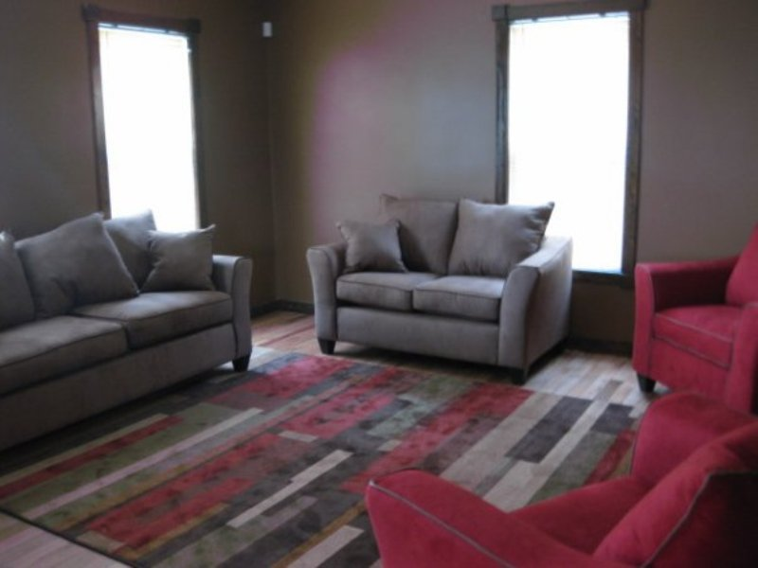
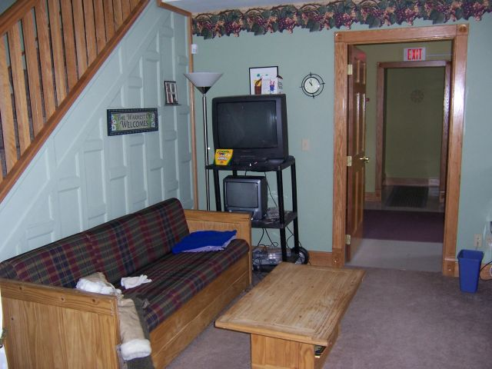
www. CityLinC.org

Slide 6
Our Mission
We Connect
1. Children and Youth to Loving Families
2. Families to Secure Futures
3. Individuals to Caring Community, and
4. Community to Personal Faith
Our Ministries
Foster Care & Adoption
Women’s Resource Center
Pathways Counseling
Red Wagon Partners
Stuff-A-Bus Campaign
Second Wind Mentors
Ministry Network

Slide 7
Our Vision
We will:
1. Focus on Children and Youth
who are high-risk
2. Fortify Families
who need additional resources
3. Free Individuals to experience
their God-given potential
4. Facilitate Community
where separation exists
5. Foster Faith where there is no hope

Slide 8

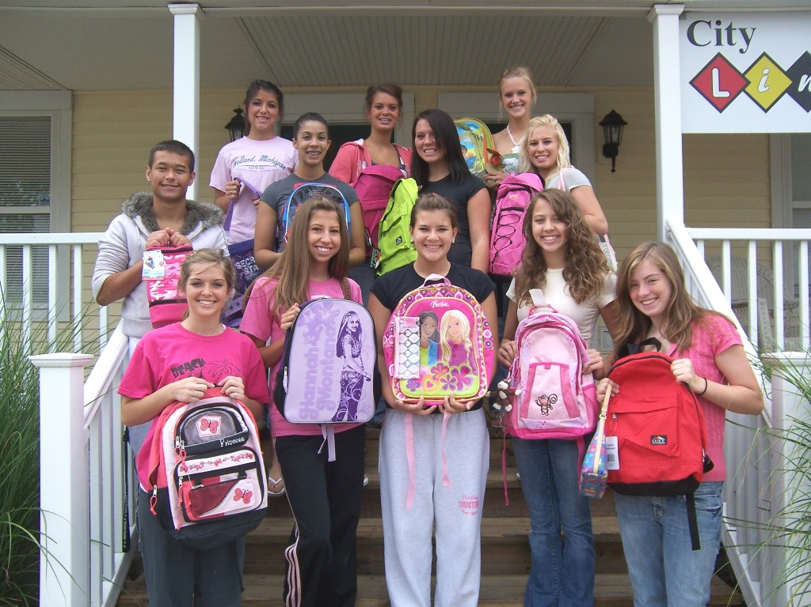
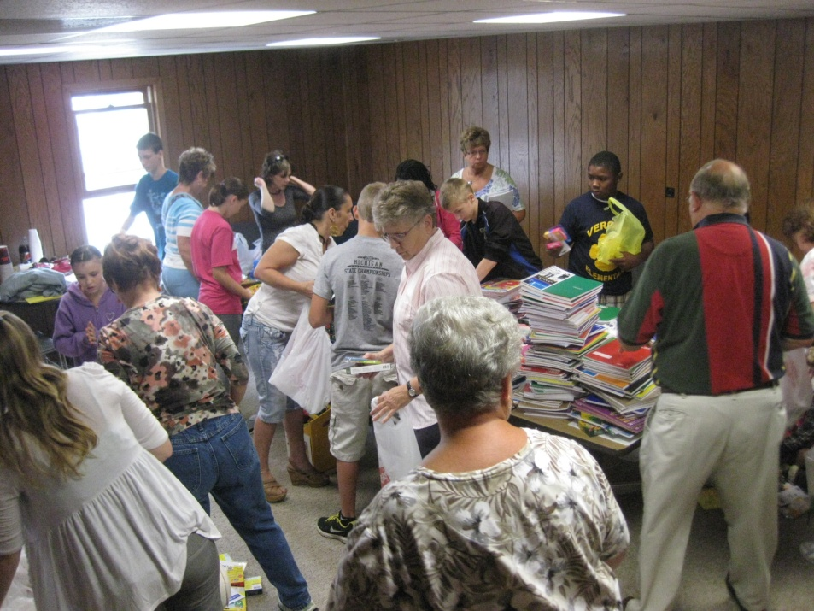
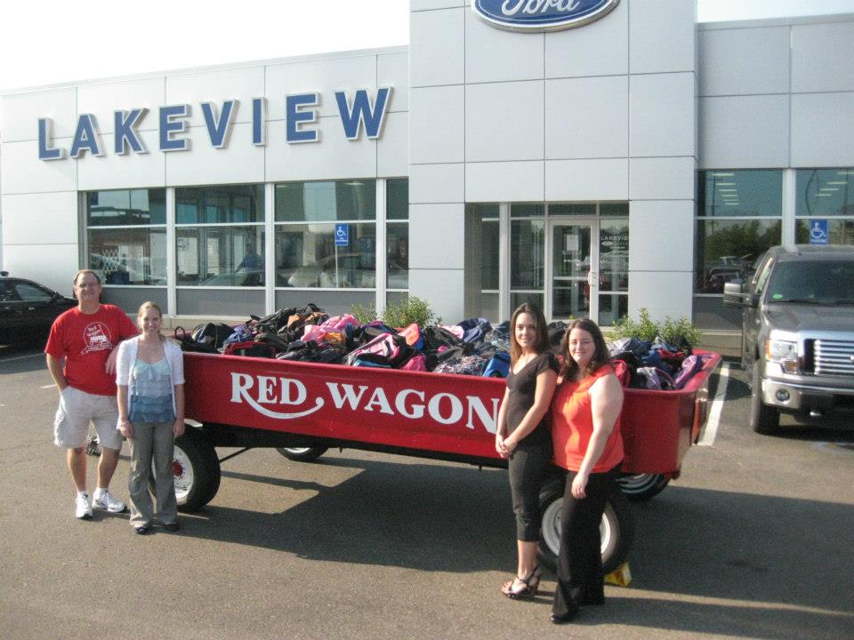

Slide 9

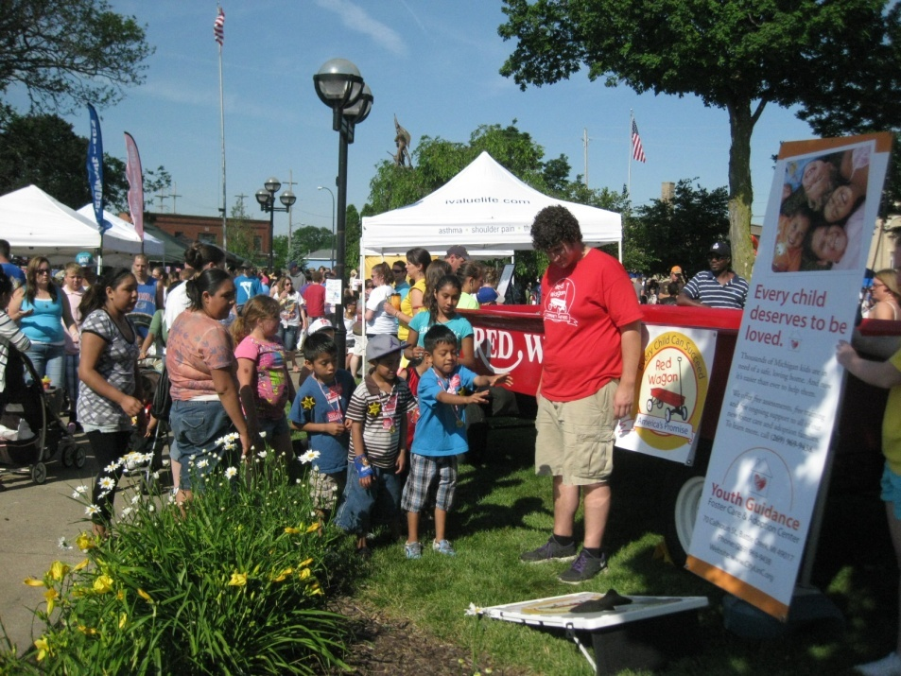
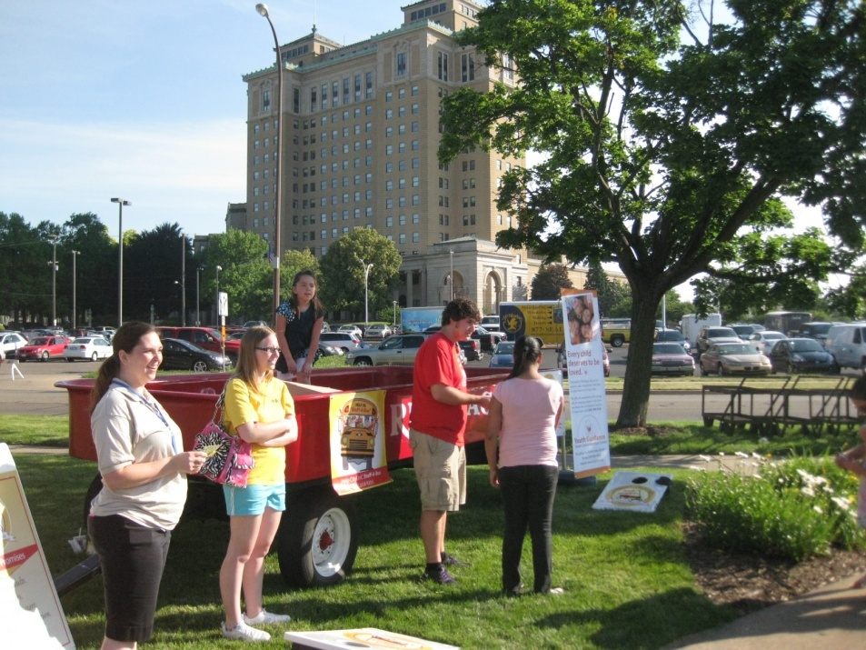
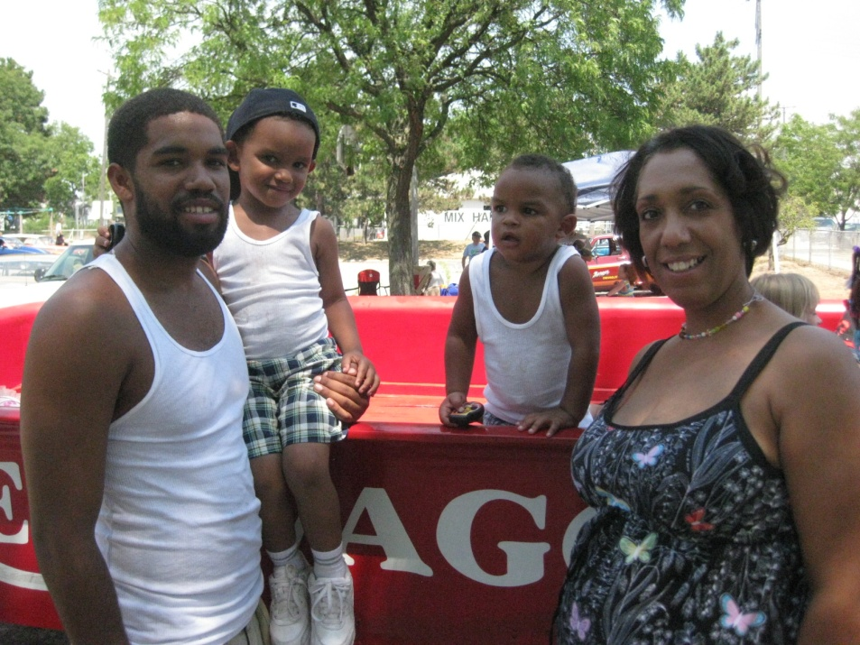

Slide 10

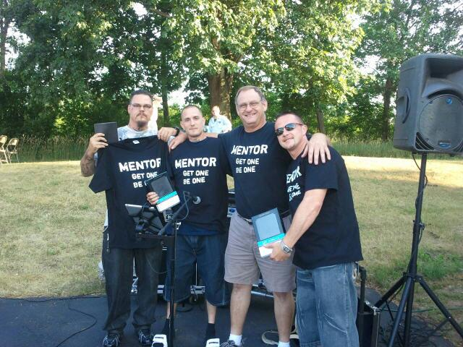
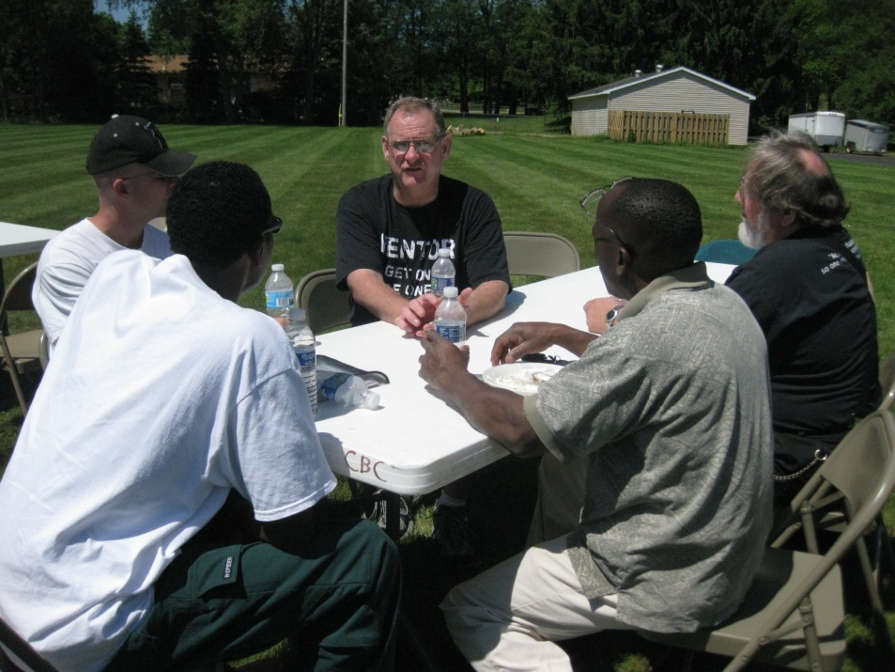
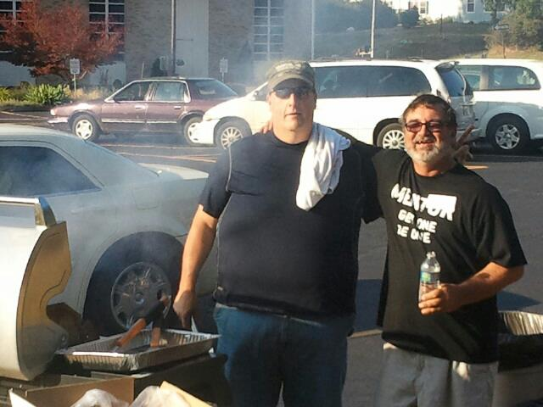

Slide 11
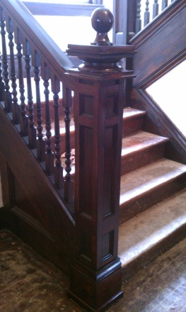

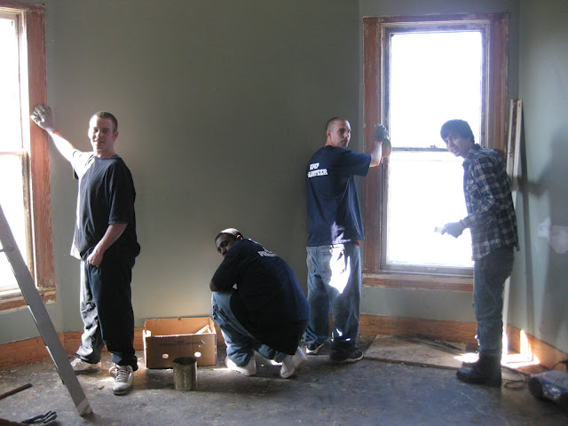
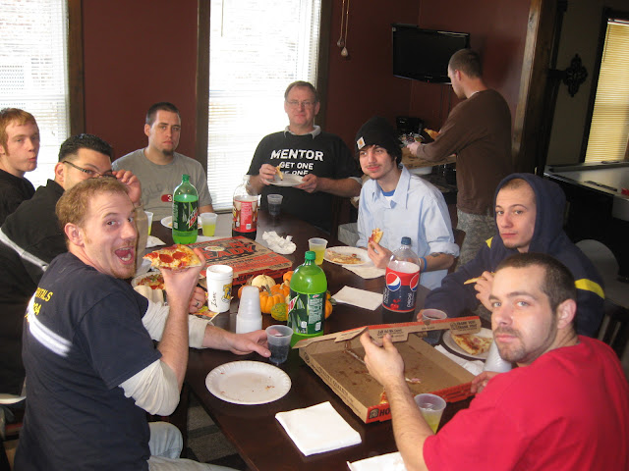
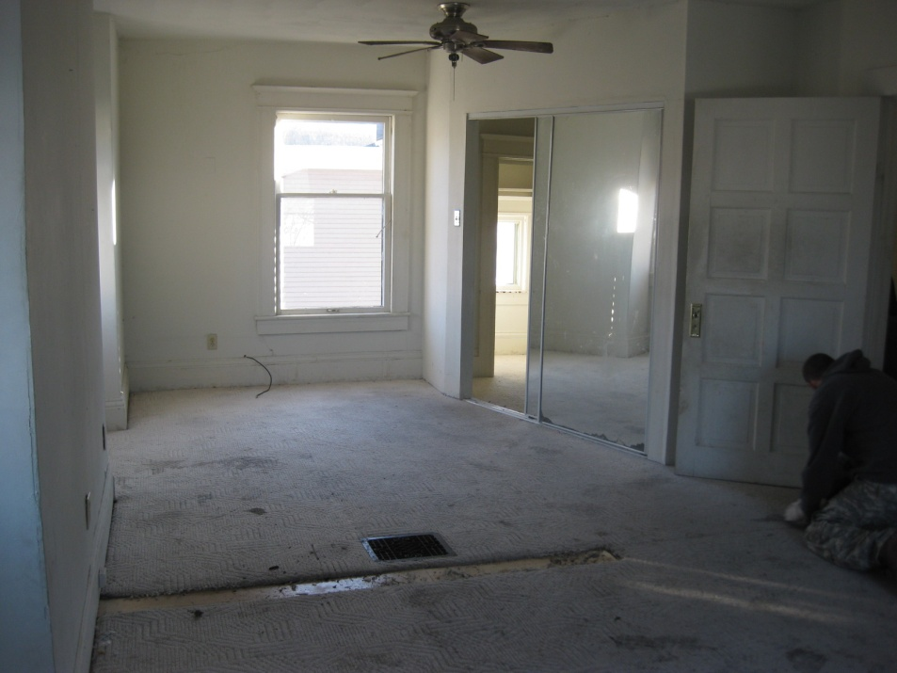
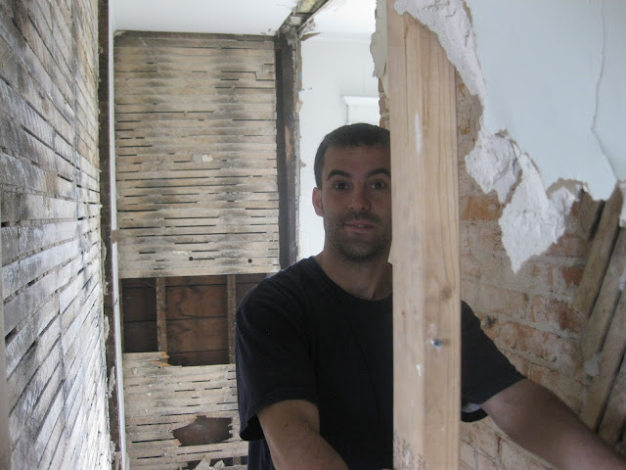
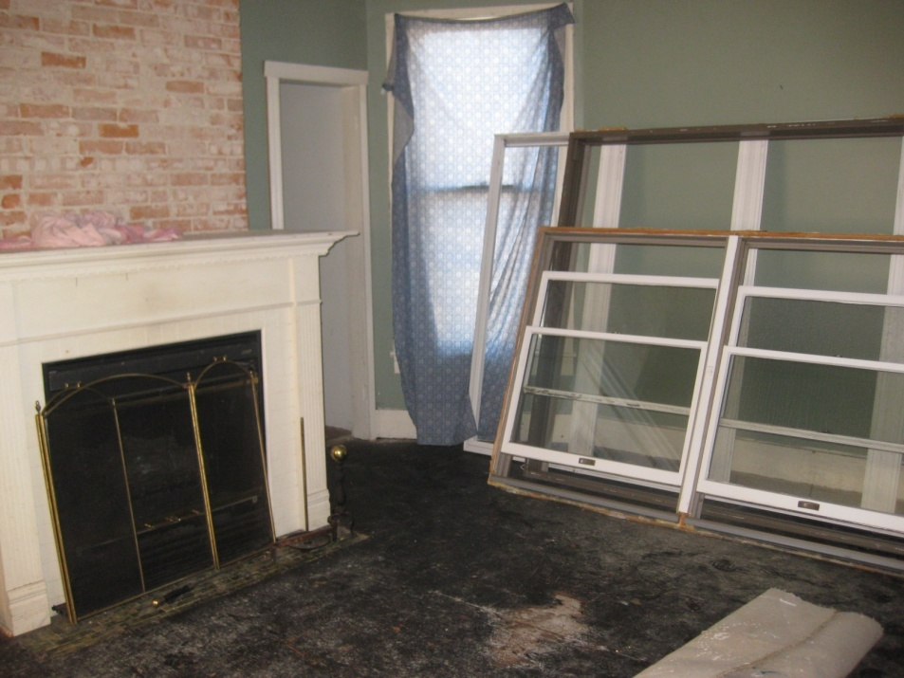
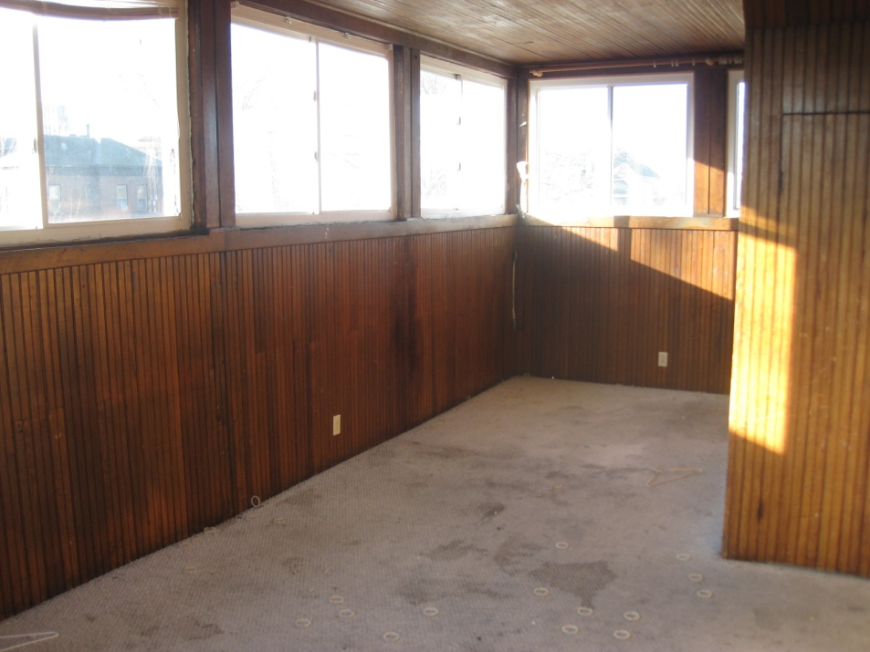

Slide 12
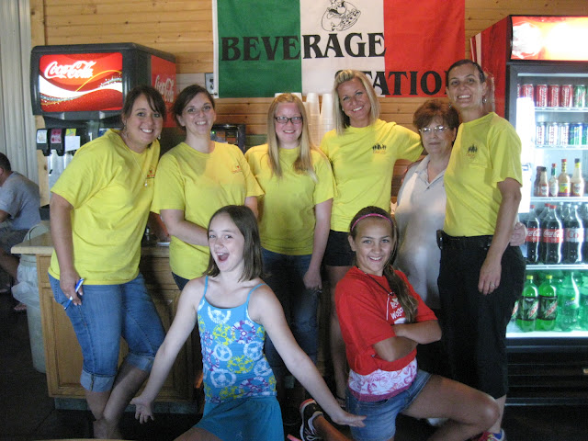
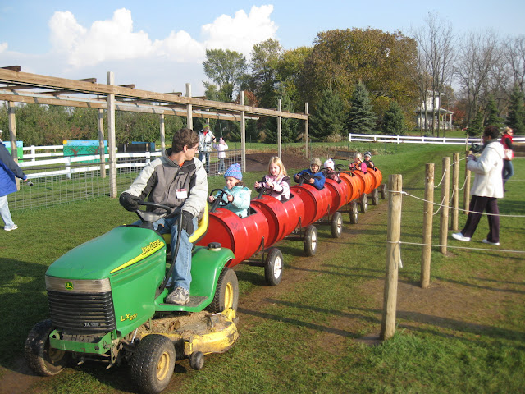

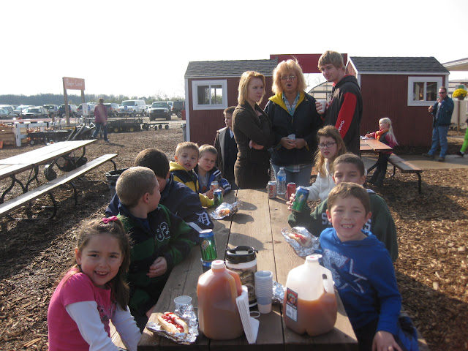
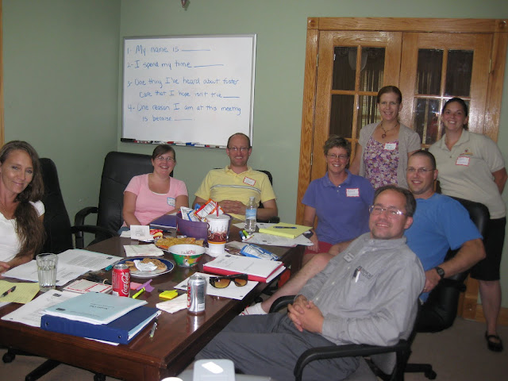
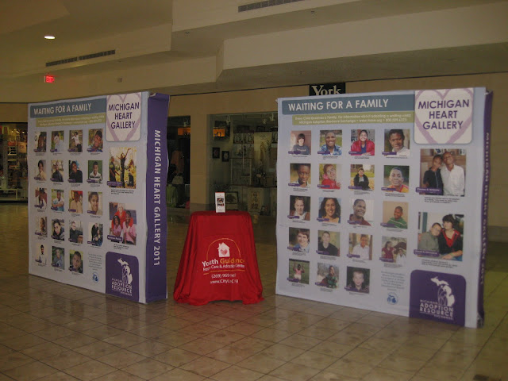

Slide 13
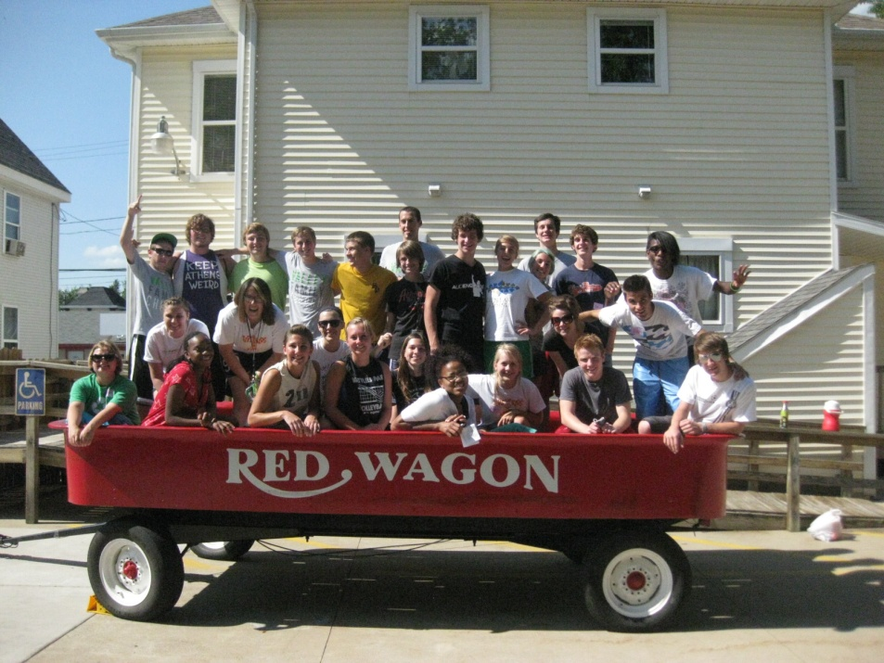
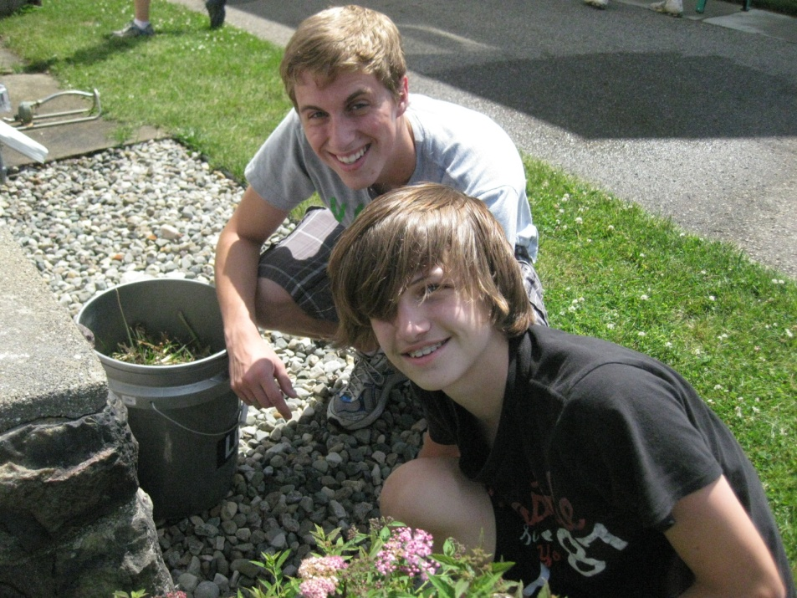
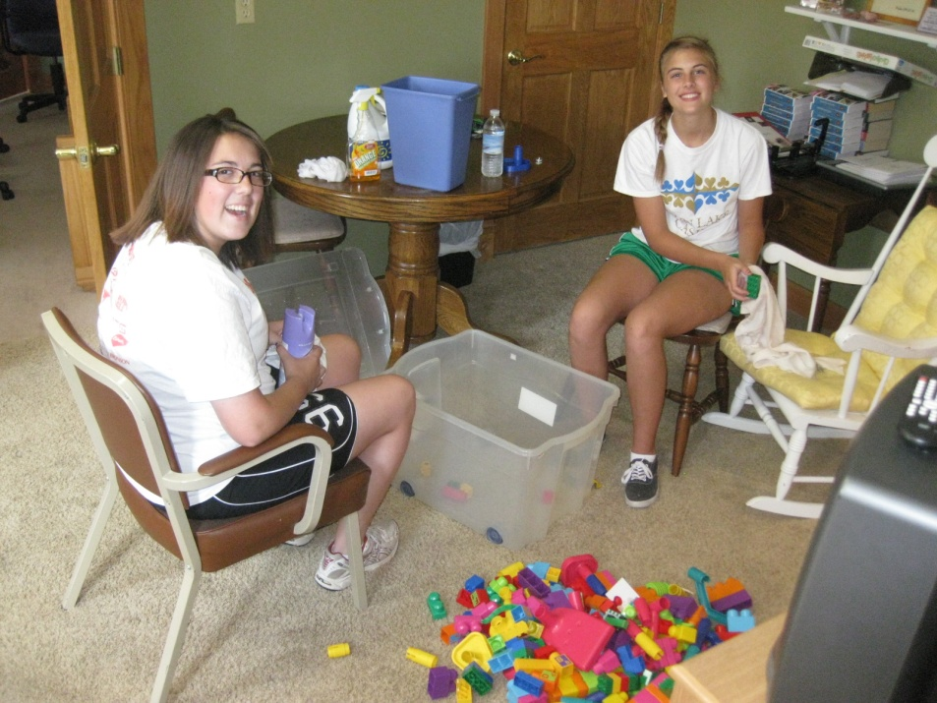
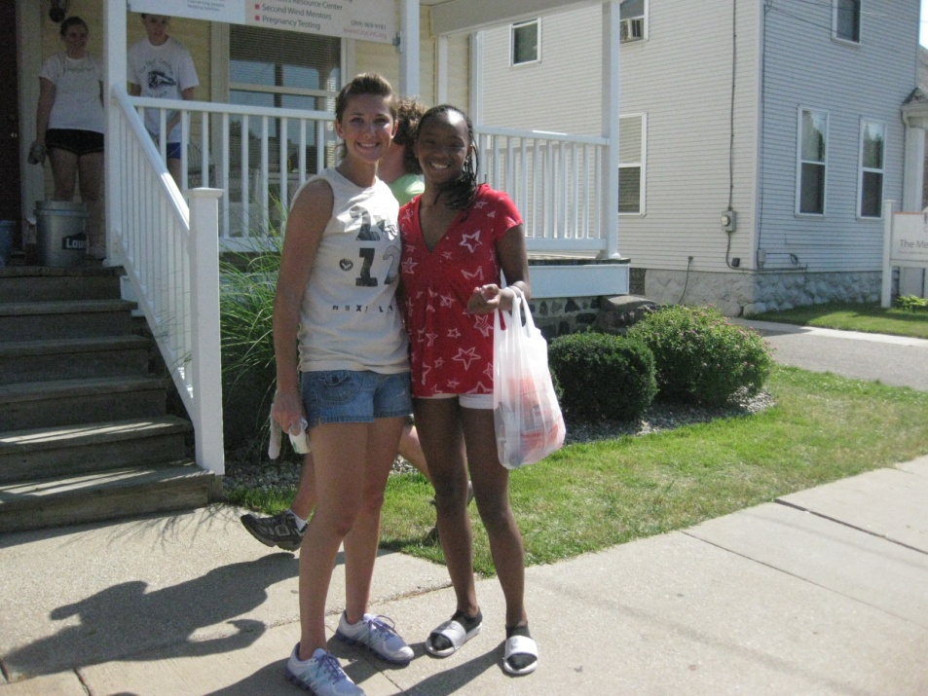

Slide 14
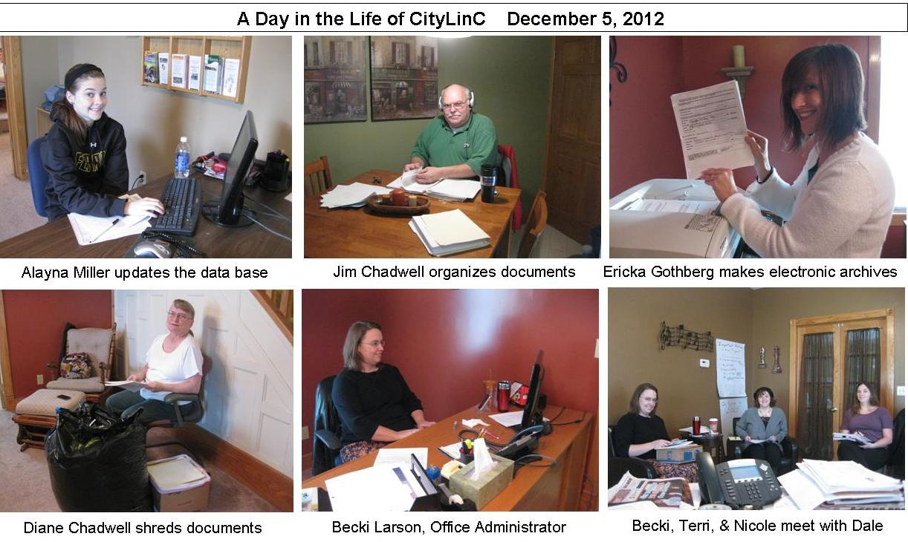
www. CityLinC.org

Slide 15
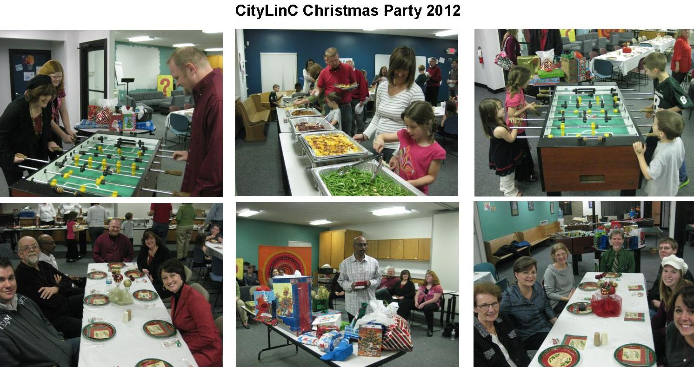
www. CityLinC.org

Slide 16

Conversations Count
John 4

Slide 17
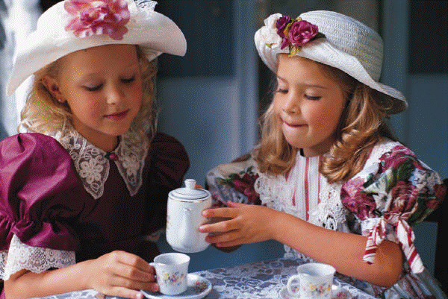

Slide 18
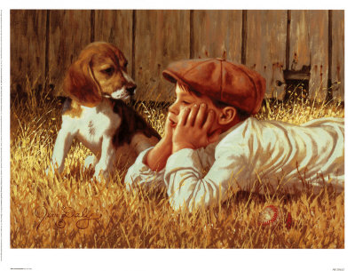

Slide 19
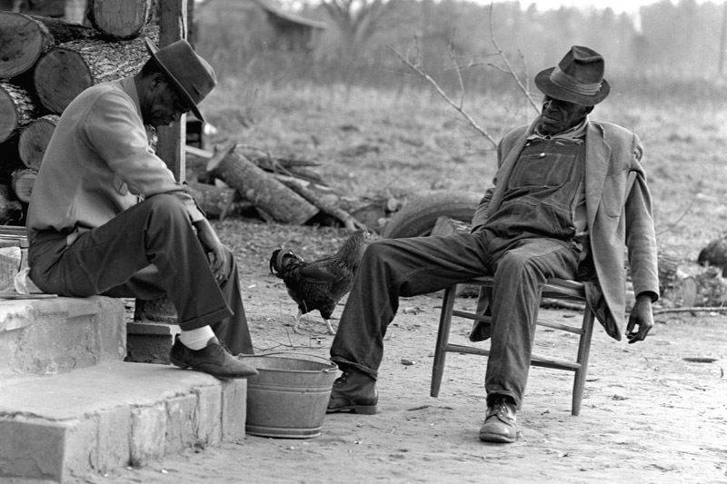

Slide 20


Slide 21
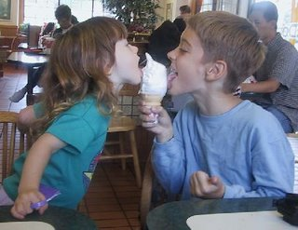

Slide 22
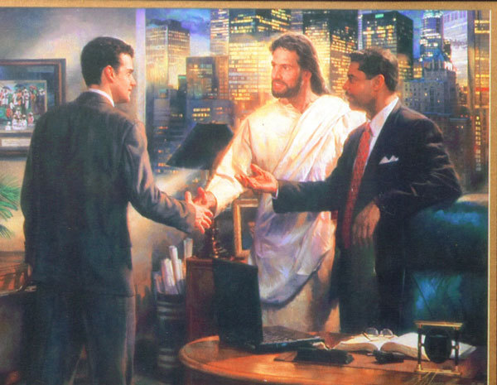

Slide 23
A wise pastor
said to me:
“We should
stop counting conversions
and start counting more conversations!”

Slide 24
Conversations Count
John 4

Slide 25
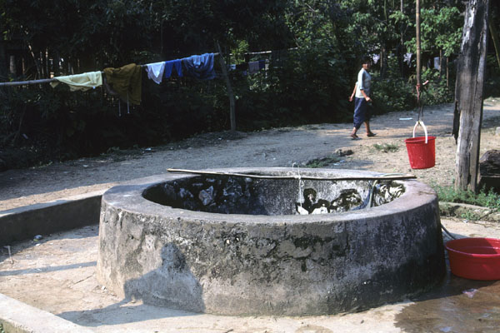
John 4
Jesus came to Sychar, Samaria,
6 Tired from the long walk, he came
to Jacob’s Well at lunch time.

Slide 26
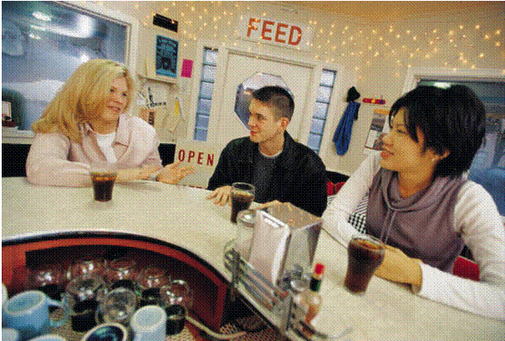
7 A Samaritan woman was there for water.
Jesus asked her,
“May I please have a drink?“

Slide 27

1. The Hard Shell Response !
9 Surprised, she replied,
“You are asking me for a drink?
You are a Jew, and I am a Samaritan…."
Jesus said, "If only you knew the gift God has for you, you would be asking ME, and I would give you LIVING water.”

Slide 28
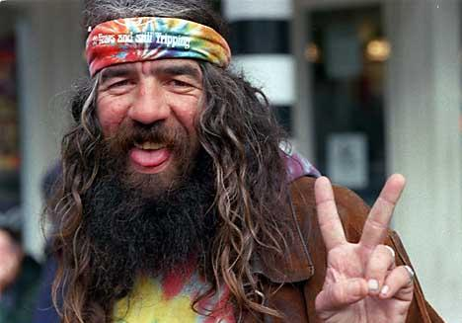
2. The Humor Game !
"But, you don't have a bucket," she laughed,
"How are you going to get this water?”

Slide 29

And Who Do You
Think You Are?
Do you think you are better than our grandfather Jacob who dug this well?
13 Jesus replied, “You will become thirsty after drinking this water. 14 But the water I give you – you will never thirst again.
It will become a well of eternal life.“

Slide 30
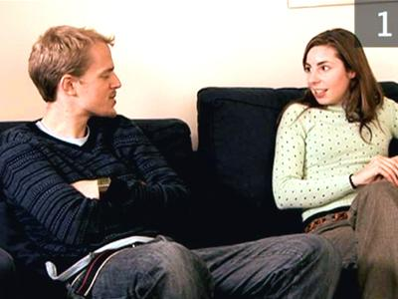
4. The Surface Response Game
    15 "Please, sir, give me some of that water!” So I will never thirst again!"

Slide 31

5. The Denial Game
16 “Go - get your husband, Jesus told her.
"I don't have a husband,“ the woman replied.
"You’re right!” Jesus said, “You don't have
a husband -- You have five husbands,
and you aren't married to the man you
are living with now!"

Slide 32

6. The Flattery Game
                19 "You must be a
                prophet,” she said.

Slide 33

7. The “Right Religion” Game
                So tell me, why do you insist that Jerusalem is the only place of worship, and not our mountain here in Samaria?”
21 Jesus replied, "Believe me, it doesn’t matter where you worship. 23 God is spirit,
and those who worship Him must worship Him in spirit and in truth.”

Slide 34

8. The “Later” Game
The woman replied, “When the Messiah comes - He will explain everything to us.
I’ll wait till then!”
26 Then Jesus told her,
“I AM the Messiah – the One sent from God!”

Slide 35


Decision Time !
Then the woman ran back to her family saying, "Come and meet a man who told me everything I ever did!
He is the Messiah – the Christ !“

Slide 36
Conversations Count
John 4

Slide 37

                “I’m not
                into
                religion.”
                Sam

Slide 38

                “I’m
                going with
                you!”
                Mike

Slide 39

                Your eyes
                didn’t
                condemn
                me!”
                Felicia

Slide 40

                “All I want
                to do is go
                fishin’ with
                someone who
                don’t do dem things!”
                Anthony

Slide 41

                “I would be a Christian...
                …but I’ve been reincarnated!”

Slide 42
Conversations Count

Slide 43
Conversations Count
  Choose three friends.
Keep in contact with them.
Pray for them.
Serve them.
ME

