Slide 2


Slide 3

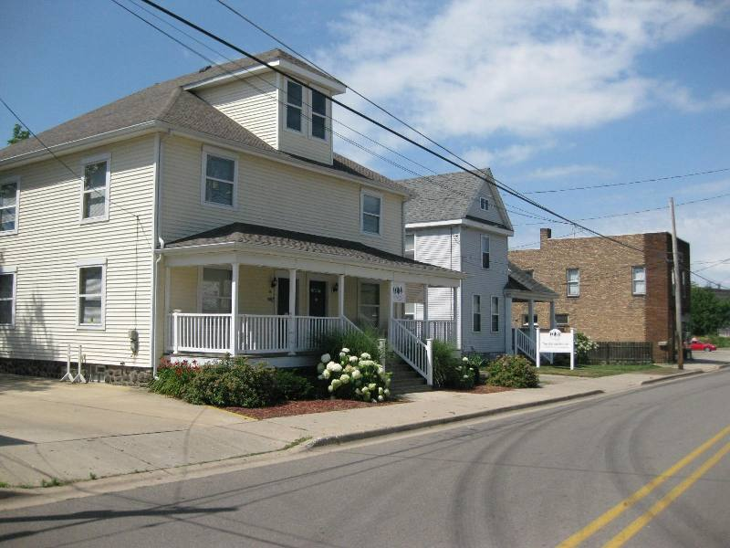
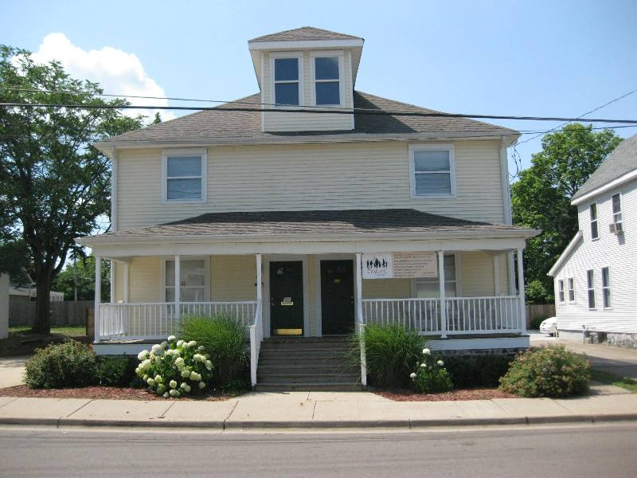
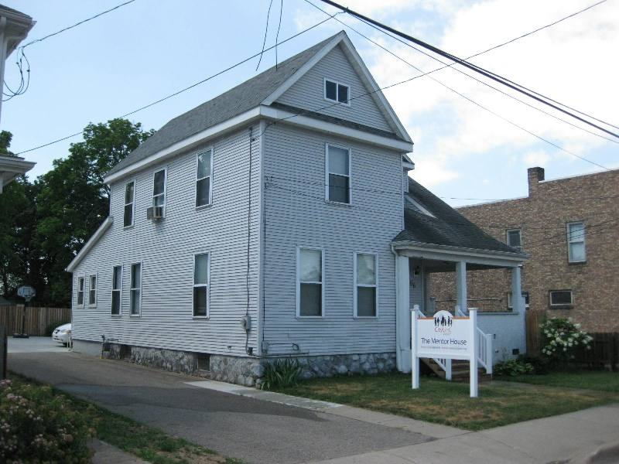

Slide 4
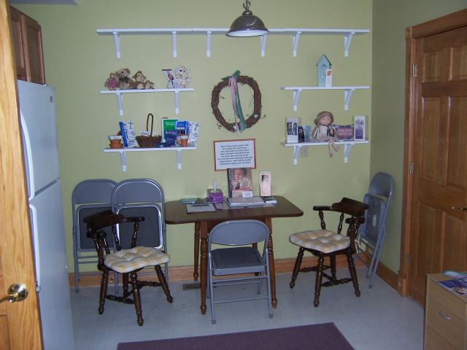
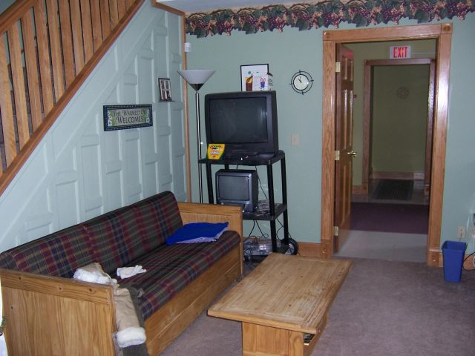
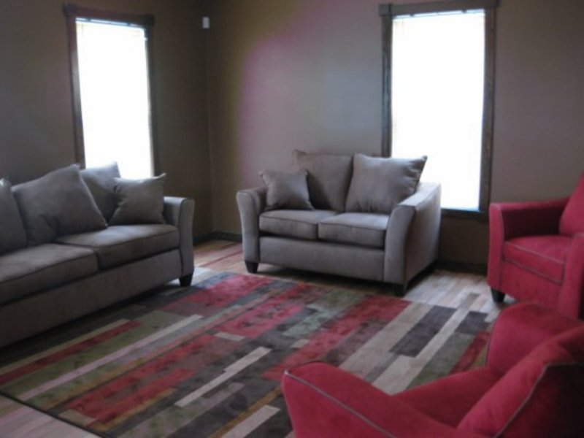
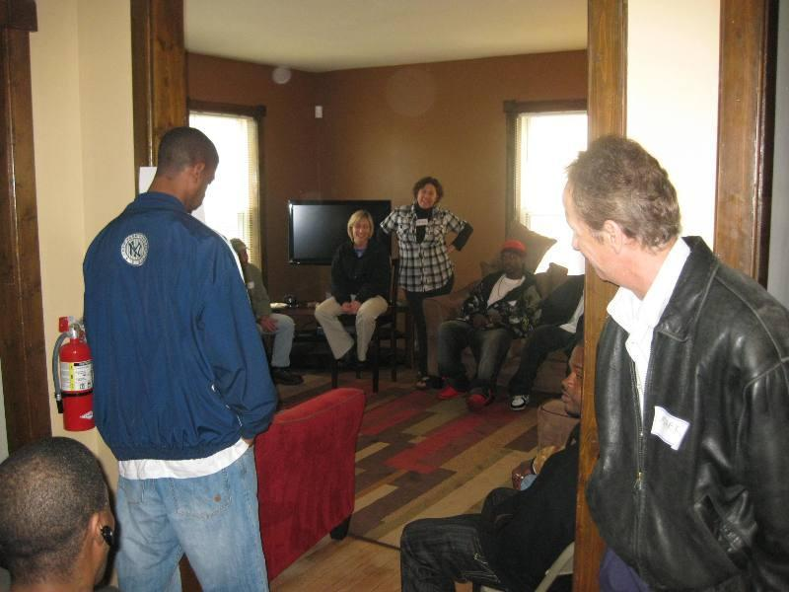

Slide 5
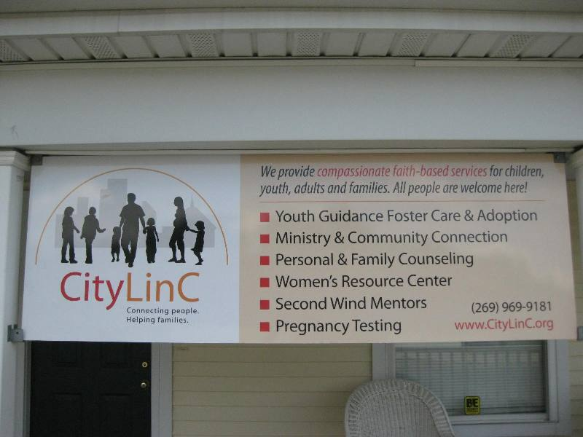

Slide 6

Conversations Count
John 4

Slide 7
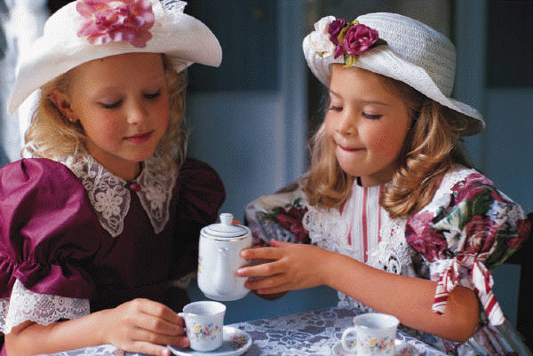

Slide 8
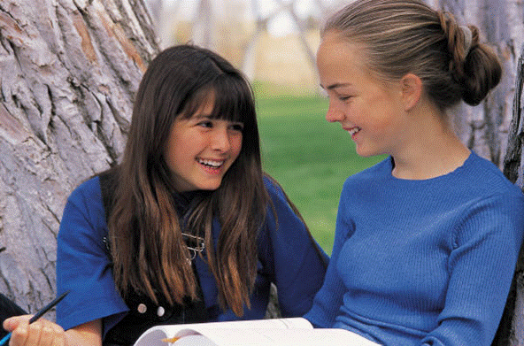

Slide 9
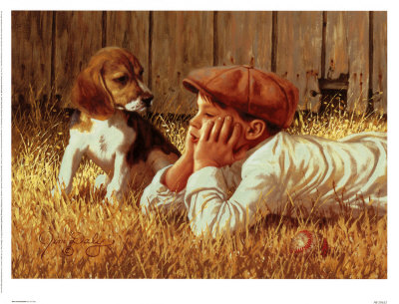

Slide 10
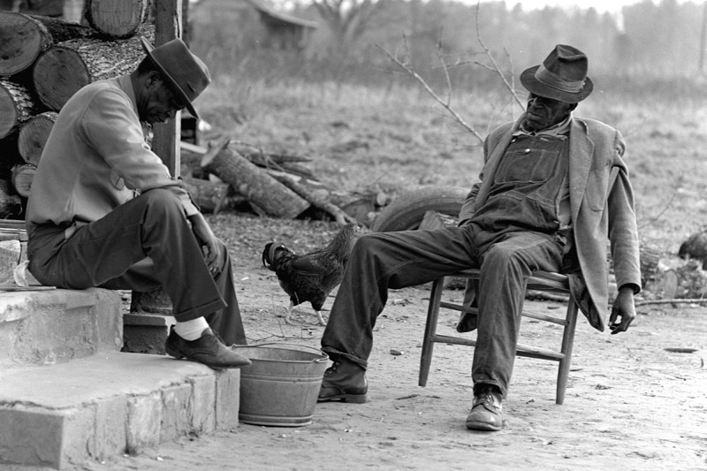

Slide 11
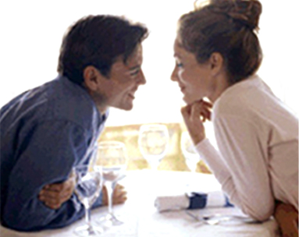

Slide 12
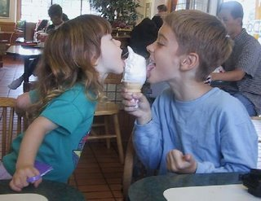

Slide 13
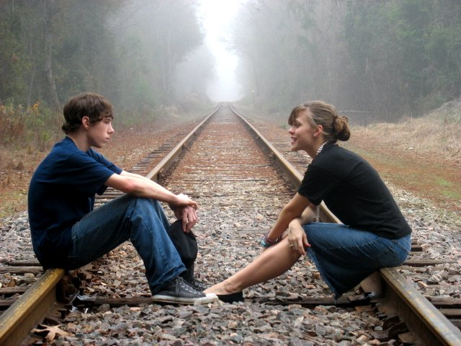

Slide 14
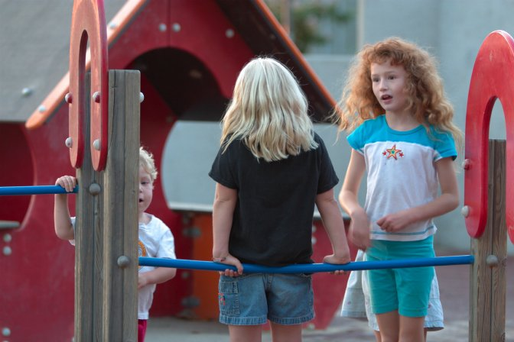

Slide 15
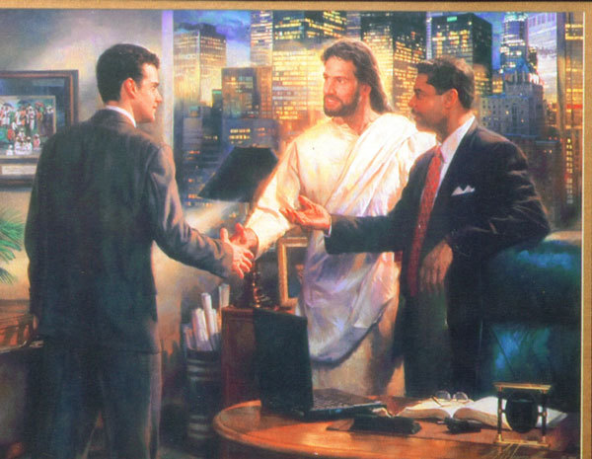

Slide 16
A wise pastor
said to me:
“We should
stop counting conversions
and start counting more conversations!”

Slide 17
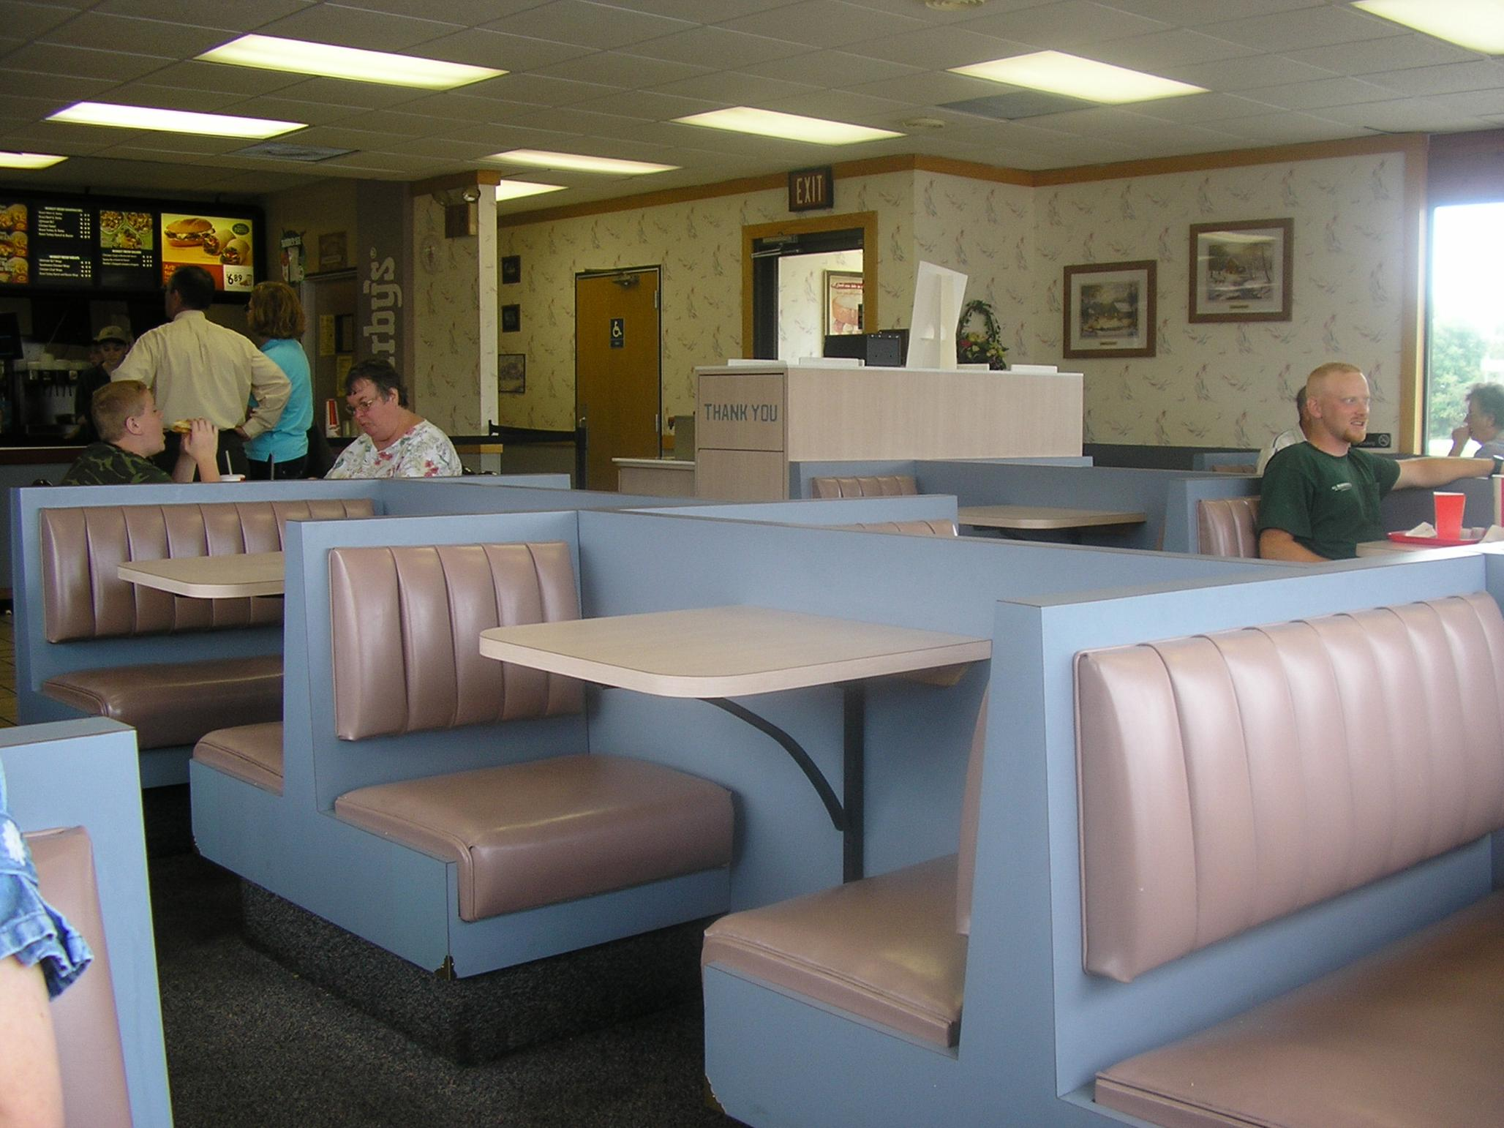

Slide 18
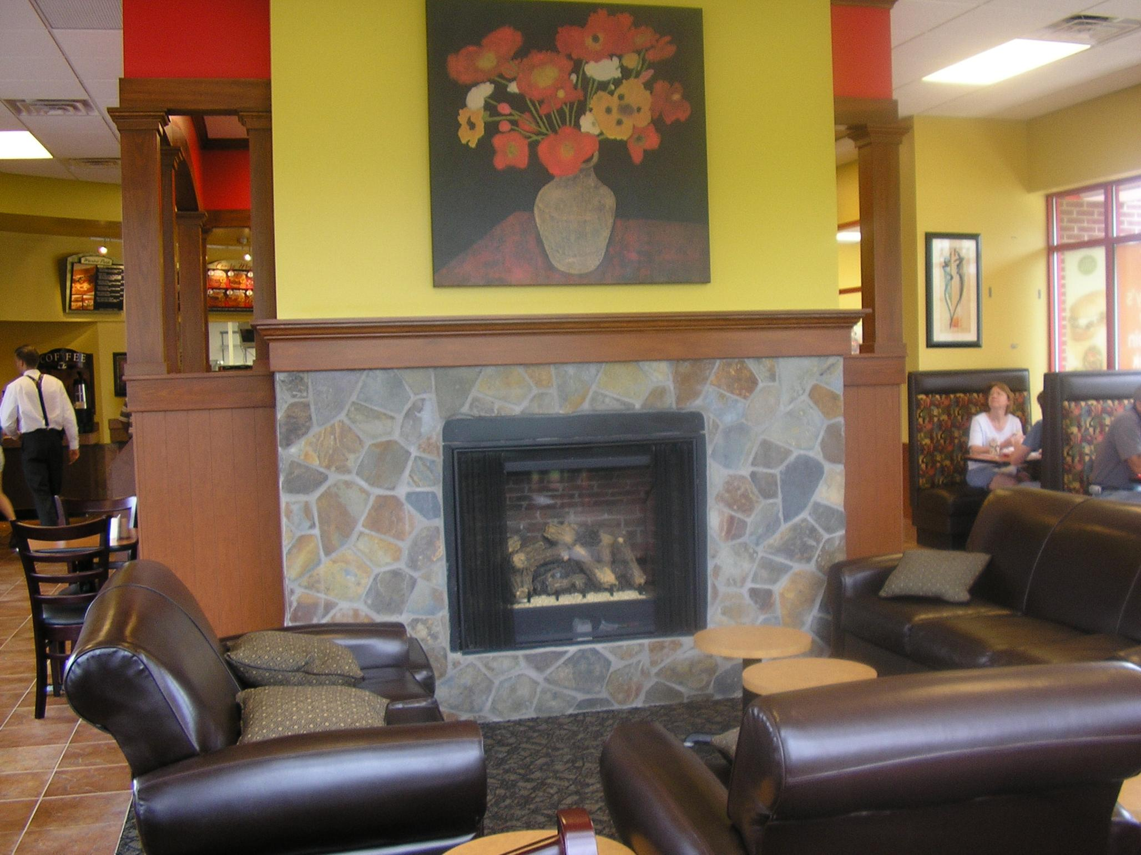

Slide 19
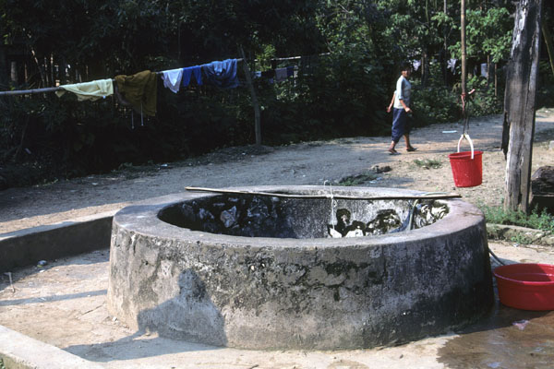
John chapter 4
Jesus came to Sychar, Samaria,
the place of Jacob’s well.
6 Jesus, tired from a long walk,
came to the well at lunch time.

Slide 20
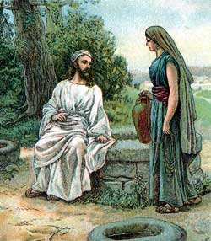
7 A Samaritan woman
was there for water.
Jesus asked her, “Would you
please give me a drink?“
9 Surprised, she said to Jesus,
"You are a Jew, and I am a Samaritan…. and you are asking me for a drink?"
Jesus replied, "If only you knew
who I am and the gift God has for you,
you would be asking ME,
and I would be giving you LIVING water.“

Slide 21
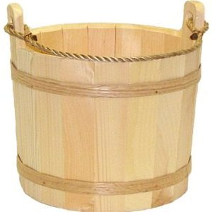
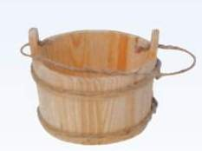
"But, you don't have a bucket,"
she laughed,
"How are you going to get this water?
And are you better than our
grandfather Jacob who gave us this well?
How can you give us better water than he?"
    Jesus replied, “You will soon become thirsty after drinking this water.
14 But the water I give you – you will never thirst again.
It will become a well of
eternal life."

Slide 22
"Please, give me some of
that water,” the woman said,
“And I will never thirst again!"
"Go - get your husband,"
Jesus told her.
"I don't have a husband,“
the woman replied.
"You’re right!” Jesus said, “You don't have
a husband -- You have five husbands,
and you aren't married to the man you
are living with now!"

Slide 23
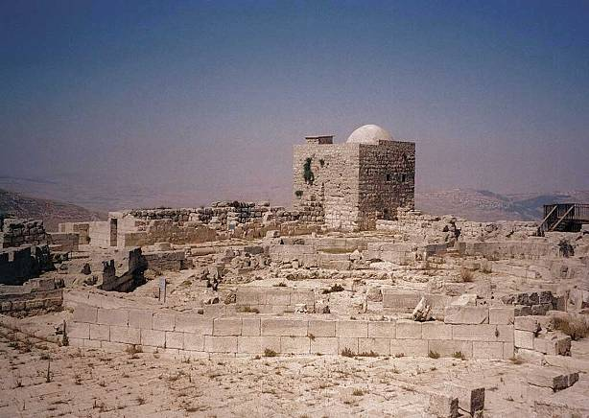
                "You must be a prophet,” she replied.
                “So tell me, why do you Jews insist that Jerusalem is the only place of worship, instead of our mountain here in Samaria?”
21 Jesus replied, "Believe me, it doesn’t
matter where you worship. 23 God is spirit,
and those who worship Him must worship
Him in spirit and in truth. 24 God is looking
for those who will worship Him that way!”

Slide 24
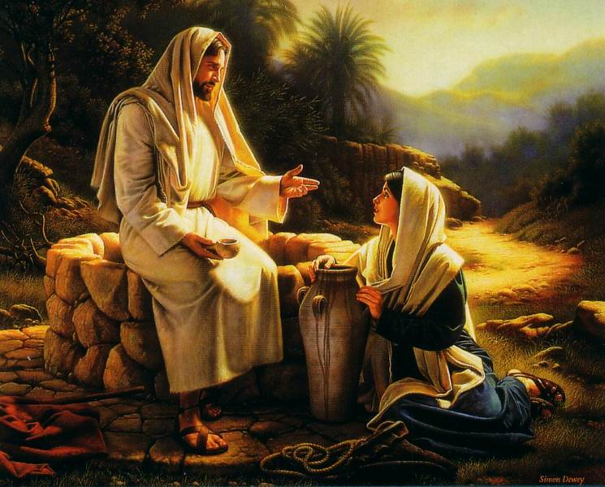
25 The woman replied,
"I know the Messiah will
come - the one who is
called Christ. He will
explain everything
to us then!"
Then Jesus told her,
"I AM the Messiah – the One sent from God!"

Slide 25
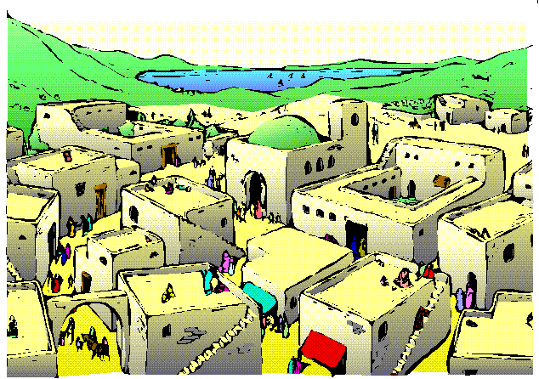
Then the woman left her water pot beside
the well and ran back to her village saying,
"Come and meet a man who
told me everything I ever did!
He is the Messiah –
the Christ !“

Slide 26
Conversations Count
John 4

Slide 27
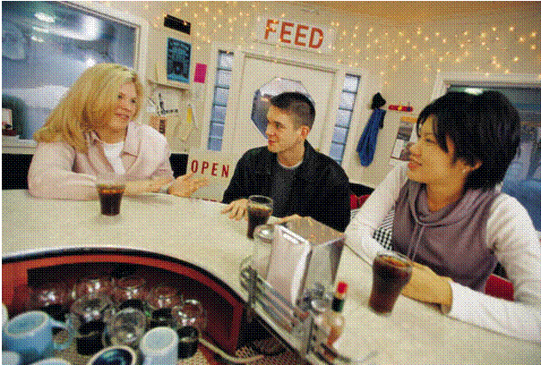
A. Go where people are !
B. Ask for help & opinions !
Jesus came to Sychar, Samaria, the place of
Jacob’s well. 6 Jesus, tired from a long walk,
came to the well at lunch time. 7 A Samaritan
woman was there for water. Jesus asked her,
“Would you please give me a drink?“

Slide 28

Know The Games People Play
John 4

Slide 29
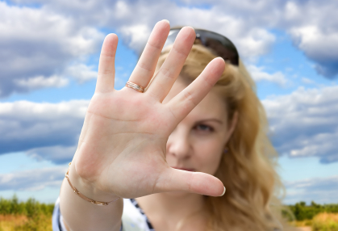
1. The Challenge Game!
(YOU talkin’ to me?)
9 Surprised, she said to Jesus, "You are a Jew…,
and you are asking a Samaritan woman for a drink?"
10 Jesus replied, "If only you knew who I am, and the gift God has for you, you would be asking ME, and I would be giving you LIVING water.“

Slide 30
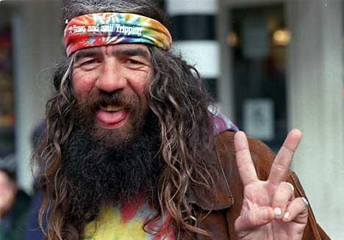
2. The Humor Game !
"But, you don't even have a bucket," she laughed,
"How are you going to get this water?”

Slide 31
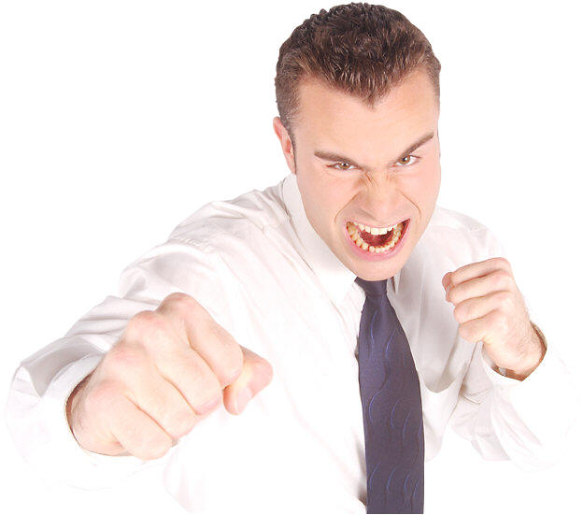
3. The “Better” Game
So you are better than our grandfather Jacob
who gave us this well? How can you give us better
water than what we already have?"
13 Jesus replied,
“You will be thirsty again after drinking this water.
But the water I give you - you will never thirst again.
It will become a well of eternal life."

Slide 32
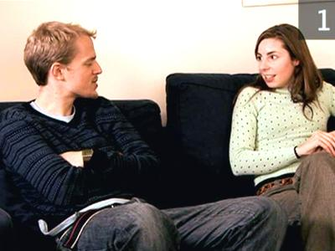
* Watch for the first sign of interest !
"Please, sir, give me some of that
water!” And I will never thirst again!"

Slide 33

4. The Denial Game
(But, I don’t have a husband!)
16 "Go - get your husband," Jesus told her.
17 "I don't have a husband,“ the woman replied.
"You’re right!” Jesus said, “You don't have a
husband -- You have five husbands, and you
aren't married to the man you are living with now!"

Slide 34

5. The Flattery Game
                19 "You must be a
                prophet,” she said.

Slide 35
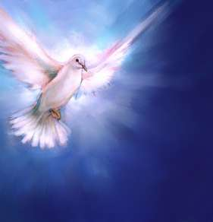
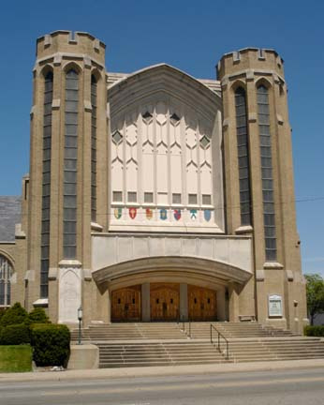
6. The “Right Way” Game
20 So tell me, why do you Jews
think that Jerusalem is the only
place of worship, and not our
mountain here in Samaria?
21 Jesus replied, "Believe me,
it doesn’t matter where you
worship. God is spirit, and
those who worship Him must
worship Him in spirit and in truth.
God is looking for those who
will worship Him that way!”

Slide 36
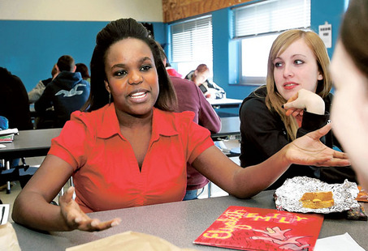
7. The Delay Game
The woman replied, “When the Messiah comes - He will explain everything to us.
I’ll wait till then!”
26 Then Jesus told her,
“I AM the Messiah – the One sent from God!”

Slide 37
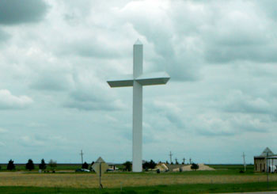
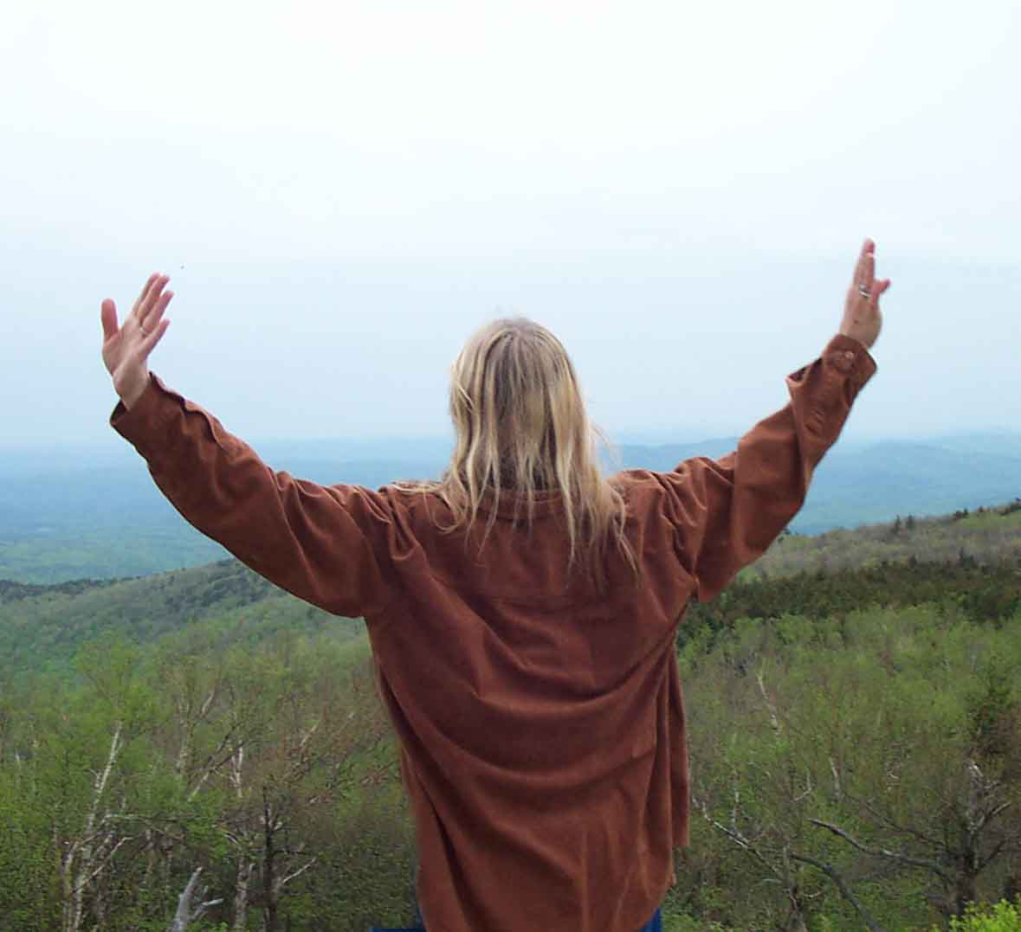
*** Be there when they decide!
Then the woman left her water pot beside
the well and ran back to her village saying,
"Come and meet a man
who told me everything I ever did!
He is the Messiah – the Christ !“

Slide 38
Conversations Count
John 4

Slide 39
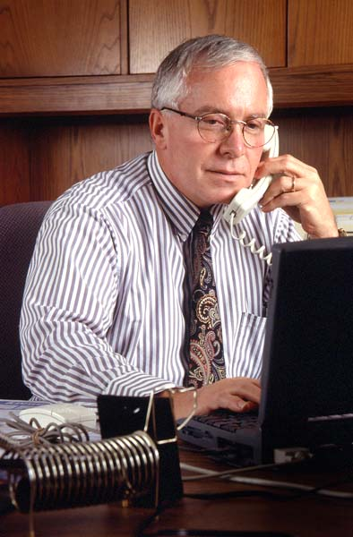
                “I’m not into religion.”
                Dick

Slide 40
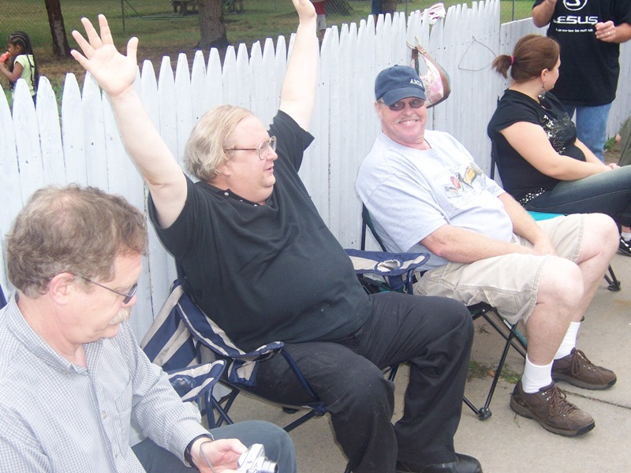
                “I’m going
                with you!”
                Mike

Slide 41
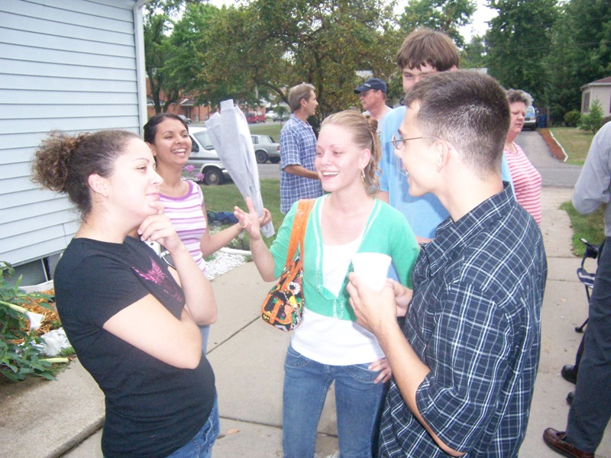
                Your eyes
                didn’t
                condemn
                me!”
                Felicia

Slide 42
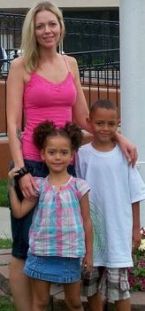
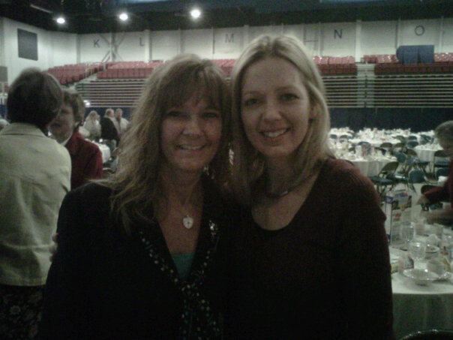
                “You helped
                save my life!”
                Erica

Slide 43
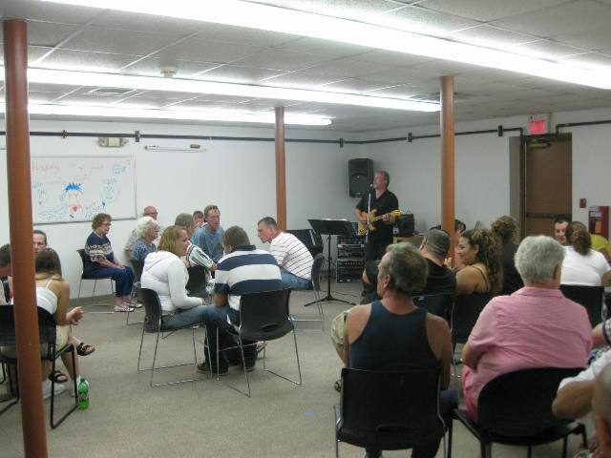
                All I wants to do is go
                fishin’ with someone who
                don’t do dem things!”

Slide 44

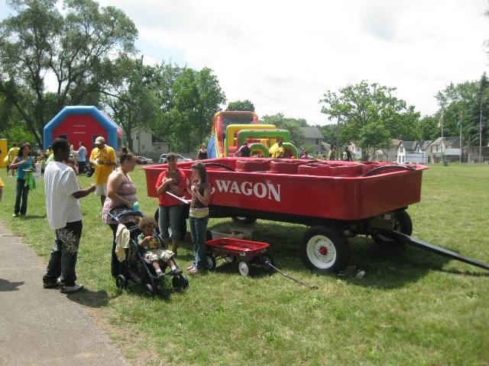
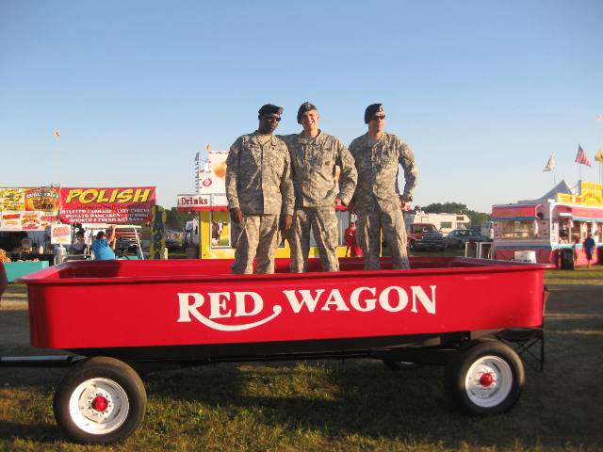
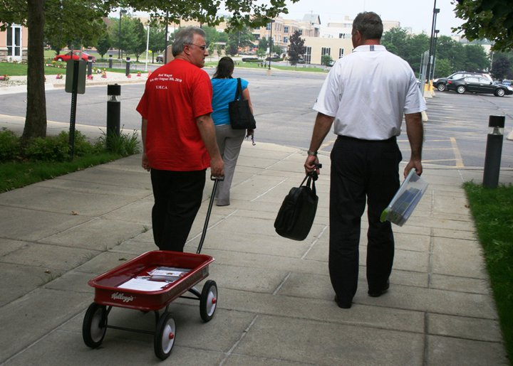
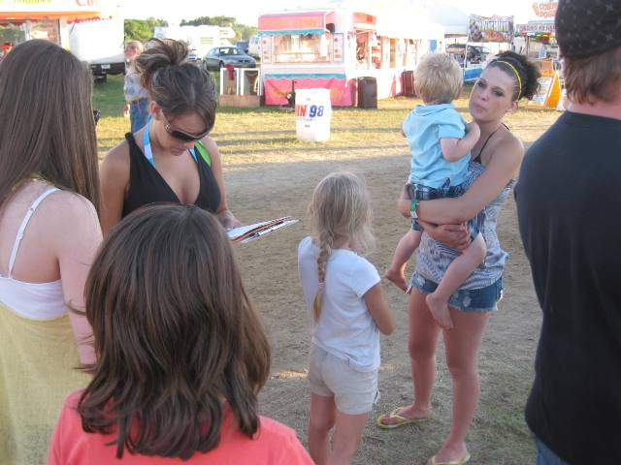
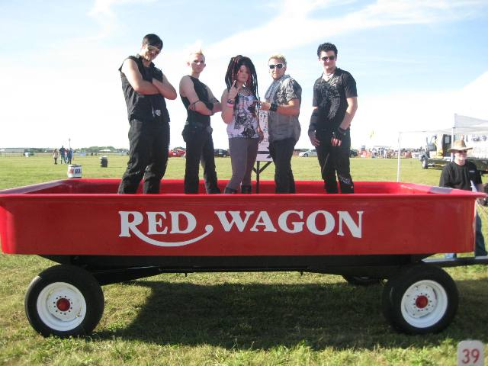

Slide 45


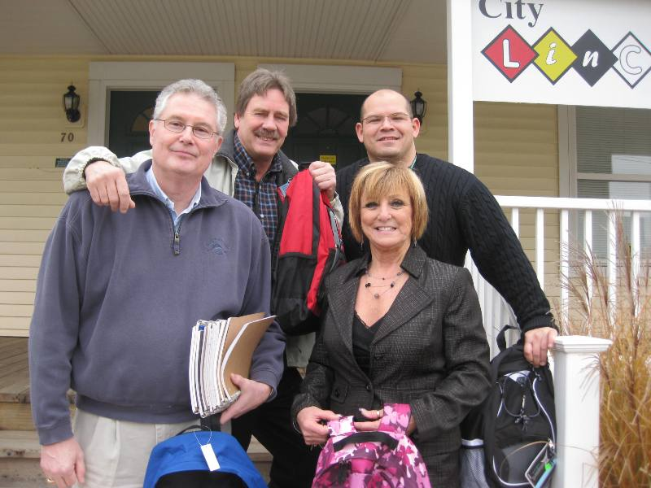
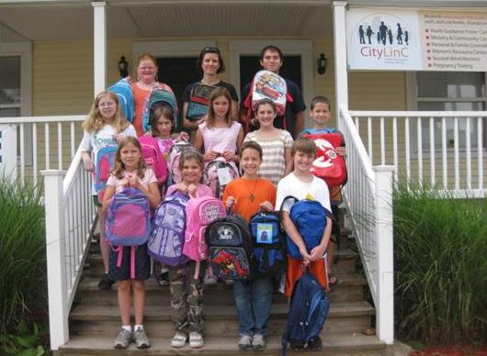

Slide 46

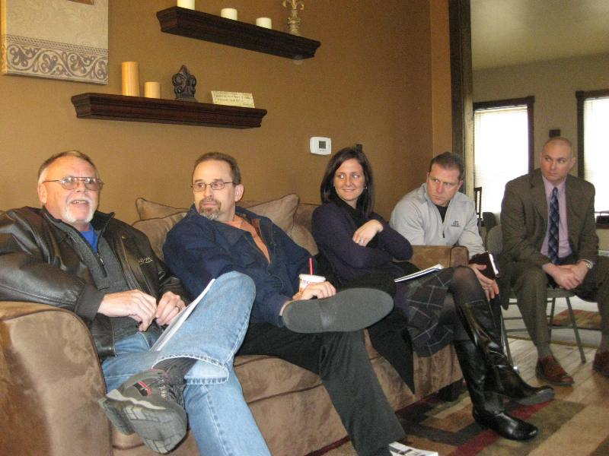



Slide 47





Slide 48



Slide 49
Conversations Count
  I will befriend three people.
I will keep regular contact.
I will pray for them.
I will serve them.
ME

