Slide 1
North Athens Baptist Church
Sunday, September 16, 2012

Slide 2
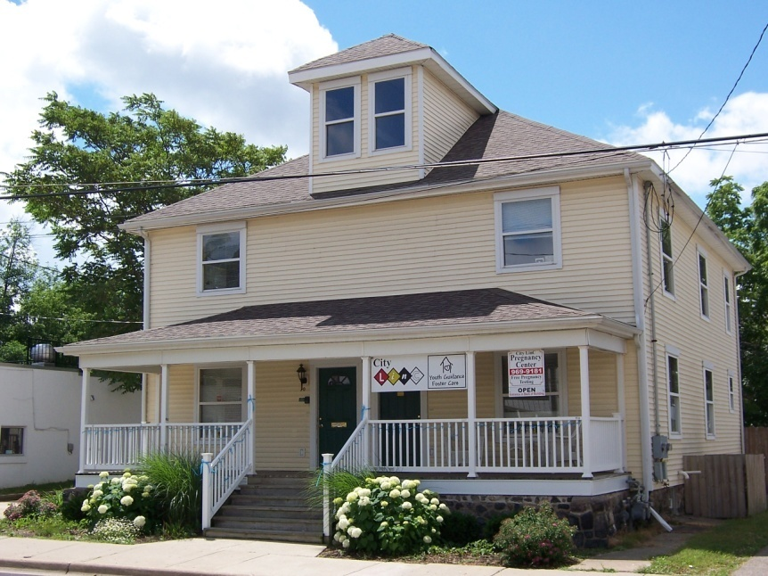
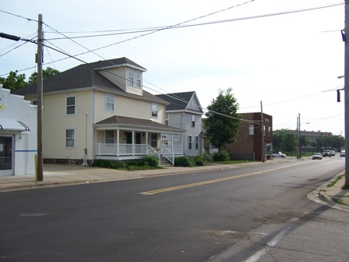

Slide 3
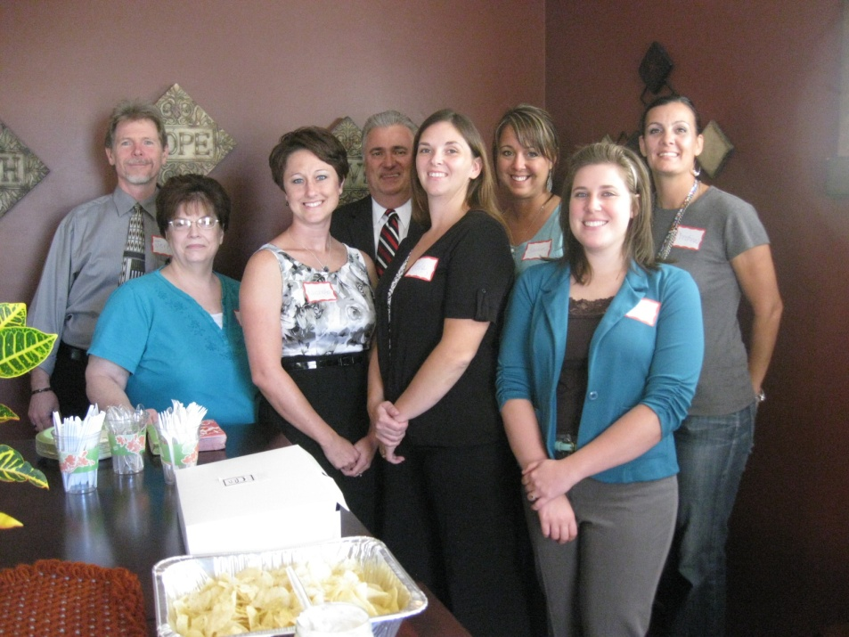
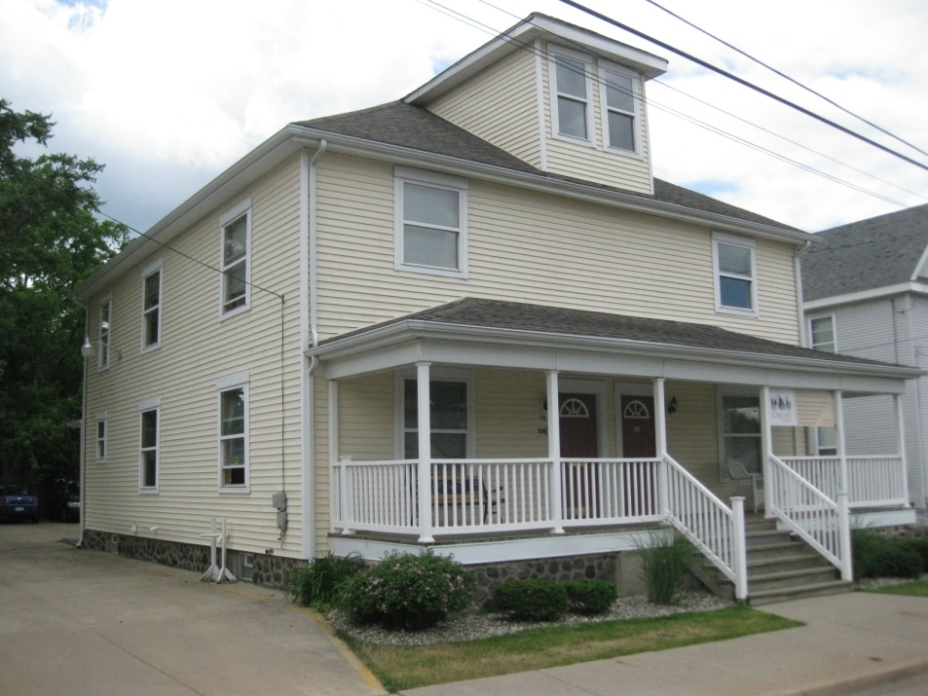
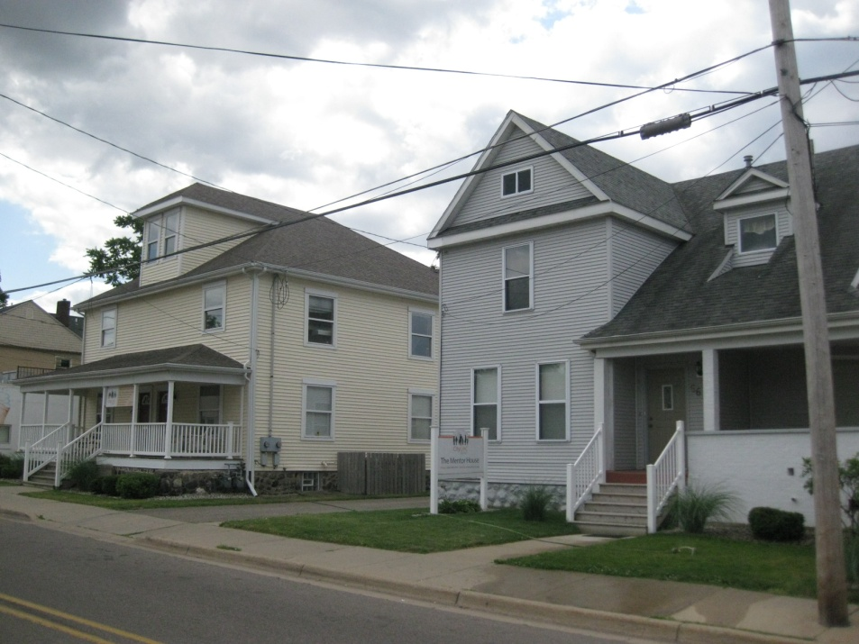
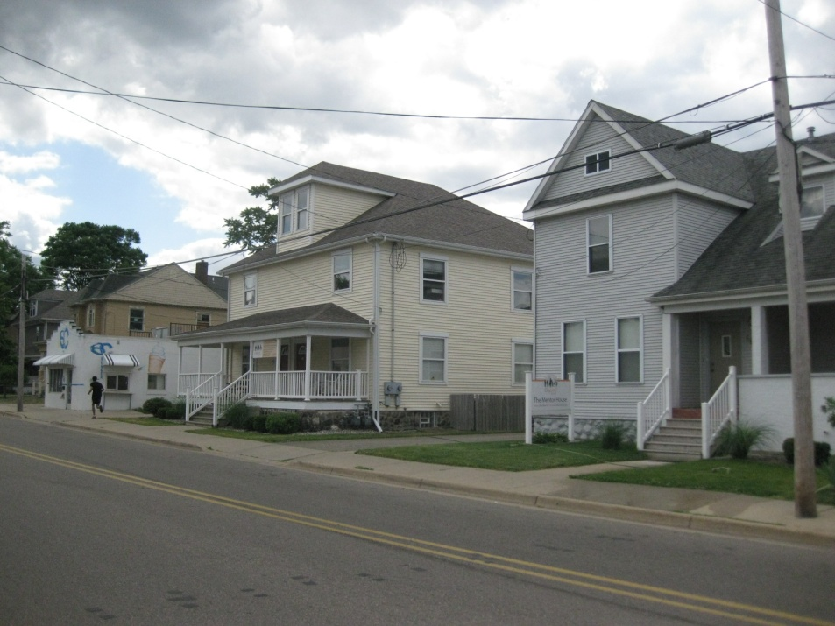
2008
2010
2012

Slide 4
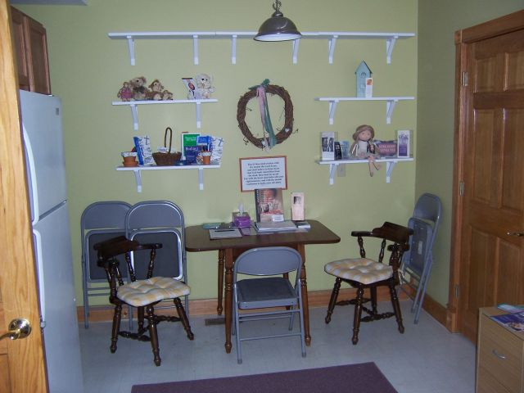
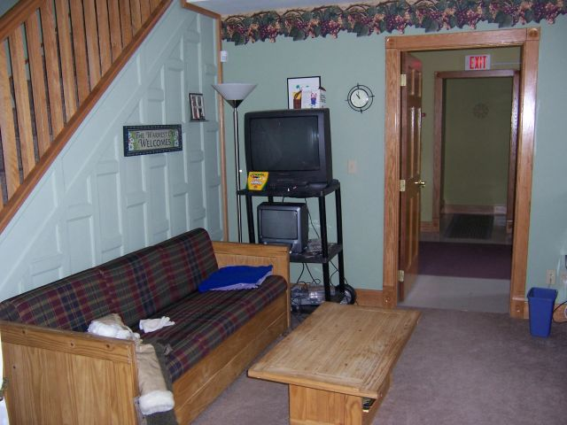
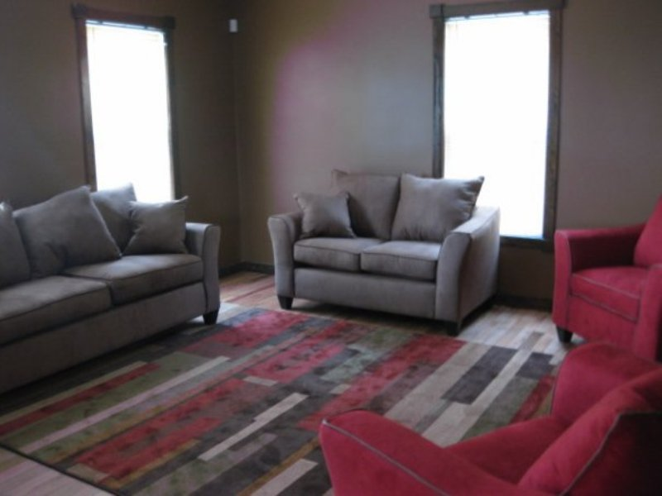
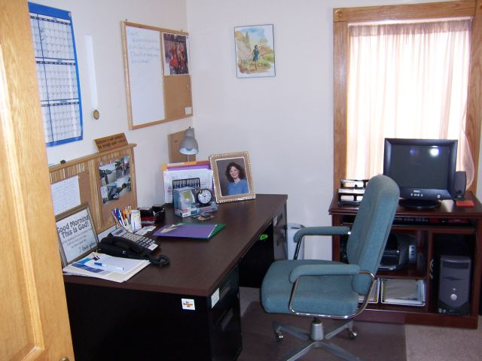

Slide 5

Our Mission
We Connect
1. Children and Youth to Loving Families
2. Families to Secure Futures
3. Individuals to Caring Community, and
4. Community to Personal Faith
Our Ministries
Foster Care & Adoption
Women’s Resource Center
Pathways Counseling
Red Wagon Partners
Stuff-A-Bus Campaign
Second Wind Mentors
Ministry Network

Slide 6
Our Vision
We will:
1. Focus on Children and Youth
who are high-risk
2. Fortify Families
who need additional resources
3. Free Individuals to experience
their God-given potential
4. Facilitate Community
where separation exists
5. Foster Faith where there is no hope

Slide 7

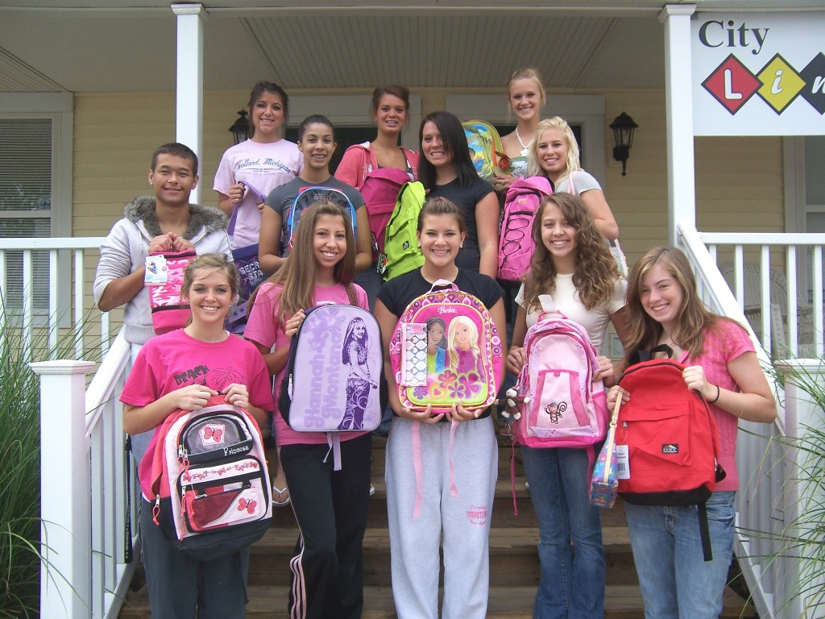
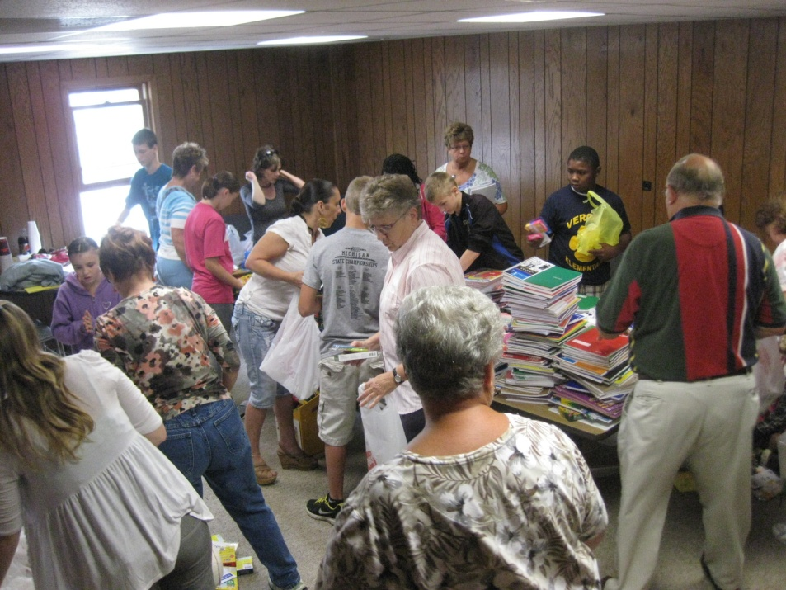
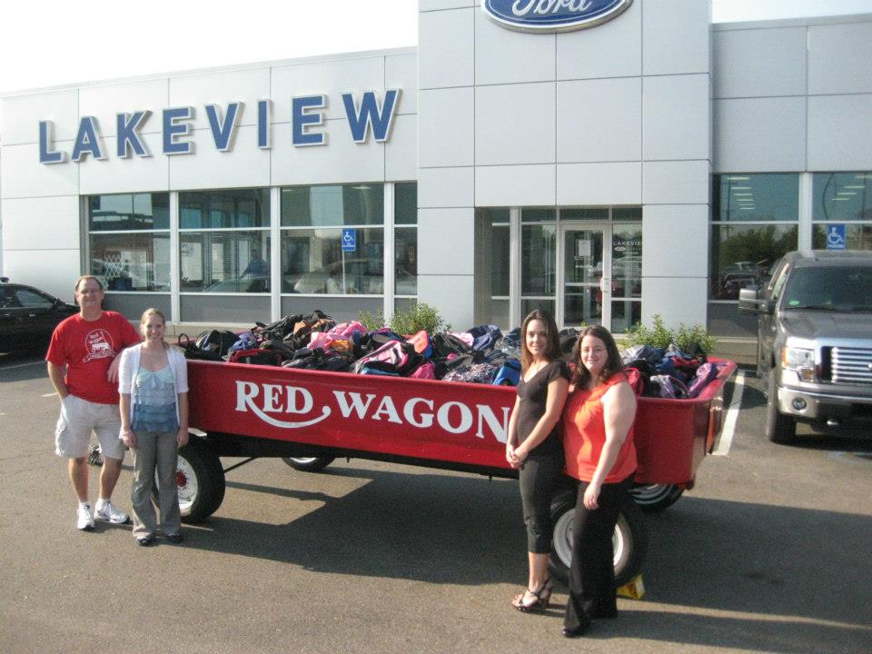

Slide 8

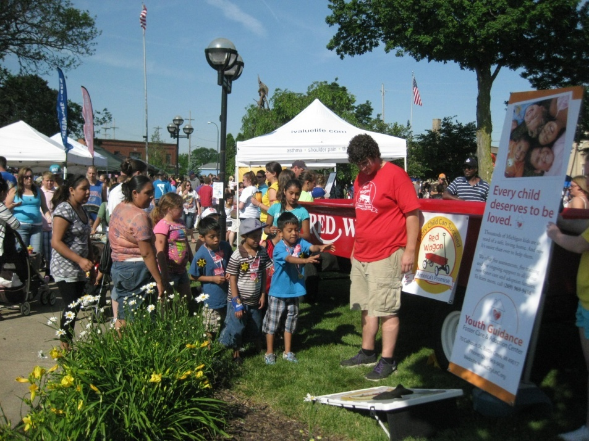
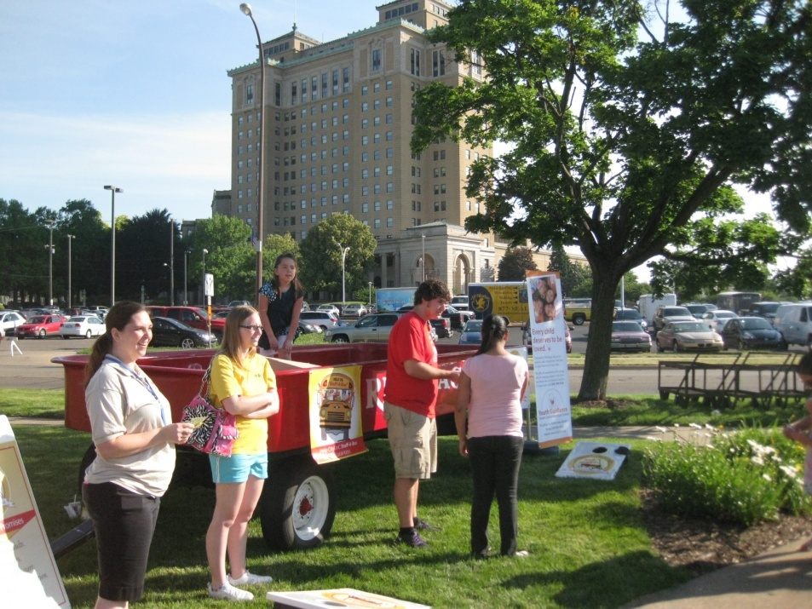
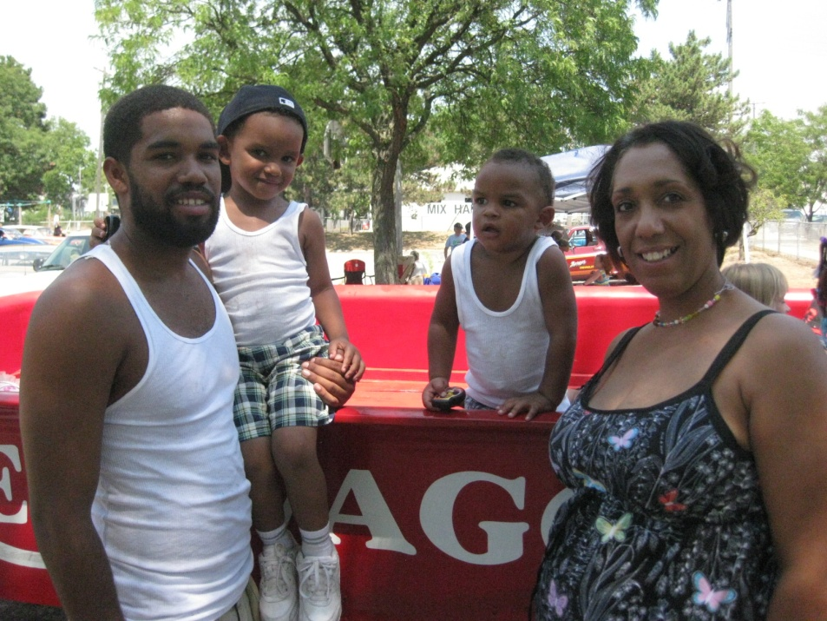

Slide 9

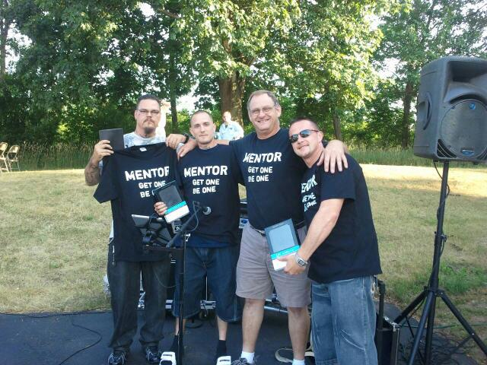
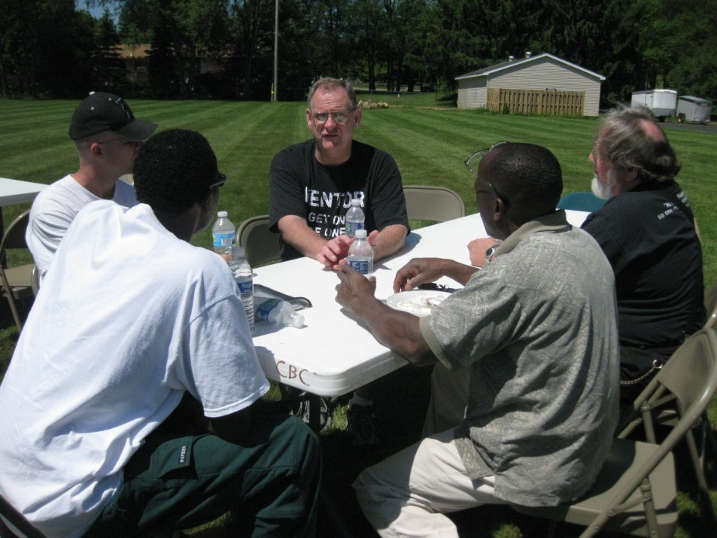
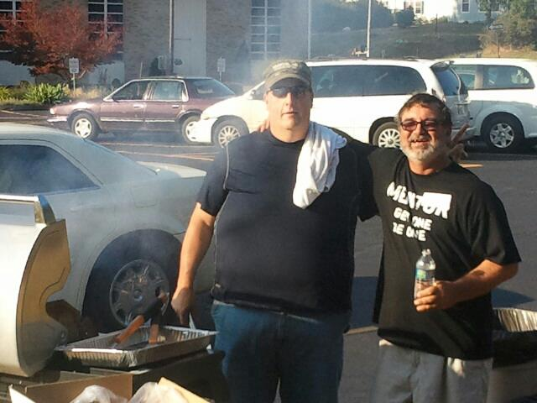

Slide 10
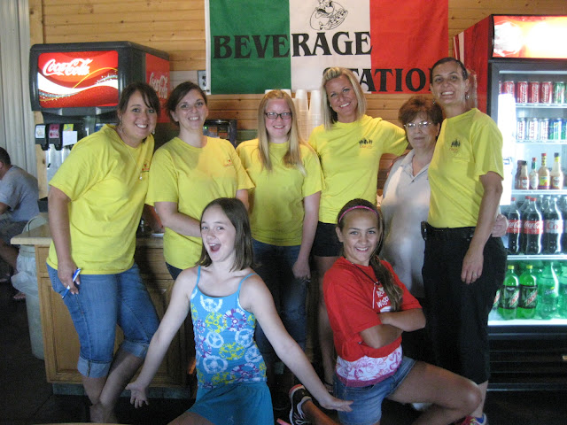
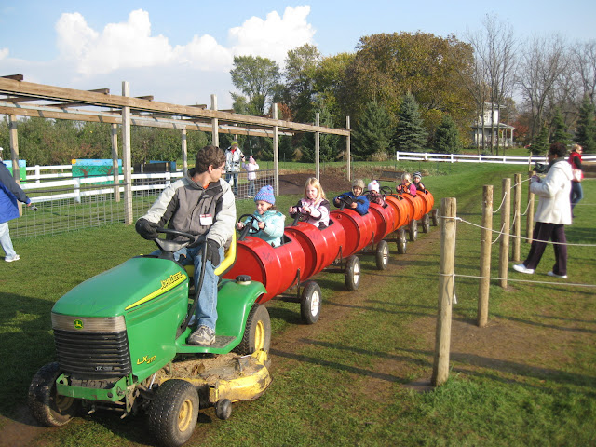

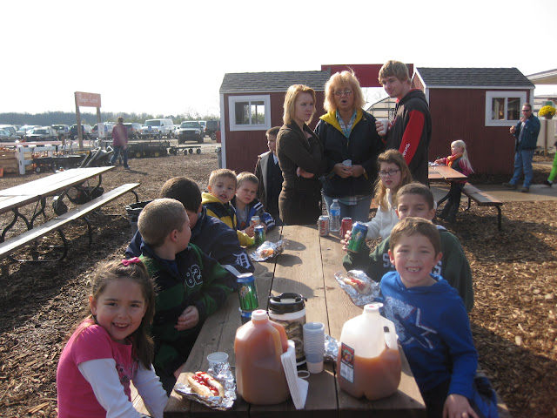
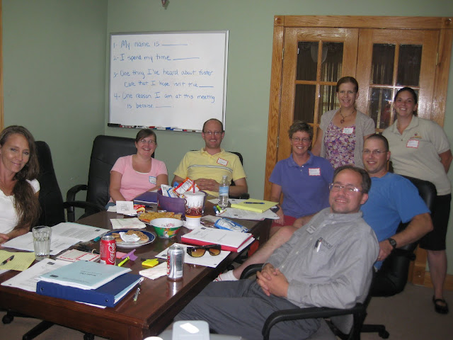
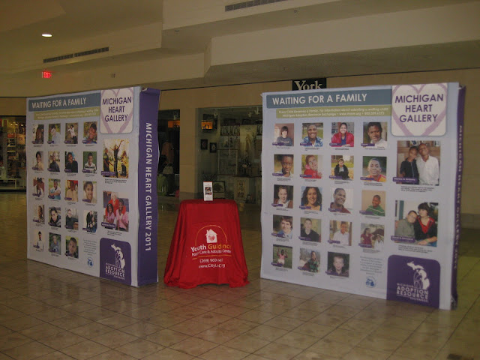

Slide 11
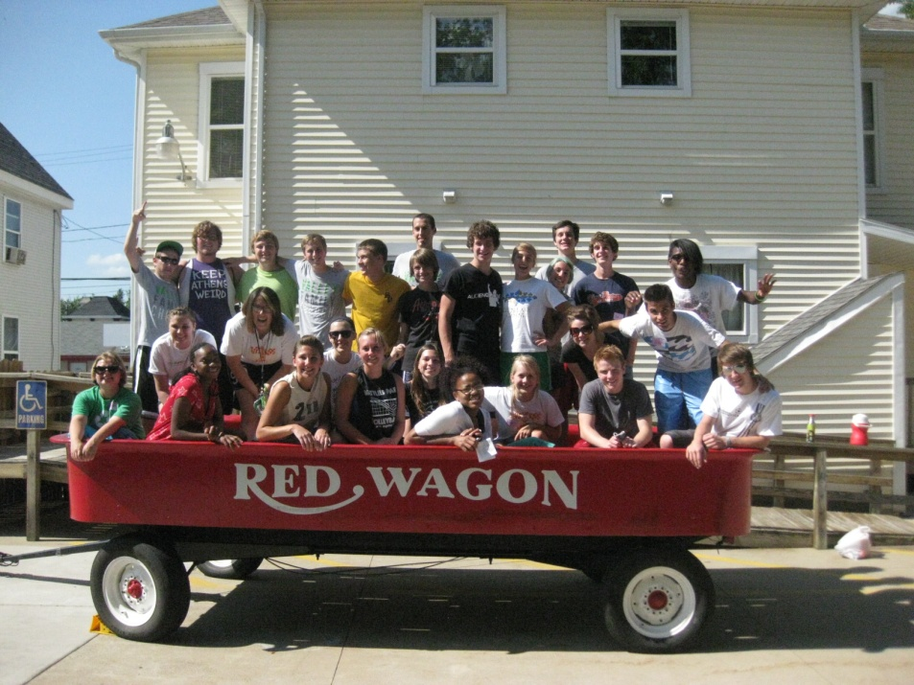
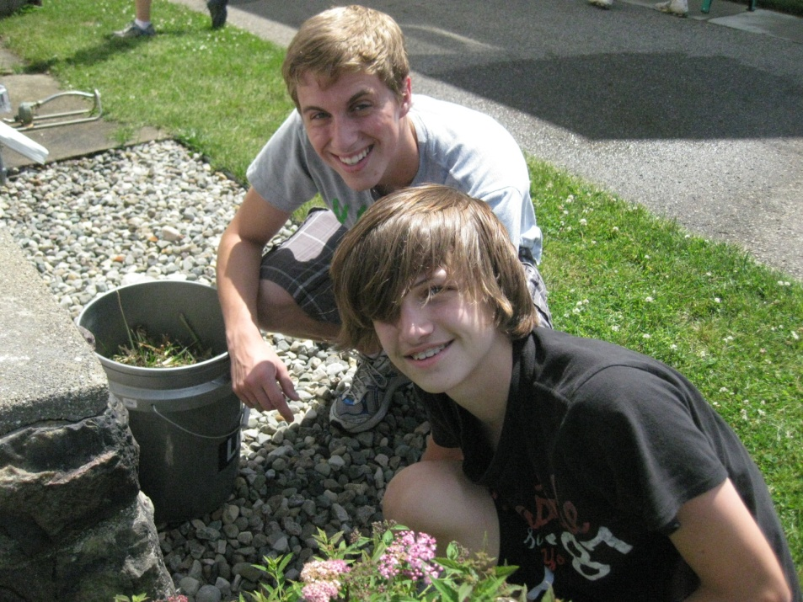
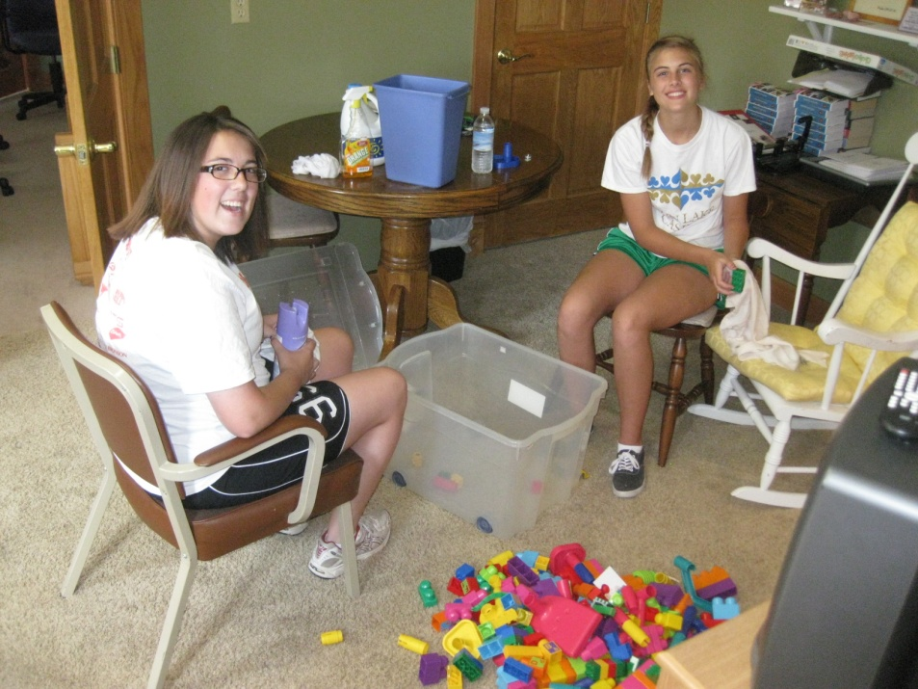
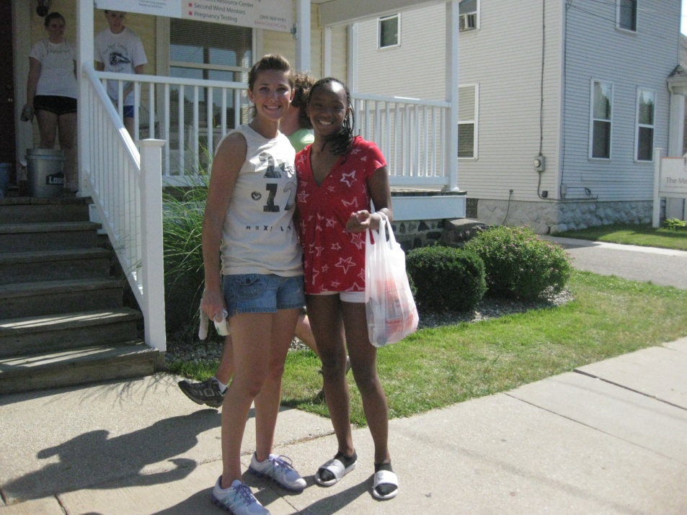

Slide 12

Conversations Count
John 4

Slide 13
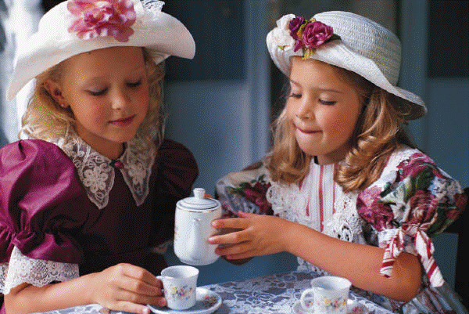

Slide 14
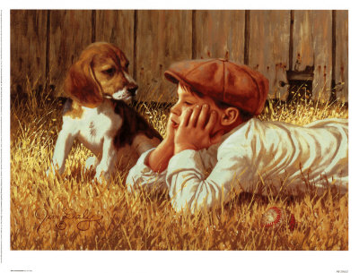

Slide 15
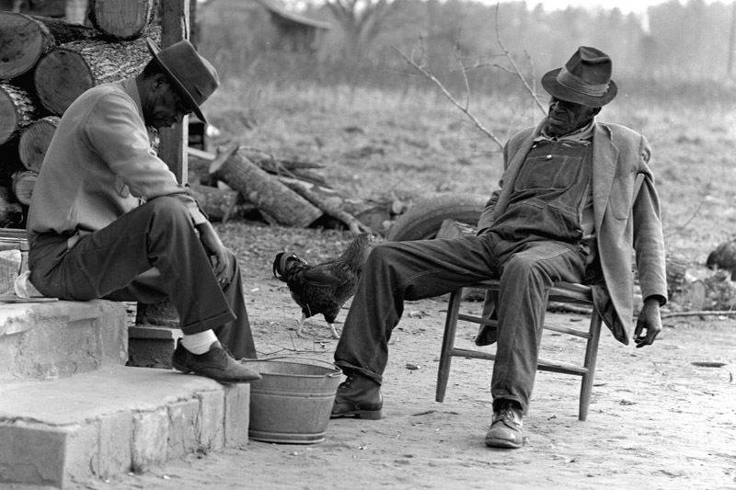

Slide 16


Slide 17
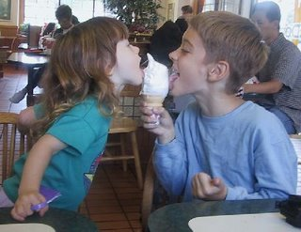

Slide 18
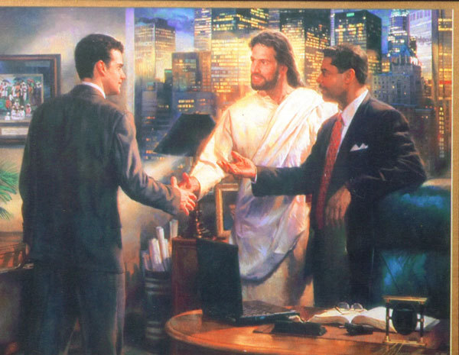

Slide 19
A wise pastor
said to me:
“We should
stop counting conversions
and start counting more conversations!”

Slide 20
Conversations Count
John 4

Slide 21
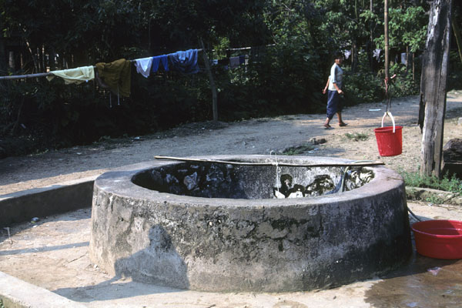
John 4
Jesus came to Sychar, Samaria,
6 Tired from the long walk, he came
to Jacob’s Well at lunch time.

Slide 22
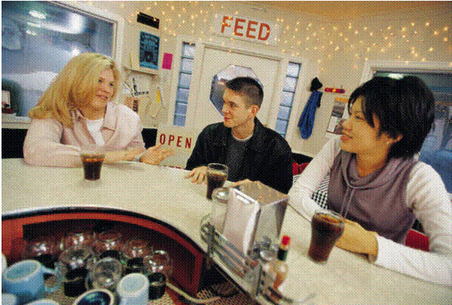
7 A Samaritan woman was there for water.
Jesus asked her,
“May I please have a drink?“

Slide 23

1. The Hard Shell Response !
9 Surprised, she replied,
“You are asking me for a drink?
You are a Jew, and I am a Samaritan…."
Jesus said, "If only you knew the gift God has for you, you would be asking ME, and I would give you LIVING water.”

Slide 24
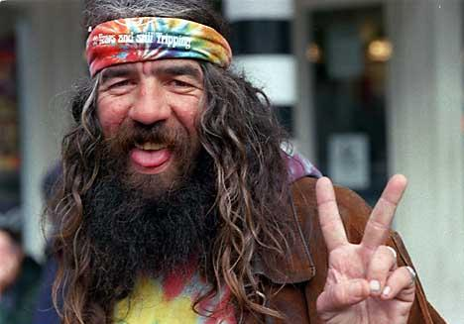
2. The Humor Game !
"But, you don't have a bucket," she laughed,
"How are you going to get this water?”

Slide 25

And Who Do You
Think You Are?
Do you think you are better than our grandfather Jacob who dug this well?
13 Jesus replied, “You will become thirsty after drinking this water. 14 But the water I give you – you will never thirst again.
It will become a well of eternal life.“

Slide 26
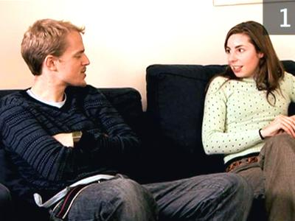
4. The Surface Response Game
    15 "Please, sir, give me some of that water!” So I will never thirst again!"

Slide 27

5. The Denial Game
16 “Go - get your husband, Jesus told her.
"I don't have a husband,“ the woman replied.
"You’re right!” Jesus said, “You don't have
a husband -- You have five husbands,
and you aren't married to the man you
are living with now!"

Slide 28

6. The Flattery Game
                19 "You must be a
                prophet,” she said.

Slide 29
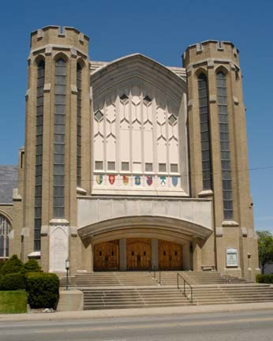
7. The “Right Religion” Game
                So tell me, why do you insist that Jerusalem is the only place of worship, and not our mountain here in Samaria?”
21 Jesus replied, "Believe me, it doesn’t matter where you worship. 23 God is spirit,
and those who worship Him must worship Him in spirit and in truth.”

Slide 30
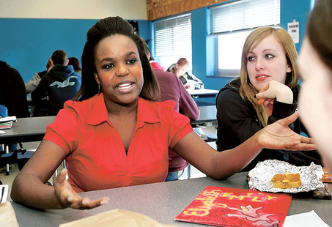
8. The “Later” Game
The woman replied, “When the Messiah comes - He will explain everything to us.
I’ll wait till then!”
26 Then Jesus told her,
“I AM the Messiah – the One sent from God!”

Slide 31
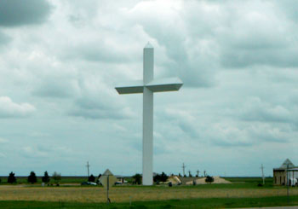

Decision Time !
Then the woman ran back to her family saying, "Come and meet a man who told me everything I ever did!
He is the Messiah – the Christ !“

Slide 32
Conversations Count
John 4

Slide 33
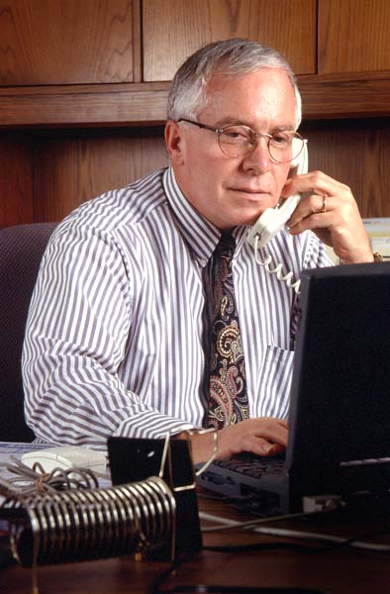
                “I’m not
                into
                religion.”
                Sam

Slide 34
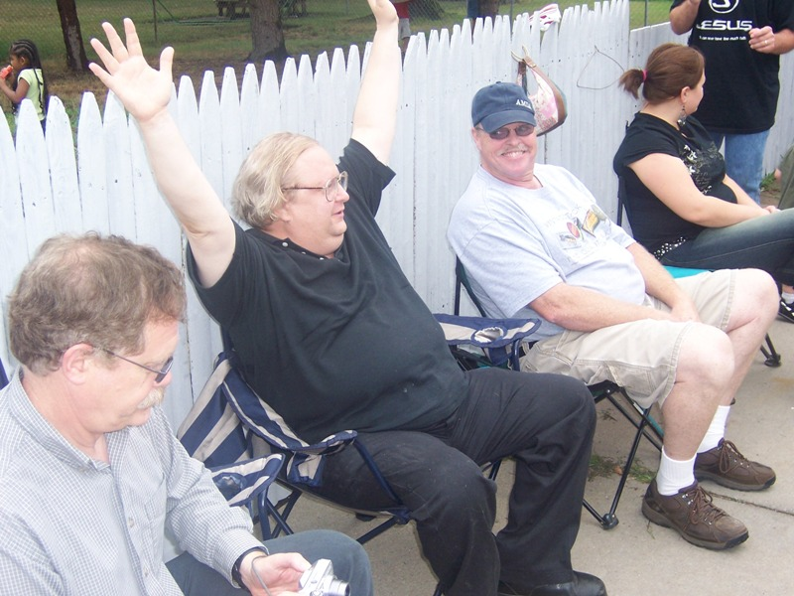
                “I’m
                going with
                you!”
                Mike

Slide 35
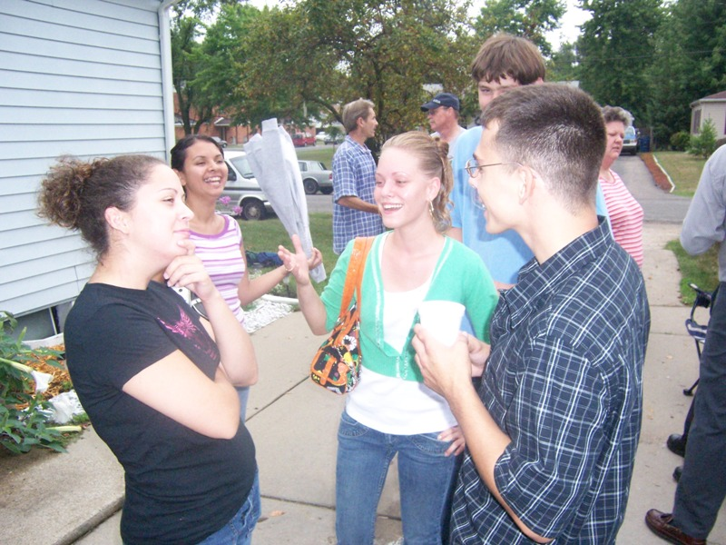
                Your eyes
                didn’t
                condemn
                me!”
                Felicia

Slide 36
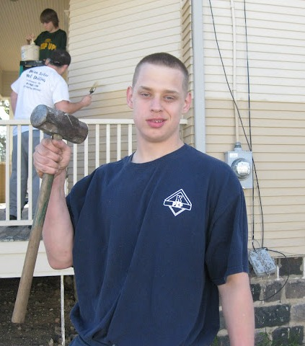
                “All I want
                to do is go
                fishin’ with
                someone who
                don’t do dem things!”
                Anthony

Slide 37
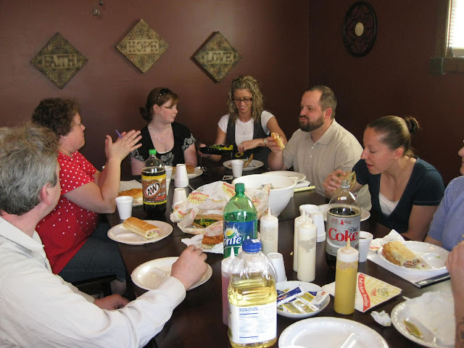
                “I would be a Christian...
                …but I’ve been reincarnated!”

Slide 38
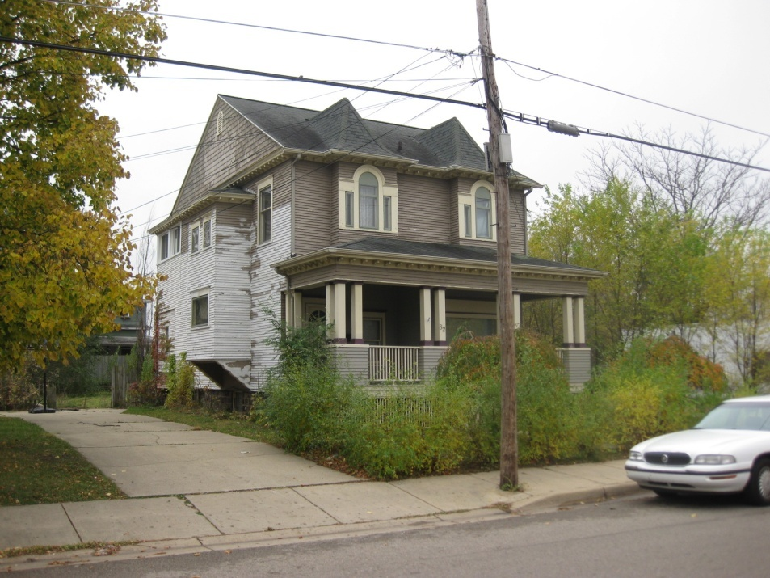
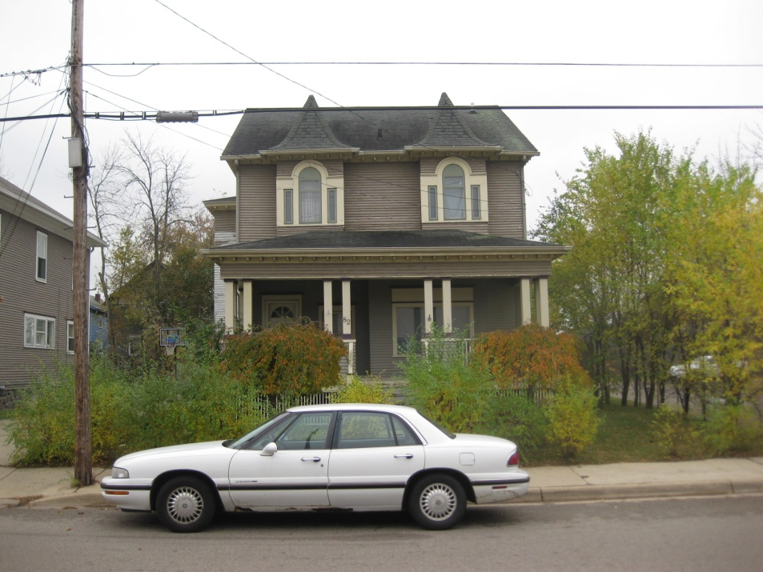
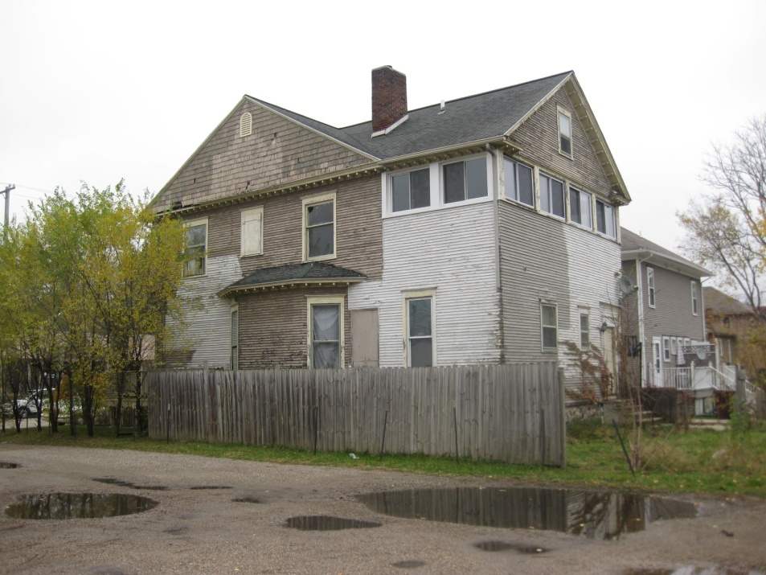
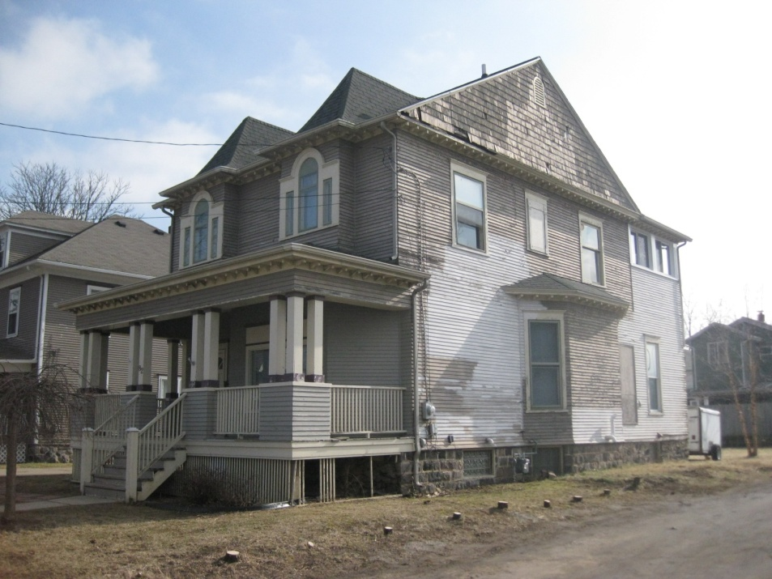

Slide 39
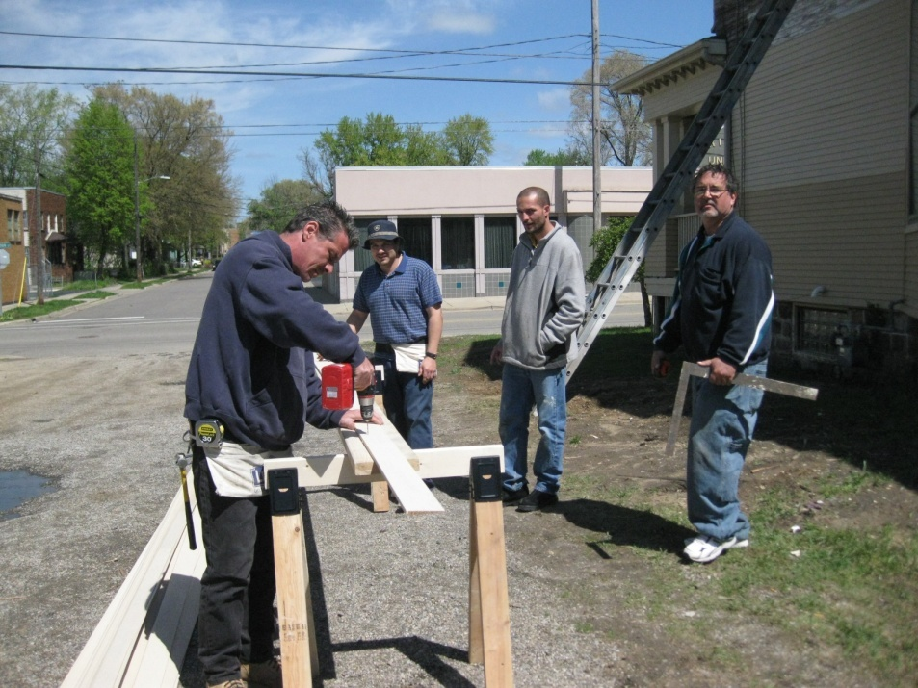




Slide 40





Slide 41









Slide 42






Slide 43



Slide 44
Conversations Count
  I will choose three friends.
I will keep in contact.
I will pray for them.
I will serve them.
ME

