Slide 1
Hastings Assembly of God
Sunday, January 30, 2011

Slide 2

Conversations Count
John 4

Slide 3
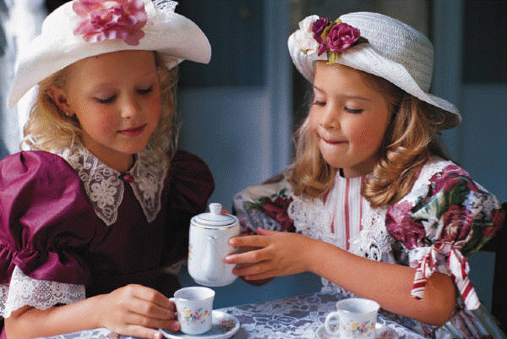

Slide 4
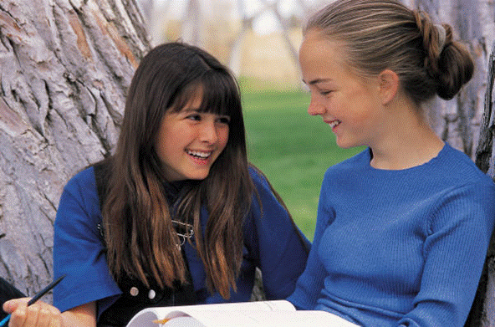

Slide 5
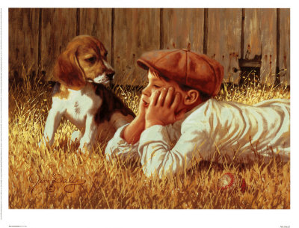

Slide 6
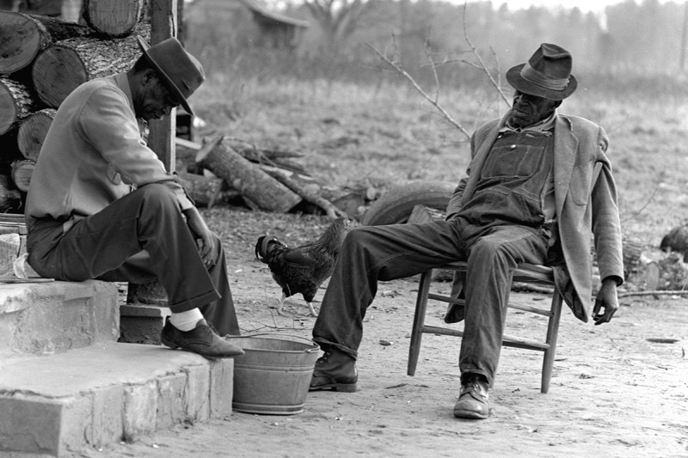

Slide 7
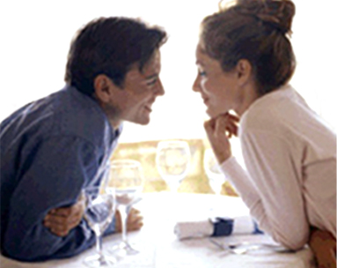

Slide 8
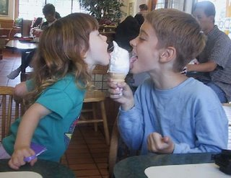

Slide 9
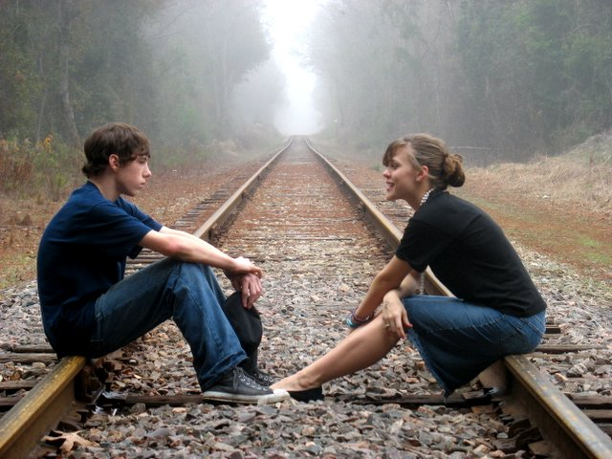

Slide 10
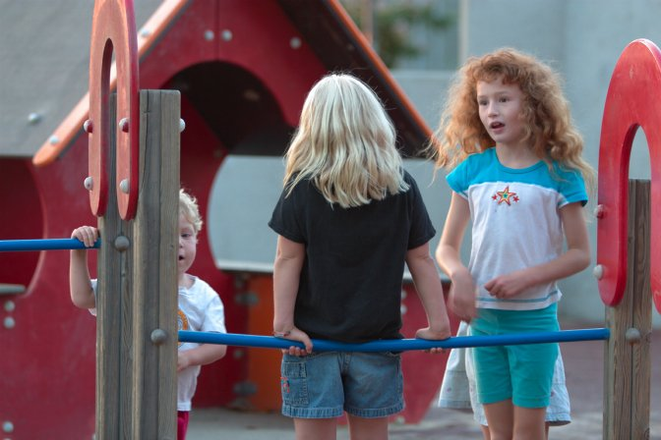

Slide 11
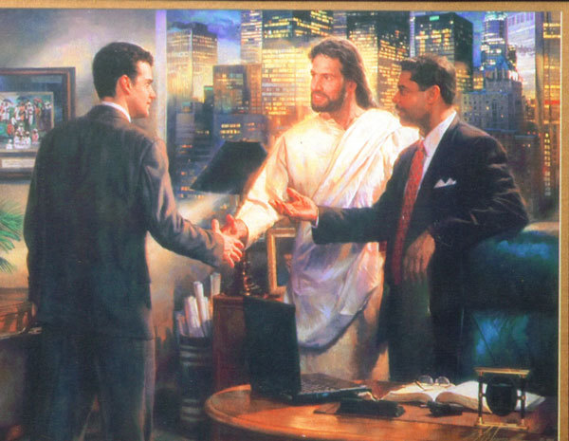

Slide 12
A wise pastor
said to me:
“We should
stop counting conversions
and start counting more conversations!”

Slide 13
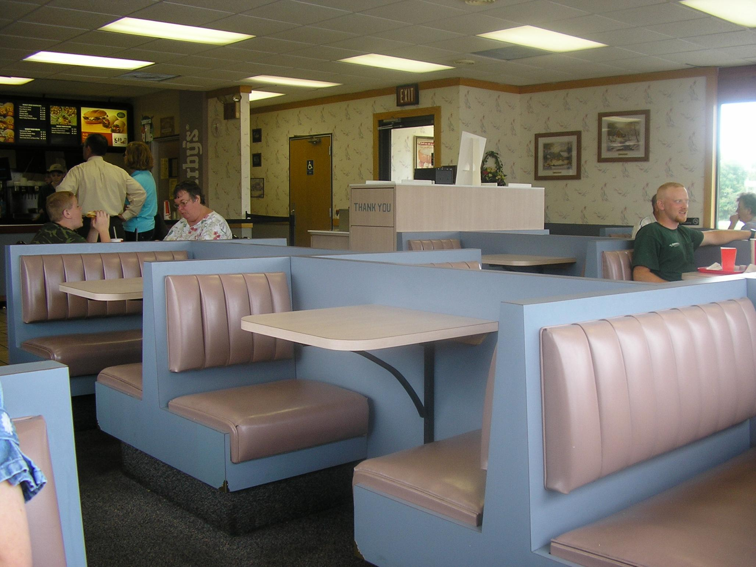

Slide 14
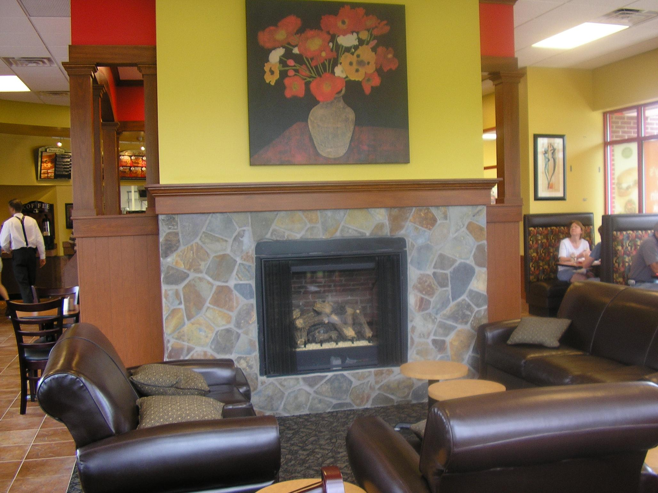

Slide 15
Conversations Count
John 4

Slide 16
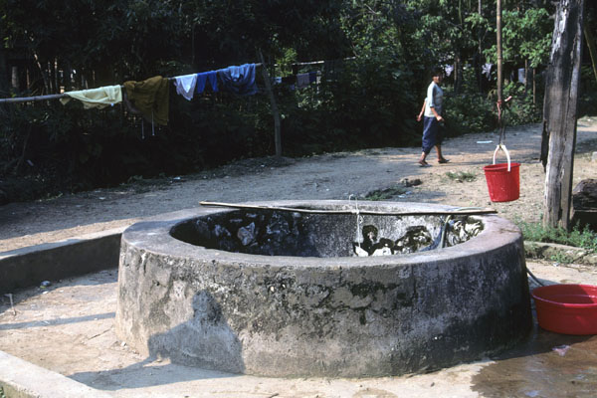
John chapter 4
Jesus came to Sychar, Samaria,
the place of Jacob’s well.
6 Jesus, tired from a long walk,
came to the well at lunch time.

Slide 17
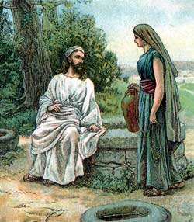
7 A Samaritan woman
was there for water.
Jesus asked her, “Would you
please give me a drink?“
9 Surprised, she said to Jesus,
"You are a Jew, and I am a Samaritan…. and you are asking me for a drink?"
Jesus replied, "If only you knew
who I am and the gift God has for you,
you would be asking ME,
and I would be giving you LIVING water.“

Slide 18
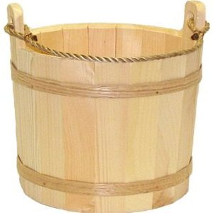
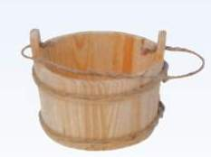
"But, you don't have a bucket,"
she laughed,
"How are you going to get this water?
Are you better than our
grandfather Jacob who gave us this well?
How can you give us better water than he?"
    Jesus replied, “You will soon become thirsty after drinking this water.
14 But the water I give you – you will never thirst again.
It will become a well of
eternal life."

Slide 19
"Please, give me some of
that water,” the woman said,
“And I will never thirst again!"
"Go - get your husband,"
Jesus told her.
"I don't have a husband,“
the woman replied.
"You’re right!” Jesus said, “You don't have
a husband -- You have five husbands,
and you aren't married to the man you
are living with now!"

Slide 20
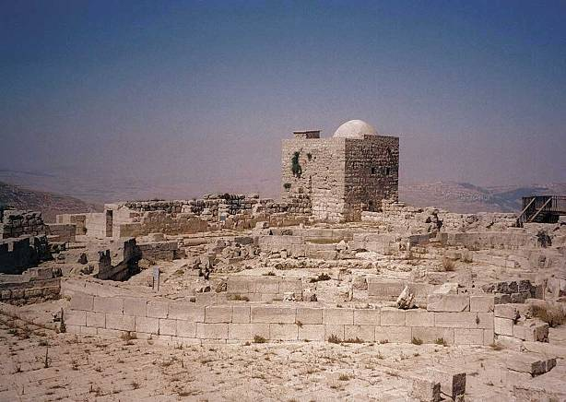
                "You must be a prophet,” she replied.
                “So tell me, why do you Jews insist that Jerusalem is the only place of worship, instead of our mountain here in Samaria?”
21 Jesus replied, "Believe me, it doesn’t
matter where you worship. 23 God is spirit,
and those who worship Him must worship
Him in spirit and in truth. 24 God is looking
for those who will worship Him that way!”

Slide 21
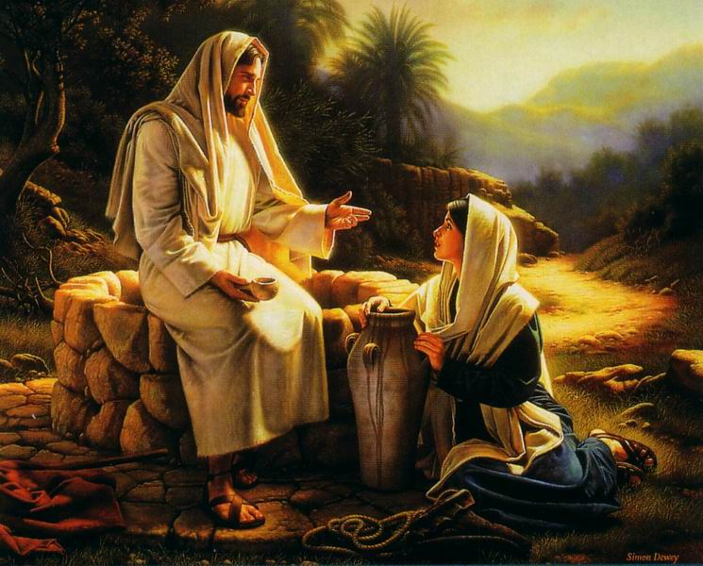
25 The woman replied,
"I know the Messiah will
come - the one who is
called Christ. He will
explain everything
to us then!"
Then Jesus told her,
"I AM the Messiah – the One sent from God!"

Slide 22
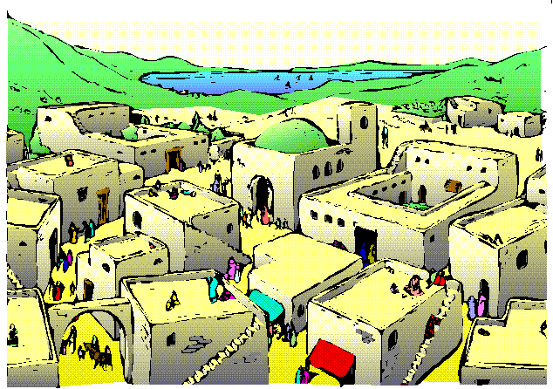
Then the woman left her water pot beside
the well and ran back to her village saying,
"Come and meet a man who
told me everything I ever did!
He is the Messiah –
the Christ !“

Slide 23
Conversations Count
John 4

Slide 24
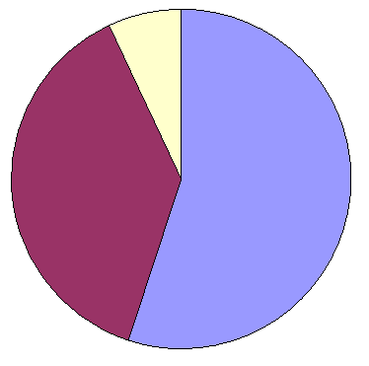
Conversations Count !
Words
7%
Tone of Voice
38%
Body Language
55%

Slide 25

Conversations Count !
Words
7%
Words
7%
Tone of Voice
38%
FaceBook !
Body Language
55%

Slide 26
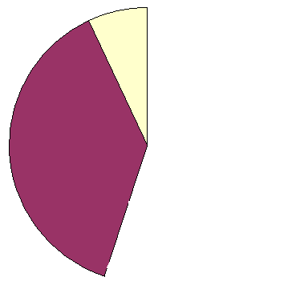
Conversations Count !
Words
7%
Tone of Voice
38%
Cell phone !

Slide 27
Conversations Count !
Words
7%
Conversation !
Tone of Voice
38%
Body Language
55%

Slide 28
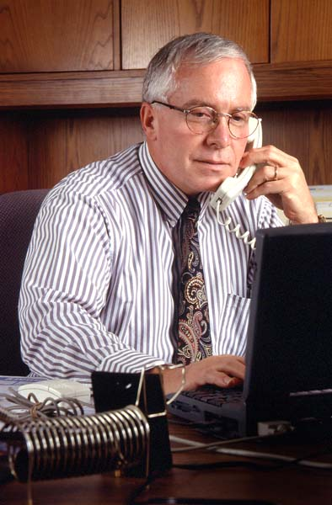
                “I’m not into religion.”
                Dick

Slide 29
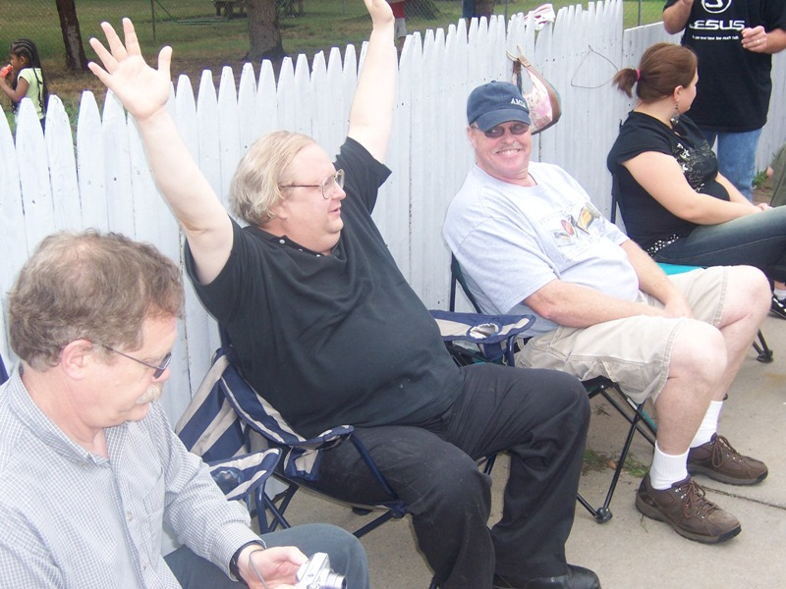
                “I’m going
                with you!”
                Mike

Slide 30
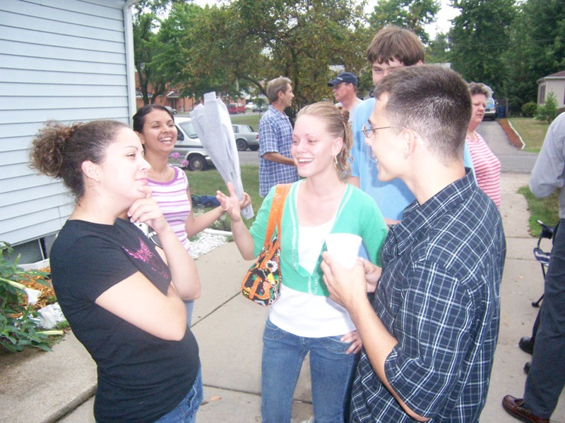
                Your eyes
                didn’t
                condemn
                me!”
                Felicia

Slide 31
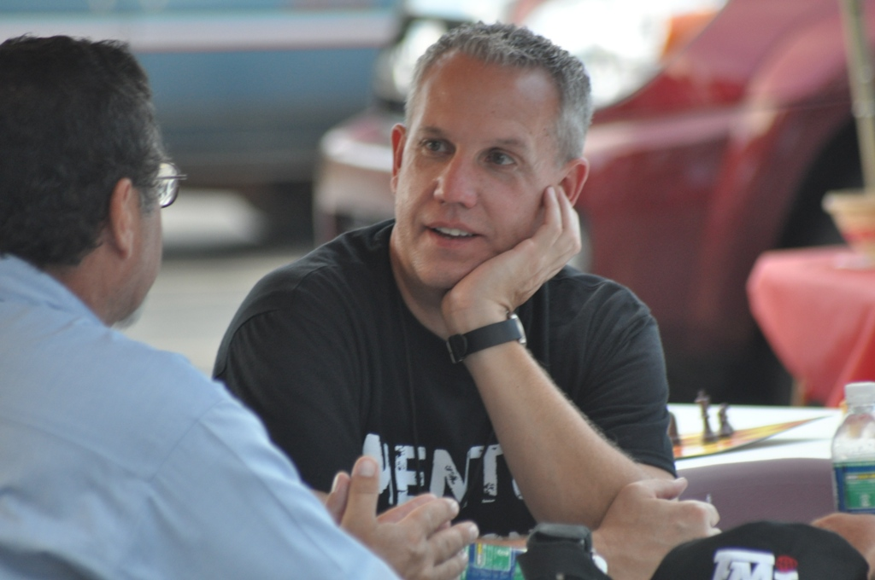
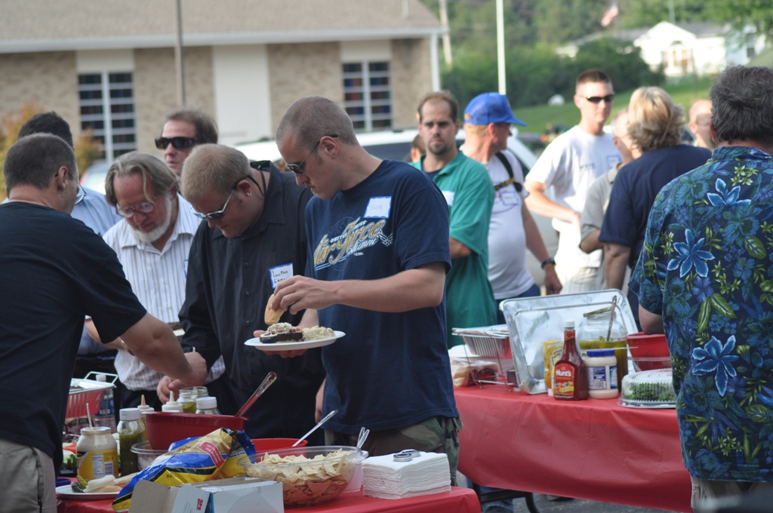
                “All I want
                to do is go
                fishin’ with
                someone who
                don’t do dem things!”

Slide 32
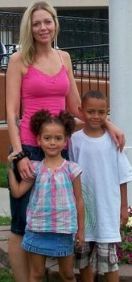
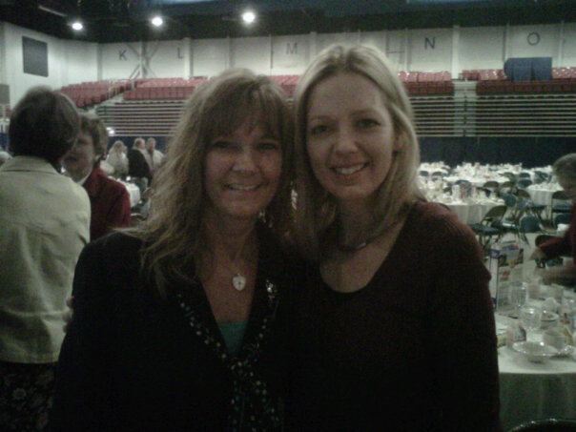
                “You helped
                save my life!”
                Erica

Slide 33
Conversations Count
  I will befriend three people.
I will keep regular contact.
I will pray for them.
I will serve them.
ME

