Slide 1
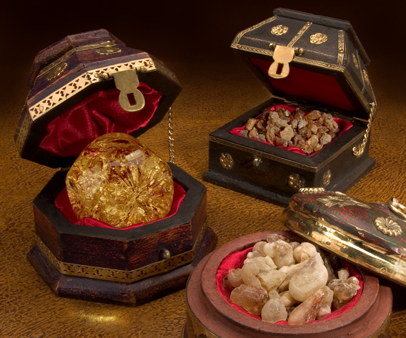
Three Gifts You Can Give To God

Slide 2

Christmas IQ Test
True of False ?
1. Caesar Augustus made a decree
that all the world should be taxed.
2. Joseph went to Bethlehem “to be taxed with
Mary, his espoused wife, upon a donkey,
being great with child.”
Jesus was born in a manger
among cows and sheep.

Slide 3
4. Shepherds heard the angels sing,
“Glory to God in the highest and on
earth, peace, goodwill toward men”
Three wise men brought gifts:
gold, frankincense, and myrrh.
6. The Bible says that the wise men were
“Kings from the east who came to
Jerusalem saying, “Where is he
that is born King of the Jews?”
7. The wise men followed the star to
Jerusalem and then to Bethlehem.

Slide 4
8. The wise men found baby Jesus, “wrapped
in swaddling clothes, laying in a manger.”
9. The wise did not return to Herod because
Joseph told them that God had warned him
in a dream to flee to Egypt.
10. The birth of Jesus is talked about in the
Gospel of Matthew, the Gospel of Luke,
and the Book of Galatians.

Slide 5
Three Gifts You Can Give To God

Slide 6
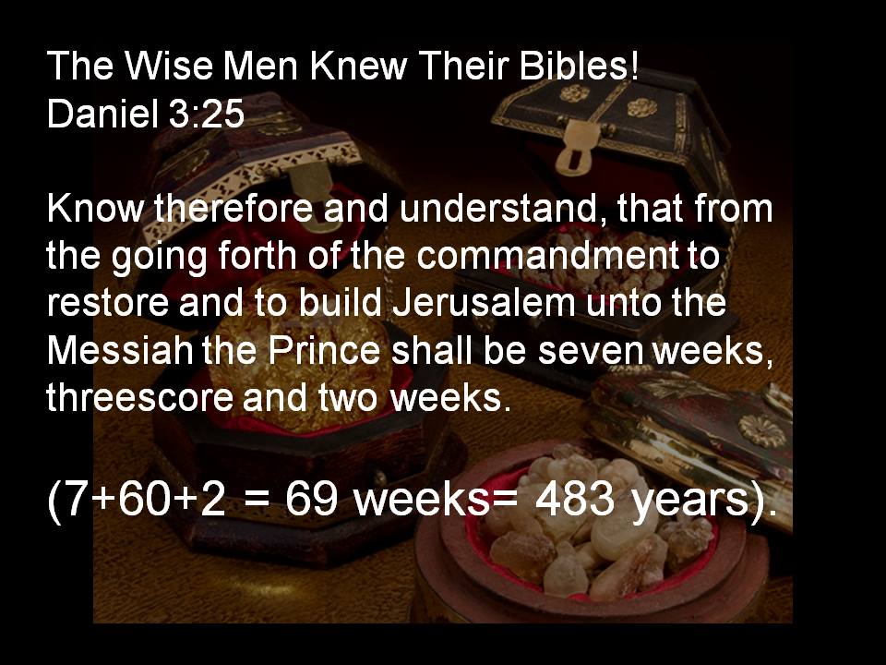

Slide 7
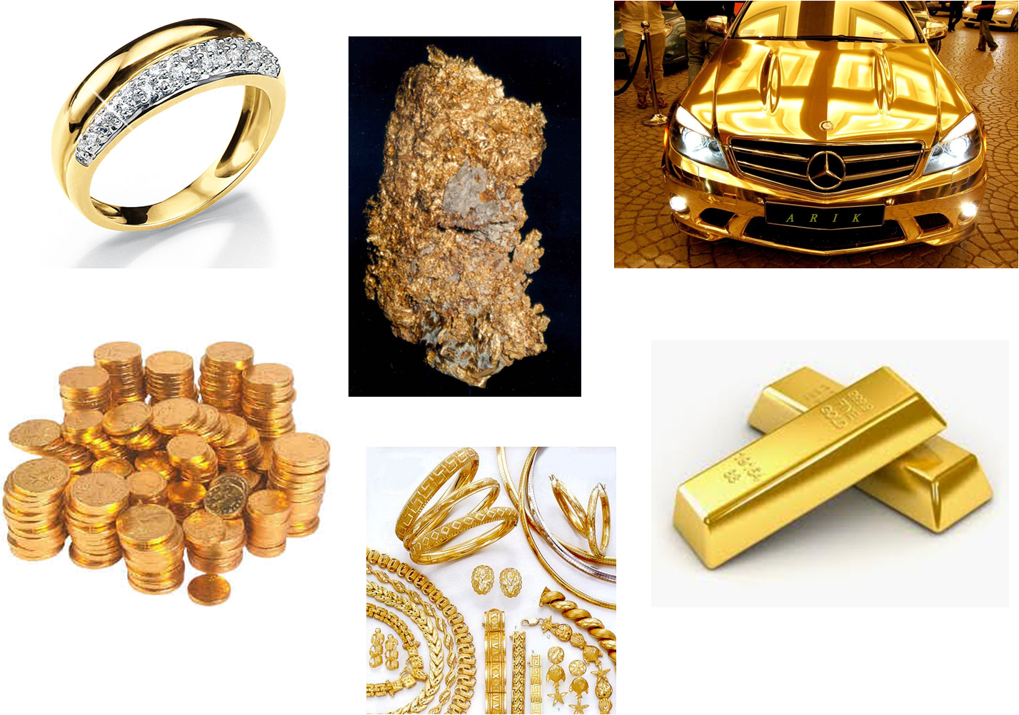
Valuable Gifts – Our Lives

Slide 8
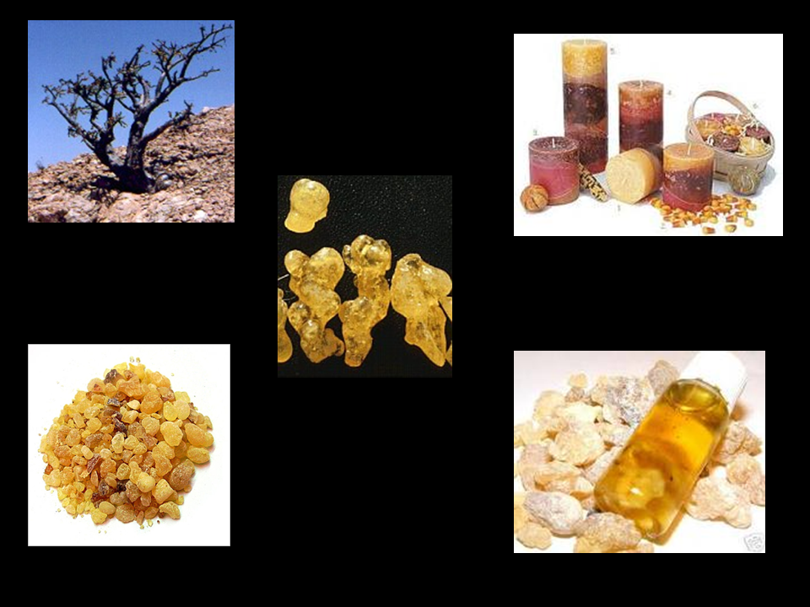
Special Gifts – Our Worship

Slide 9
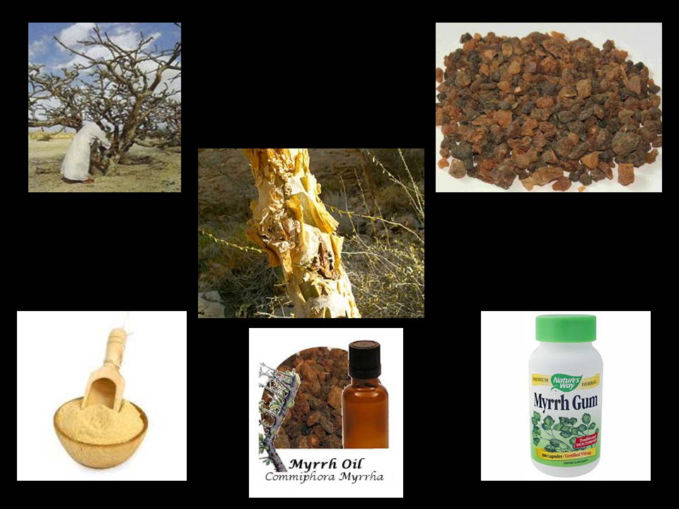
Practical Gifts – Our Service

Slide 10
Three Gifts You Can Give To God
Our Lives Our Worship
Our Service

