Slide 1
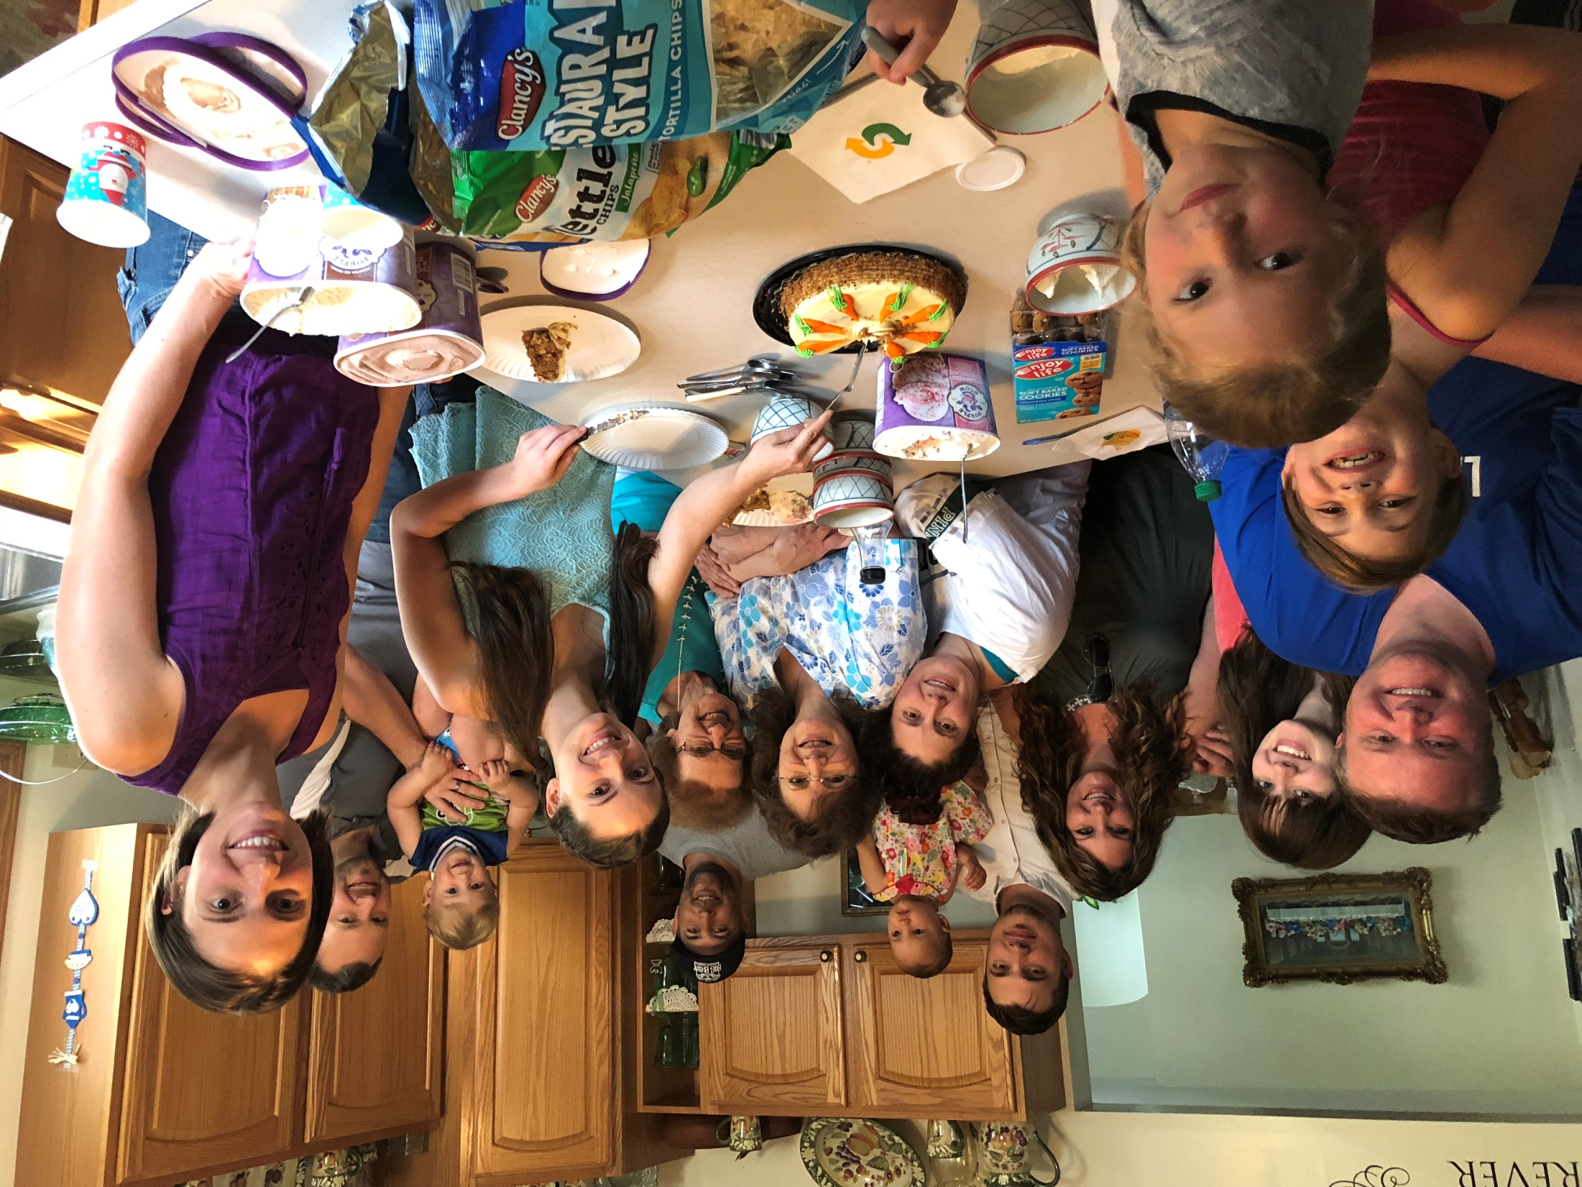

Slide 2
Remember to entertain strangers. For, some have unknowingly entertained angels.
Hebrews 13:1

Slide 3
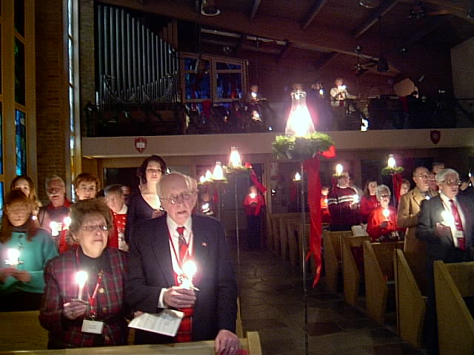

Slide 4
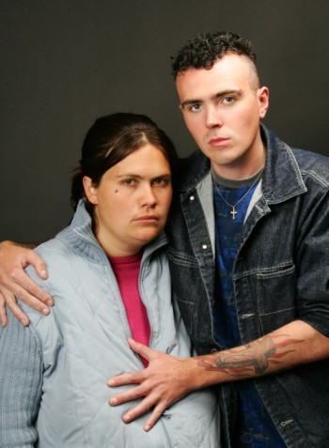

Slide 5
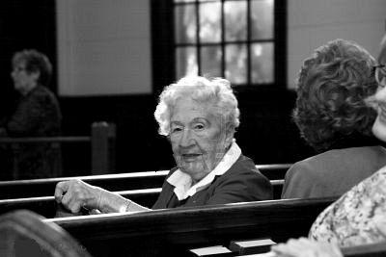

Slide 9
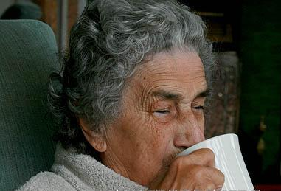

Slide 10
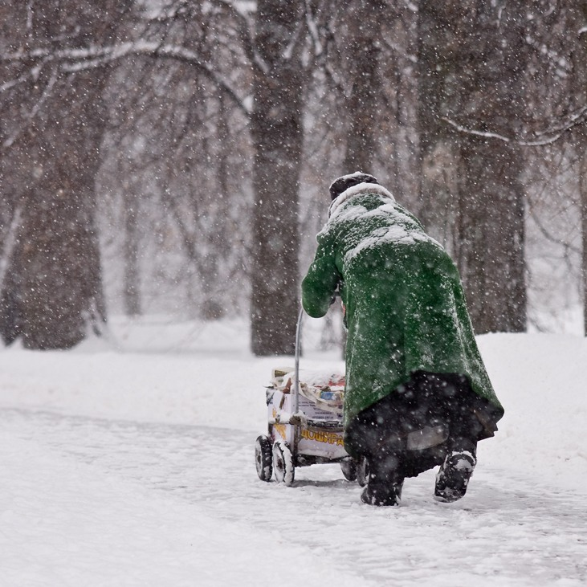

Slide 11
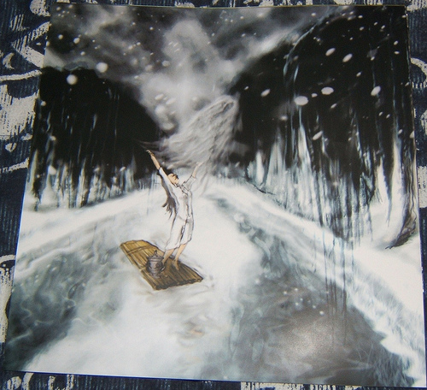

Slide 12
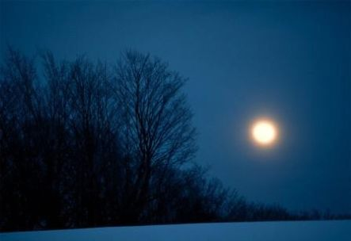

Slide 13
Be sure to
entertain strangers.
Some do not realize they are entertaining angels.
Hebrews 13:2

Slide 14
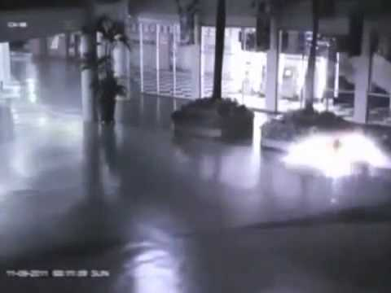

Slide 15
Be sure to
entertain strangers.
Some do not realize they are entertaining angels.
Hebrews 13:2

