Slide 1
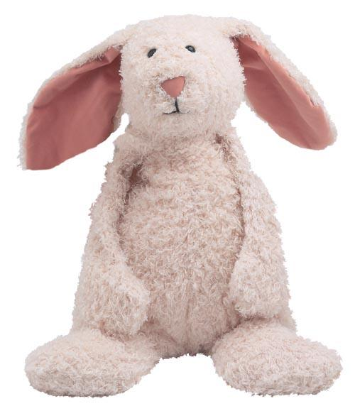
How To Have
A
REAL Christmas

Slide 2


Slide 3
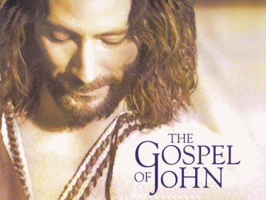
The
Real Jesus

Slide 4
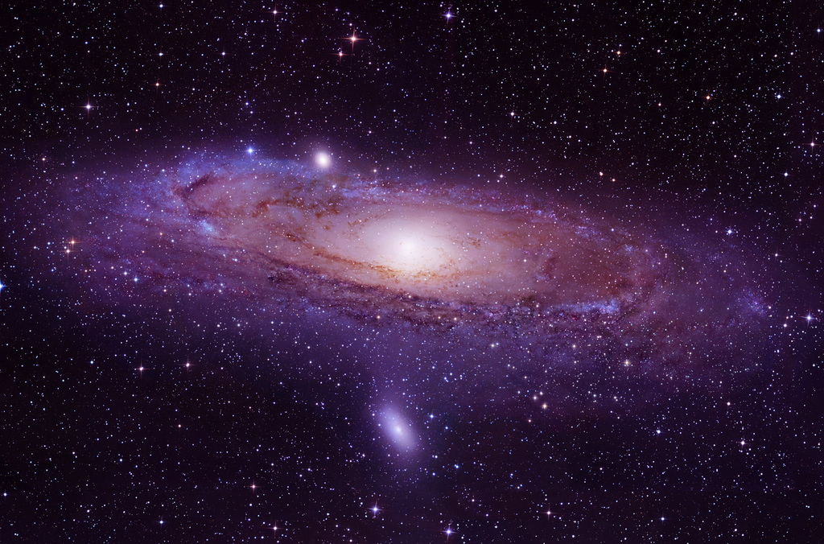
“LOGOS”
In the beginning was the Word…
John 1:1

Slide 5
…And the Word was WITH God
“LOGOS”
…And the Word WAS God

Slide 6
“LOGOS”
The Word was in the beginning
with God…

Slide 7
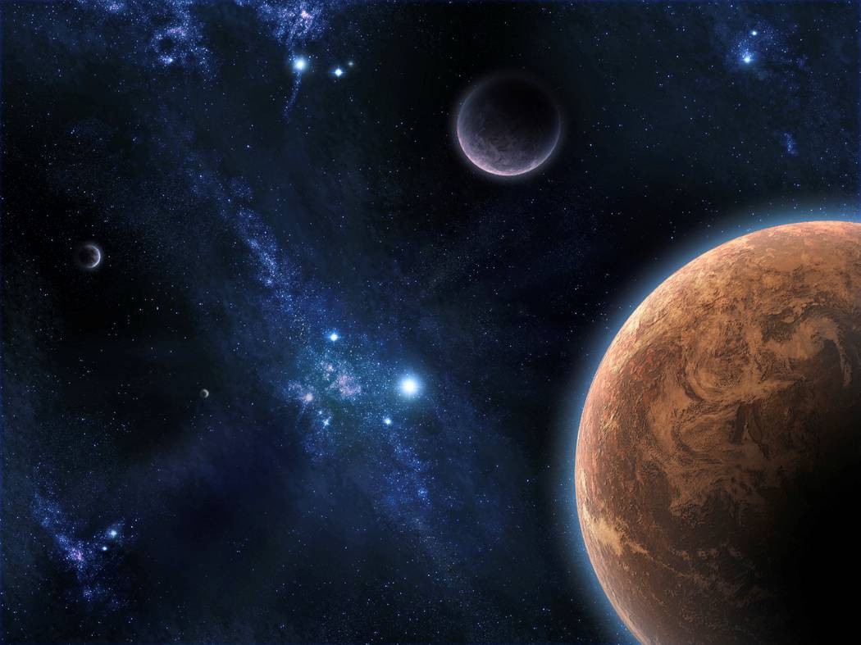
All things were made by Him…
“LOGOS”
…And nothing was made without Him
(Gen 1:1 Heb 1:1 Acts 8:21)

Slide 8

In Him was Life….
And the Life was the Light of men

Slide 9
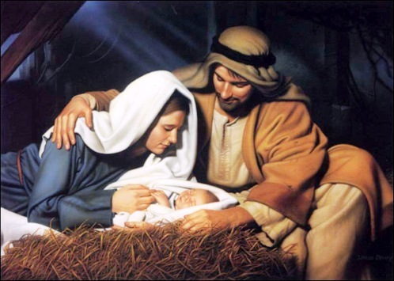
And the Word became flesh…
…and lived with us

Slide 10
The
Real Jesus

Slide 11
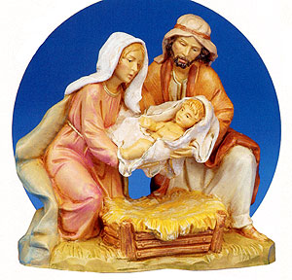
1 John 1:1
¹ The Word which was
from the beginning,
which we have heard,
which we have seen,
which we have gazed upon,
which we have handled,

Slide 12
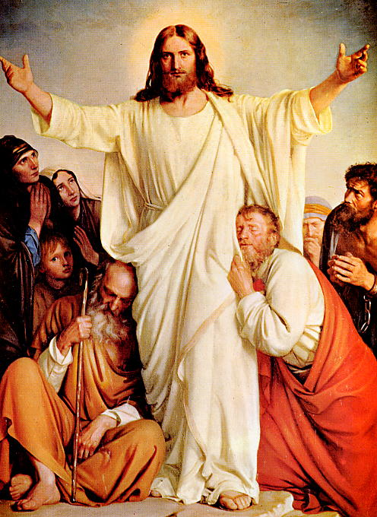
² That Life…
was shown to us,
and we have seen it,
and experienced it,
and show it to you.
Eternal Life was with us
and the Father made it REAL to us !

Slide 13
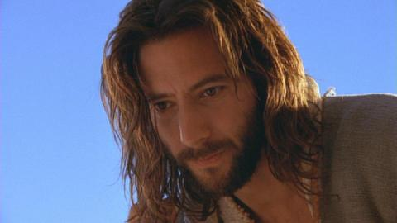
³ What we have
seen and heard
we show to you,
that you may have relationship with us.
For truly our relationship is with the Father and with His Son Jesus Christ.

Slide 14
Christmas
has
always
been
about
The Real
Jesus !

Slide 15
How to Have a Real Christmas
Hear
Take time to listen
Look
Take time to see
Handle
Take time to love
Gaze
Take time for relationship

Slide 16
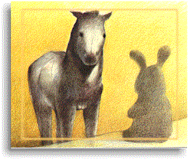
The Velvetine Rabbit
by Margery Williams
Rabbit: "What is REAL?”
Skin Horse:
"Real isn't how you are made,
it's a thing that happens to you.
When a child loves you for a long,
long time, not just to play with,
but REALLY loves you,
then you become Real.”

Slide 17
The Velvetine Rabbit
by Margery Williams
Rabbit: "Does it hurt?"
Skin Horse:
“Sometimes, but when you are
Real you don't mind being hurt.“

Slide 18
The Velvetine Rabbit
by Margery Williams
Rabbit: "Does it happen
all at once, or bit by bit?"
Skin Horse:
“It doesn't happen all at once,
You become! It takes a long time. That's why it doesn't happen to people
who break easy, have sharp edges,
or who have to be carefully kept.

Slide 19
Skin Horse:
“Generally, by the time you are
Real, most of your hair has
been loved off, and your eyes
drop out and you get loose in
the joints and become very shabby.
But these things don't matter at all, because
once you are Real you can't be ugly,
except to people who don't understand.“
Rabbit: "Then, you must be real!”
(The Skin Horse just smiled.)

Slide 20
How to Have REAL JOY
at Christmas
Jesus
Others
You

Slide 21
Anyway
by Mother Teresa
People are unreasonable,
illogical and self-centered.
Love people anyway.
If you do good, people will
accuse you of selfish motives.
Do good anyway.

Slide 22
If you are successful,
you’ll win false friends
and true enemies.
Succeed anyway.
The good you do today
will be forgotten tomorrow.
Do good anyway.
Honesty and frankness
make you vulnerable.
Be honest and frank anyway.

Slide 23
What you spend years building
may be destroyed overnight.
Build anyway.
People really need help
but may attack you if you help them.
Help people anyway.
Give the world your best
and you may get kicked in the teeth.
Give the world your best anyway!

Slide 24


Slide 25
Merry Christmas !

