Slide 1
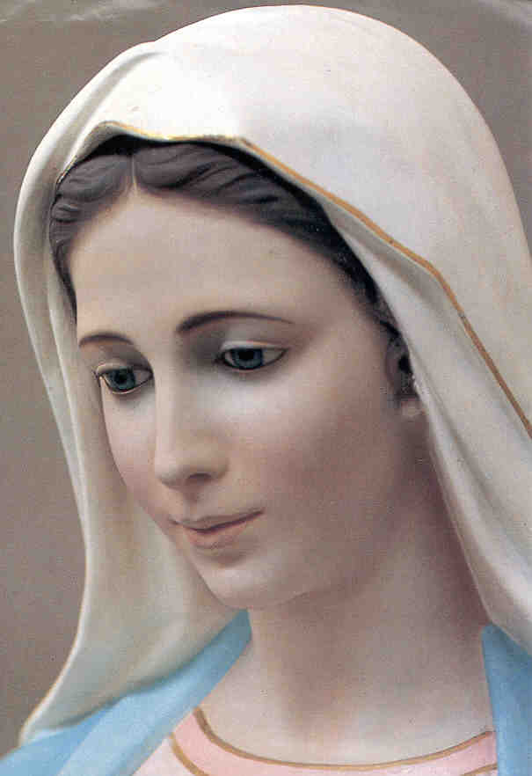
How To Have A Mary Christmas

Slide 2

Christmas IQ Test
True of False ?
1. Caesar Augustus made a decree
that all the world should be taxed.
2. Joseph went to Bethlehem “to be taxed with
Mary, his espoused wife, upon a donkey,
being great with child.”
Jesus was born in a manger
among cows and sheep.

Slide 3
4. Shepherds heard the angels sing,
“Glory to God in the highest and on
earth, peace, goodwill toward men”
Three wise men brought gifts:
gold, frankincense, and myrrh.
6. The Bible says that the wise men were
“Kings from the east who came to
Jerusalem saying, “Where is he
that is born King of the Jews?”
7. The wise men followed the star to
Jerusalem and then to Bethlehem.

Slide 4
8. The wise men found baby Jesus, “wrapped
in swaddling clothes, laying in a manger.”
9. The wise did not return to Herod because
Joseph told them that God had warned him
in a dream to flee to Egypt.
10. The birth of Jesus is talked about in the
Gospel of Matthew, the Gospel of Luke,
and the Book of Galatians.

Slide 5
How To Have A Mary Christmas
Luke 1:46

Slide 6
Luke 1:46
“My soul
magnifies
the Lord,
And my spirit rejoices
in God
my Savior.”

Slide 7
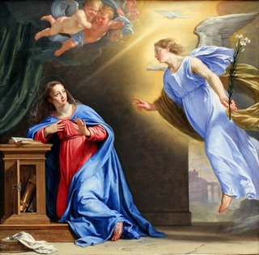
Luke 1:26
²⁶Now in the sixth month, the angel Gabriel was sent by God to a city of Galilee named Nazareth,
²⁷to a virgin engaged to
a man whose name was Joseph, of the house of David. The virgin’s name was Mary.
²⁸And the angel said to her,
“Rejoice, highly favored one, the Lord is with you.
Blessed are you among women!”

Slide 8
²⁹But Mary was troubled
at his words, and wondered what kind of greeting this was.
³⁰So the angel said to her, “Do not be afraid, Mary,
for you have found favor
with God.
³¹You will conceive
and bring forth a Son,
and shall call His name Jesus.

Slide 9
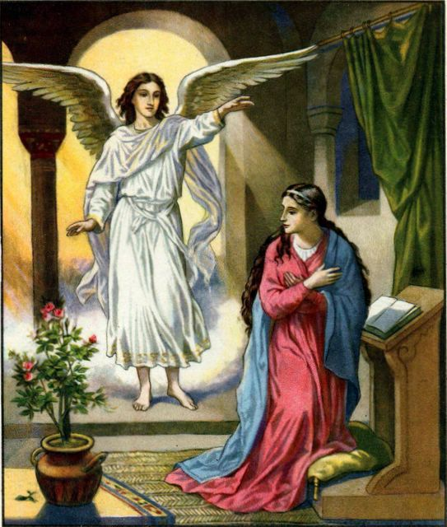
³²He will be great, and will
be called the Son of the Highest. And the Lord God will give Him the throne of His father David.
³³And He will reign over the house of Jacob forever, and of His kingdom there will be no end.”
³⁴Then Mary said to the angel, “How can this be,
since I do not know a man?”

Slide 10
³⁵And the angel said to her, “The Holy Spirit will come upon you, and the power of the Highest will overshadow you. And the
Holy One who is to be
born will be called the
Son of God.
³⁸Then Mary said,
“Behold the maidservant of the Lord!
Let it happen to me as you have said!”

Slide 11
Luke 1:46
And Mary said,
“My soul
magnifies
the Lord,
And my spirit rejoices
in God
my Savior.

Slide 12


My soul MAGNIFIES the Lord !
MAGNIFY:
To make BIGGER !

Slide 13
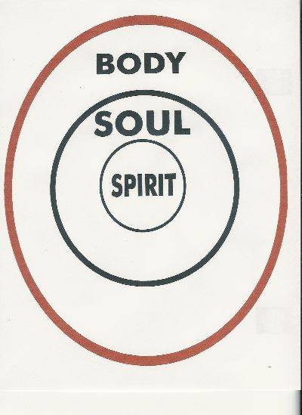
My SOUL magnifies the Lord !
My SPIRIT rejoices !
Mind
Emotions
Will
Attitude

Slide 14
SPIRIT:
What others feel
when they are in your presence
“Invisible Imprint”
Dr Richard Dobbins
  An Angry spirit
  An Overly Sensitive spirit
  A Nervous spirit
  A Critical spirit
  An Overbearing spirit
  A Pessimistic spirit
Spirits
Godly
Human
Demonic
“Spoiled Brats”

Slide 15
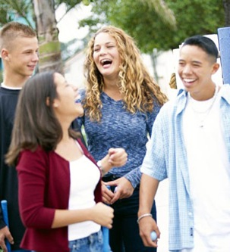
GOD is BIGGER
than my:
Mind - “Fear not…”
Will - “Let it happen…”
Emotions -
“My soul magnifies
the Lord!”
Attitude -
“My spirit rejoices!”

Slide 16
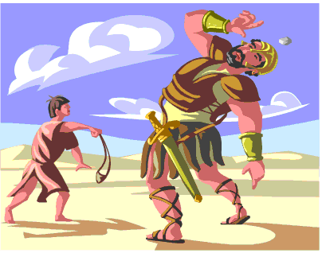

Slide 17
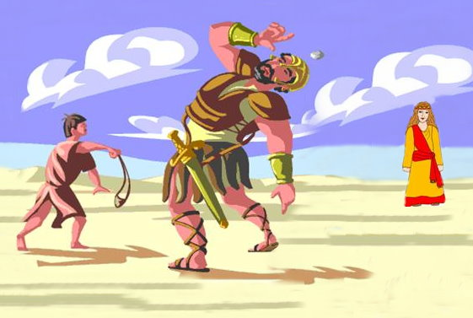

Slide 18
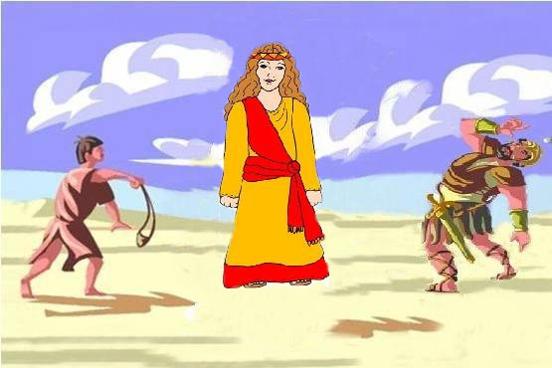

Slide 19
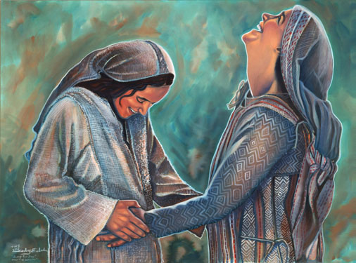
Have a
Mary Christmas
Mind
Emotions
Will
Attitude

Slide 20
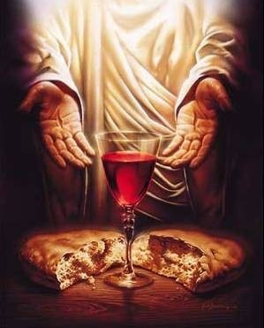
Mind
Emotions
Will
Attitude
“This is my Body
which is broken for you!”

