Slide 1
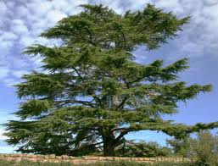
Psalm 92:12-14
The righteous shall grow like a Cedar in Lebanon.
Those who are planted in the house of the Lord shall flourish in the courts of our God.
They shall bear fruit in their old age .
They shall be fresh and flourishing.

Slide 2
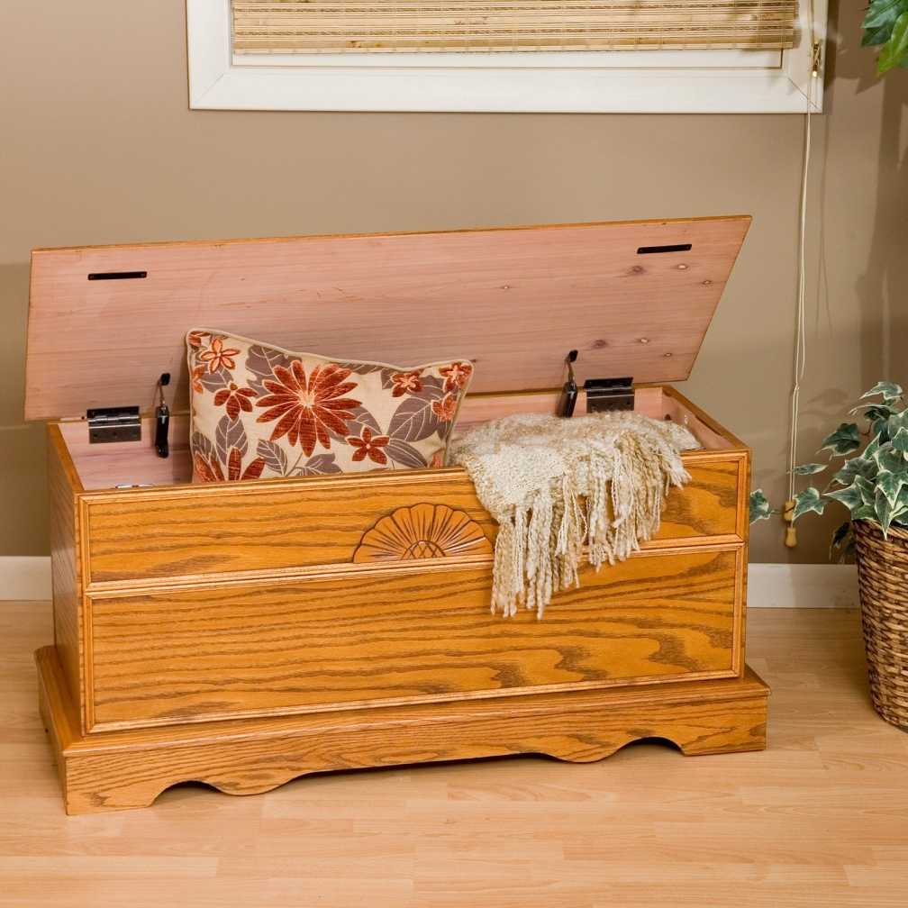
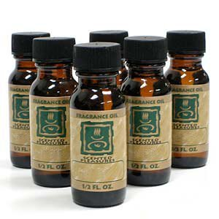
sCent
E
D
A
R

Slide 3
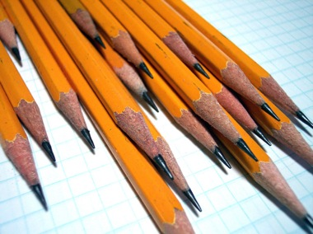
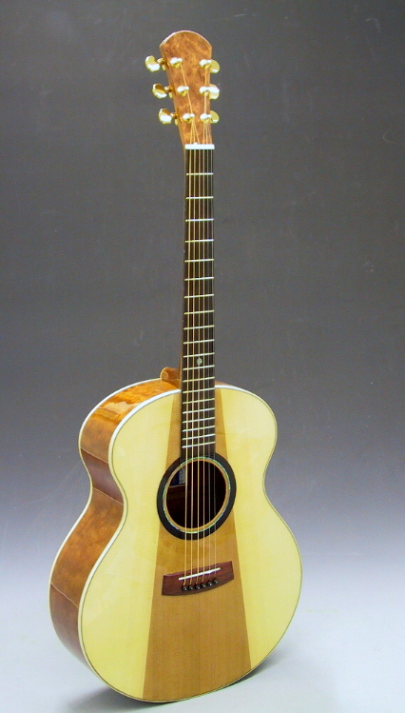
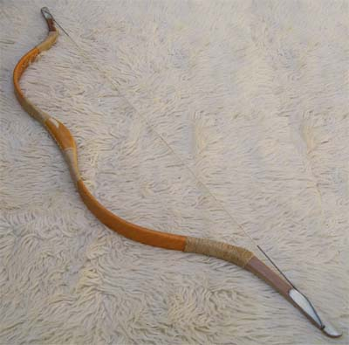
sCent
Elastic
D
A
R

Slide 4
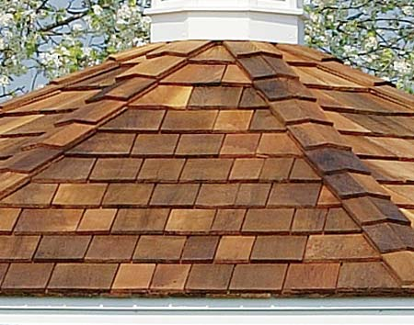
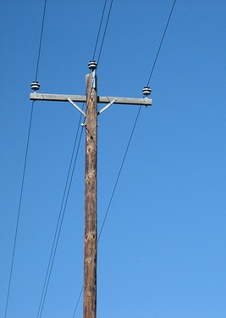
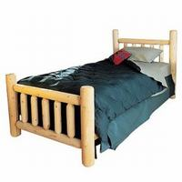
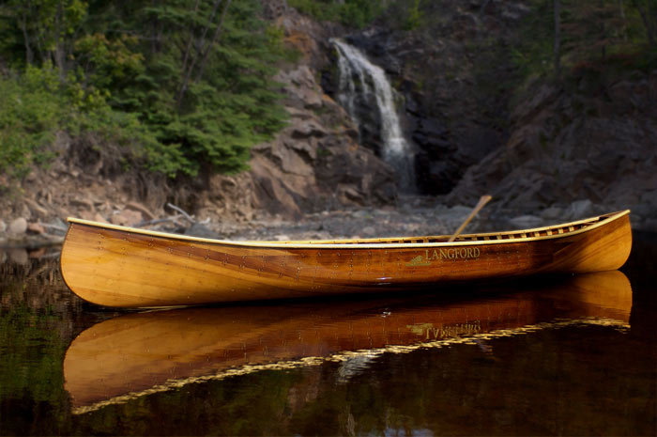
sCent
Elastic
Durable
A
R

Slide 5
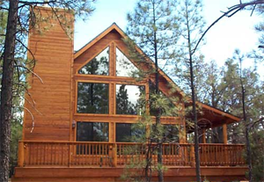
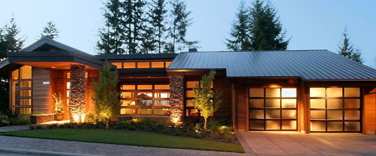
sCent
Elastic
Durable
Attractive
R

Slide 6

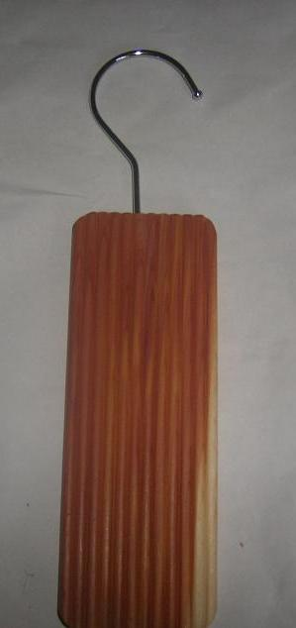
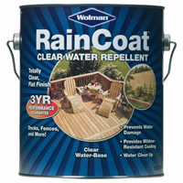
sCent
Elastic
Durable
Attractive
Repelling

Slide 7
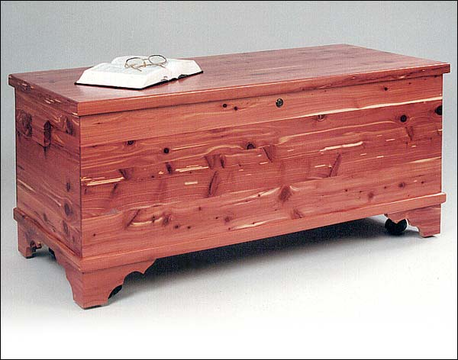
How do you restore the beauty, fragrance, and value of Cedar?

Slide 8
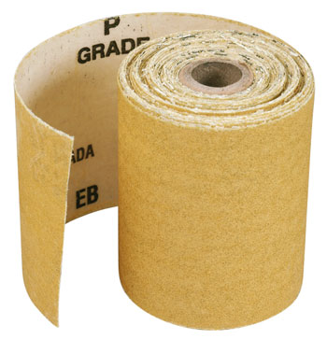
How do you restore the beauty, fragrance, and value of Cedar?

