Slide 1
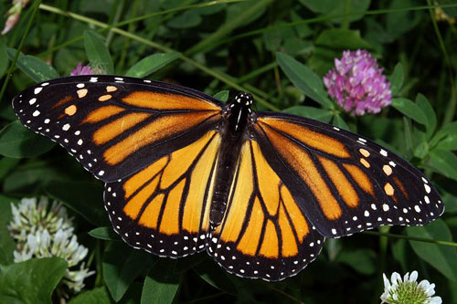
If anyone be in Christ, they are a new creation. Old things are passed away - all things have become new!
II Corinthians 5:17
He makes all things new!

